Slide 1
Nature Research Portfolio Authors and institutional services from Springer Nature
Joffrey Planchard
Institutional Partnerships Manager, Nature Research

Slide 2
Introduction to the Springer Nature brands
1.0
Notes:
Springer Nature was formed in 2015 through the merger of Nature Publishing Group, Palgrave Macmillan, Macmillan Education and Springer Science+Business Media.
The purpose of my presentation today is to introduce some the brands within Springer Nature and in particular the Nature Research brand and its products and services

Slide 3
Uniting some of the best known brands in our field
Notes:
Springer Nature is the world’s largest academic book publisher, publisher of the world’s most influential journals and a pioneer in the field of open research.
It is home to an array of respected and trusted brands providing quality content through a range of innovative products and services.
You will surely recognise some of the famous brands appearing on this slide

Slide 4
Our key principles
SPRINGER NATURE STRATEGIC PRINCIPLES
Be customer centric
Be data-driven in all we do
Be best-in-class at research services
Notes:
There are 3 key principles which decide our strategy.
First, we are Obsessively Customer Centric which means that we put our partners, institutions, researchers and libraries, at the very heart of what we do.
Then, we are data-driven in all we do which means that we perform serious analysis before making decisions and building the strategies for our brands.
Finally, we always aim to be the best in all the services that we create and offer to our partners.

Slide 5
Introducing a new brand
The Nature Research portfolio comprises our best-in-kind scientific publications, products and services that support the broad needs of the researchers.
Nature Research Journals
Nature
Nature-branded research journals
Nature-branded reviews journals
Scientific Reports
Nature Communications
Nature Research Services
Nature Jobs
Nature Masterclasses
Nature Optional Author Services
Nature Research Products
Nature Index
Nature Insights
Nature Outlook
Nature Outlines
Nature News
Nature Research Events
Nature Conferences
Notes:
Before the creation of Springer Nature, the publishing company behind the journal Nature was called the Nature Publishing Group. But now Springer Nature is the publisher brand for all the content we publish.
So we have created a new brand, Nature Research, which includes our best-in-kind publications, products and services designed to support the broad needs of the researchers.
The Nature Research portfolio is divided in 4 sections which I will be describing in a second, with a particular focus on the sections dealing with services and products.

Slide 6
Our values
We work to ensure Nature Research is valued as a:
• centre of editorial expertise
• partner to the research community
• committed pioneer
• home to a breadth of research
• brand of integrity & trust
• model of excellence
This also applies and extends across all components within Springer Nature
Notes:
The brand has been created with six strong values in mind and at Nature Research, we work to ensure that the brand is recognized and valued as a:
Centre of editorial expertise
partner to the research community
committed pioneer
home to a breadth of research
brand of integrity & trust
model of excellence
This strong commitment also extends across all components within Springer Nature.

Slide 7
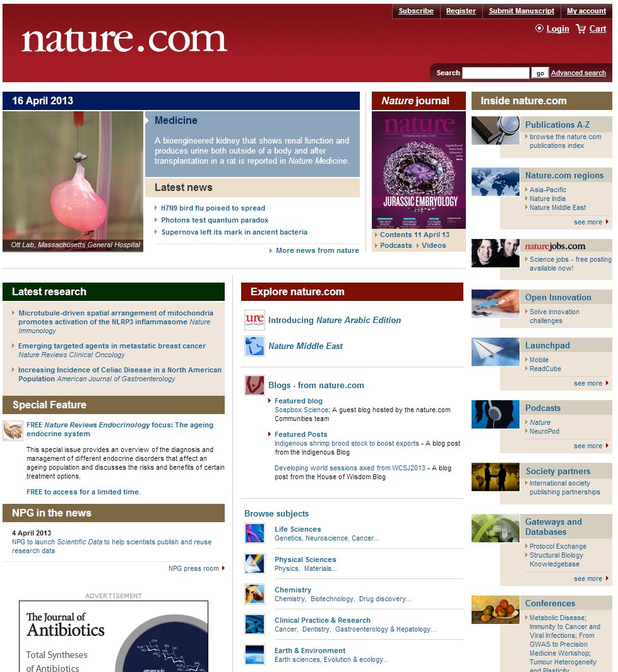
All resources are available on nature.com
Over 11.8 million unique users per month*
988,127 active registrants**
Links to all parts of nature.com: news, jobs, regional portals, podcasts and blogs, librarian gateway, conferences, subject specific pages and A-Z journal listing
*Webtrends 2015
**Publisher’s data 2015
www.nature.com
Notes:
Please note that all our Nature Research resources are available on nature.com
This morning, Irina gave a presentation of our portfolio of Nature journals so I won’t get back on it and I will be now talking in detail of our portfolio of services and products available for authors and researchers, including our training and editing services and our free content.
On nature.com, you can find all the information concerning all these products and many more including our Nature Conferences and all Multimedia.
Almost 12 million users per month go on nature.com and almost 1 million receive our news alerts to stay informed on what happens in the world of science.
Nature.com also offers an incredible opportunity to connect with peers thanks to the blogging platform and other multimedia activities like podcasts, videos and webcasts

Slide 8
Introduction to the Nature Research Journals portfolio
2.0
Notes:
I said I won’t talk about journals but there are only 2 things I want to remind you and to make clear…
The list of all journals is available on nature.com and to access it, you just need to click on the link to A-Z journal listing I just showed you.

Slide 9
All resources are available on nature.com
Over 11.8 million unique users per month*
988,127 active registrants**
Links to all parts of nature.com: news, jobs, regional portals, podcasts and blogs, librarian gateway, conferences, subject specific pages and A-Z journal listing
*Webtrends 2015
**Publisher’s data 2015
www.nature.com
Notes:
This one… just there… with the red arrow

Slide 10
Notes:
When you click on this link, this is what you get. It is pretty simple and it does what it says on the tin.
The A-Z index is a list with all journals and databases available.
So nature.com for all news and services and A-Z Index for all journals. Is that clear for everyone??
Excellent

Slide 11
Introduction to the Nature Research Services portfolio
3.0
Notes:
Let us now focus on the portfolio of services from Nature Research.
This is of particular interest for all you here today because these services are designed especially for authors and researchers in order to help create a network of collaborations and improve the scientific output.
The ultimate goal of this being to publish in important journals and get the recognition that you deserve as a researcher.
Let us start with the beginning…

Slide 12
Recruitment Services from Springer Nature
3.1
Notes:
…The recruitment services
Obviously we know that it is important for researchers to get published but before starting to write an article, you have to find a job at an institution that can give you the opportunity to do your research.
Or as a principal investigator, you need to recruit to build a team that will be able to realize the project. This is why we have created Nature Jobs

Slide 13
NatureJobs – Recruitment services from Springer Nature
Recruitment advertising platform
306,000 unique users visit Naturejobs each month
1.8 million page views
The website contains:
Career advice
Science recruitment news
Thousands of jobs
Global jobs board and recruitment platform for scientists
Great recruitment advertising opportunities for institutions
naturejobs.com
Notes:
Naturejobs.com offers a great platform for institutions to advertise their job openings and for scientists to find available jobs.
The platform has 306k unique viewers per month totaling almost 2 million page views so it enables institutions to reach an incredible number of research professionals.
The website also contains career advice, science recruitment news as well as thousands of jobs so it is wealth of resources for scientists and researchers.
At the moment, we are also running 4 Career Expo per year in different regions in the world and maybe in the future, we will be able to organize a similar event in the region.

Slide 14
Editing Services from Springer Nature
3.2
Notes:
Okay so when you have found your job or that your team is ready to start working on a promising project, you know it will be crucial to be able to present this project in a clear way:
First, so you can get some funding to pursue your project
Second, so the research paper that you will publish get accepted and get the best exposure
This is why we have designed our editing services and hese have a huge interest for you, as authors, as they improve pretty much instantly your chances to get a research grant accepted and to get published in a high-impact journal.

Slide 15
Nature Research Editing Services
Improve the quality of your publication output
Increase your chances to be published and capacity to attract funding
Nature Research Editing Services offer authors:
A network of native English-speaking editors with a range of scientific, technical and medical backgrounds
A thorough quality assessment of every edited paper by an experienced senior editor
Feedback to develop your writing skills
Nature Research offers two levels of editing services:
Nature Research Language Editing
Nature Research Scientific Editing
Notes:
As Jeff explained earlier, it is crucial that a research paper is written in good English and communicates a strong scientific message. This also applies to grant applications.
Basically, the way it works is simple. Thanks to the Nature Research Editing Services, researchers can send their research papers and grant applications for revision prior to submission.
This will improve significantly the quality of your publication output and by doing so, it will increase your chances to be published and to attract funding.
Nature Research Editing Services offer authors to have access to a network of native English speaking editors with a range of scientific, technical and scientific backgrounds.
After being reviewed and edited, a paper will always receive a thorough quality assessment by an experienced senior editor.
And you will also receive some feedback so you can develop your writing skills.
Nature Research offers two different levels of Editing services; a language editing service and a scientific editing service.

Slide 16
Nature Research Language Editing
Language Editing
Editing by native English-speaking editors, with subject expertise, and a final quality assessment by senior editor
Rapid turnaround – from 48 hours
All text types and a broad range of subject areas, from economics to engineering as well as medicine
Improve the quality of your publication output
Increase your chances to be published and capacity to attract funding
Notes:
Let us start with the language editing service.
Many authors struggle to articulate their research clearly to editors and peer reviewers in English. This lowers the chances of acceptance considerably therefore the language editing service provided by Nature Research will be of considerable help to authors for whom English is a second language.
This is done by native English-speaking editors with subject expertise and goes through final quality assesment by senior editor.
This service has a rapid turnaround (from 48 hours) and it can be applied for all subject areas (Humanities, Social sciences, Technical and Medical sciences)

Slide 17
Nature Research Scientific Editing
Scientific Editing
3 stages of editing: language edit; thorough edit by a Nature-standard editor; quality assurance edit by a second Nature-standard editor
Longer turnaround – from 7 days
Research papers & grant applications within the natural sciences
Improve the quality of your publication output
Increase your chances to be published and capacity to attract funding
Notes:
For authors whod want or need a more in-depth analysis of the scientific relevance and construction of their articles, we offer a premium scientific editing service.
Jeff already explained how crucial it is that a research paper communicates a strong scientific message in a clear way. This is why we aim to provide scientists with the best possible pre-submission editing and advice.
To achieve this, the Nature Research Scientific Editing offers at least 3 stages of editing; language edit, thorough scientific edit by a first Nature-standard editor and quality assurance edit by a second Nature-standard editors.
As a result, the scientific editing has a longer turnaround (from 7 days) and we only offer this service for articles and grant proposals within the natural sciences (meaning the areas covered by the Nature journals).

Slide 18
Training Services from Nature Research and Springer Nature
3.2
Notes:
That’s it for our Editing services. Let us now look at start with the TRAINING SERVICES FROM SPRINGER NATURE.
Before we start, just out of curiosity, I just want to do a quick survey here.
Everyone who thinks they would benefit from Editing services, please raise your hand.
I am not surprised. We have come to realise that the editing services were a response to a real need for the authors and that’s why they are successful but at the same time, it is crucial to work on long term solutions educating and training authors so they are more successful in publishing.
Therefore, whenever we have an editing project, we give feedback so there is an educational value but also we developed a full training program of which you have had an introduction earlier today.
We actually have 2 training programmes corresponding to the particular needs of researchers at different stages of their careers.

Slide 19
Nature Masterclasses
Training in scientific writing and publishing delivered by editors from the Nature journals
Nature Masterclasses offer scientists:
A unique opportunity to interact with experienced Nature journals editors
Advice on how to produce high-quality research papers
Better understanding of the editorial process
Keys to get published in top-ranked journals
Nature Research offers two training models:
Face-to-face training
Online training
Notes:
As Jeff explained earlier, to be successful in research, it is essential for scientists to understand the publication process and how to effectively communicate their research.
Our Nature Masterclasses are designed to give researchers the necessary skills to get their research published in the top international peer-reviewed journals.
Our training program specialized in scientific writing and publishing is delivered by editors from the Nature journals and it offer scientists a unique opportunity to interact with experienced Nature journals editors.
It also allows them to get advices on how to produce high-quality research papers and to get a better understanding of the editorial process.
Our program is designed with one thing in mind: giving researchers the keys so they can get published in top-ranked journals.
It is offered in two different models: Face-to-face and Online training

Slide 20
Nature Masterclasses
Face-to-Face Training
1-day to 3-day training workshops
Held on site at your institution
Tailored to researchers’ field and level of experience
Interactive exercises and discussions
Researchers receive feedback on their own abstracts
Training in scientific writing and publishing delivered by editors from the Nature journals
Notes:
The difference between the Nature Masterclasses and other author seminars is that it focuses in particular on how to get published in high-impact journals so it is designed for experienced researchers.
In order to get the best experience, the masterclass is organized by editors at Nature journals because they know better than anyone what it takes to get published in our journals.
They can explain and give clear examples of what they look for in an article.
Our face-to-face training programs can be from 1 to 3 days and are held on site, at your institution.
They are tailored to the researchers’ field and level of experience. This is why we take groups of a maximum of 25 researchers who can come with their abstract. They can even submit their abstract to us prior to the session.
Depending on the field of expertise, we find the best editor matching the group. For example, editor from Nature Physics if we are working with a group of researchers specialized in physical sciences.
They include interactive exercises and discussions with our editors; and authors also receive feedback on their own abstracts which is an invaluable piece of advice which increases significantly the chances to get published in an high-impact journal.

Slide 21
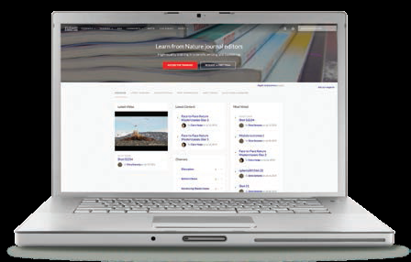
Nature Masterclasses Online
Online Training
On-demand training videos
Interaction with editors in live events
Selection of activities to test learning and online community for networking
Institution-wide access by IP recognition for all researchers
Training in scientific writing and publishing delivered by editors from the Nature journals
https://masterclasses.nature.com
Notes:
Our Online training is designed to give full flexibility for the students who take this course. It includes 24 hours of learning and covers similar areas to the ones taught in the face-to-face sessions like:
What makes a Nature paper?
How to write a Nature abstract?
How to select the journal to submit to?
How to best present your figures and data?
The difference is that this training is given through On-demand online videos recorded by our Nature editors and it also offers the opportunity to interact with editors during live events or through our blogging platform.
While the face-to-face training allow you to be in direct contact with Nature editors during a reduced amount of time (1, 2 or 3 days), the online training allows you to benefit from this “à la carte” program and allow you to participate in engaging activities to test your knowledge and you also get access to an online community where you are able to network with peers.
The second programme is the Springer Nature Publishing Academy and I’m sure this one will be somehow familiar…

Slide 22
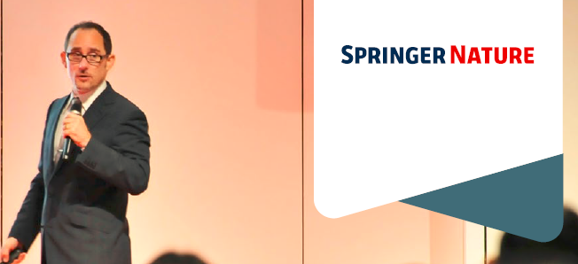
Springer Nature Publishing Academy
Face-to-Face Training for:
3 types of audiences
Authors – improve publication success
Peer reviewers – improve the quality of peer review
Journal editors – improve the quality and visibility of journals
Publishing Academy
Training program designed to help institutions improve their publication output and quality
Notes:
Here is my distinguished colleague Jeffrey Robbens.
The session that you just had is actually an introduction to the Author training workshop which is part of our Springer Nature Publishing Academy.
This training program has 3 different sections targeted to 3 different types of audience.
Our training for authors – the one you had an introduction to – is designed to increase the number of quality papers published
The aim of our training for peer reviewers is to improve the quality of the peer review and to encourage authors to take part in the peer reviewing process
Finally, the training for journal editors is designed to improve the quality and visibility of journals so the idea of this program is to cover all areas of the publishing activity and help to raise the profile of an institution or of a country

Slide 23
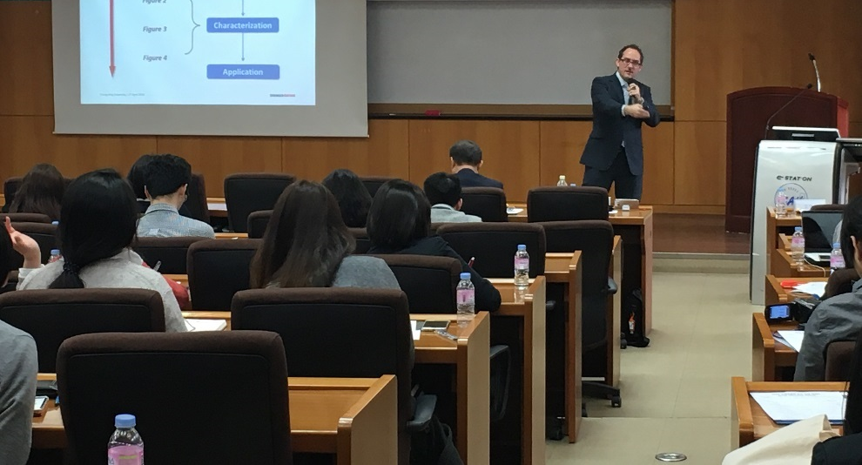
Author training workshops
1- or 2-day workshop for early career researchers
Can accommodate 50–250 attendees
Notes:
The session you had this morning was a 1-hour session but the full training for authors can be 1 or 2 days.
It is designed for a group of 50 to 250 attendees; in general for researchers at the beginning of their career…

Slide 24
Author training workshops - Topics
Covered topics customized to the institution’s needs
Reading strategies
Publication strategies
Publication ethics
Manuscript submission
Academic English
Peer review
Manuscript structure
Academic presentations
Notes:
And it will cover a broad range of topics customized depending on length of the workshop and the needs of the institution
Structure of the manuscript
Submission and Peer review process
Etc.

Slide 25
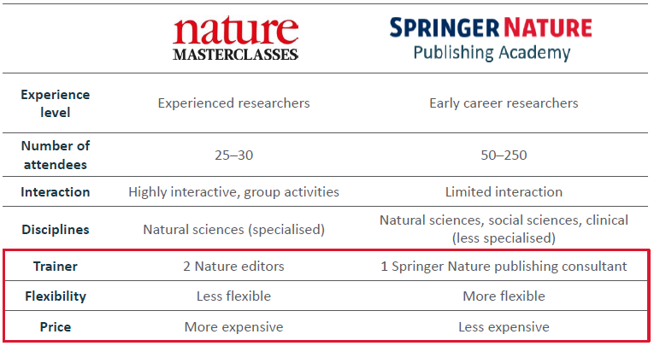
Differences between our two training workshop for authors
Notes:
So just to clarify things, there are significant differences between our Nature Masterclasses and the Author workshop of our Springer Nature Publishing Academy.
The main differences are: the experience level; the number of attendees; the level of interaction; the disciplines; the type of trainers; the flexibility of the program; and finally the price.
If you have questions, get back to us at the end of the session, Jeffrey and I will be happy to answer all of them. And I will now literally wizzz through the 2 other workshops part of the Publishing Academy

Slide 26
Peer review training workshop
1-day workshop for post-docs/junior faculty
Smaller (< 25 attendees)
Highly interactive with group activities
Notes:
The 1-day training workshop for peer reviewers is designed for a smaller group of 25 attendees which allow room for more interactions and for group activities…

Slide 27
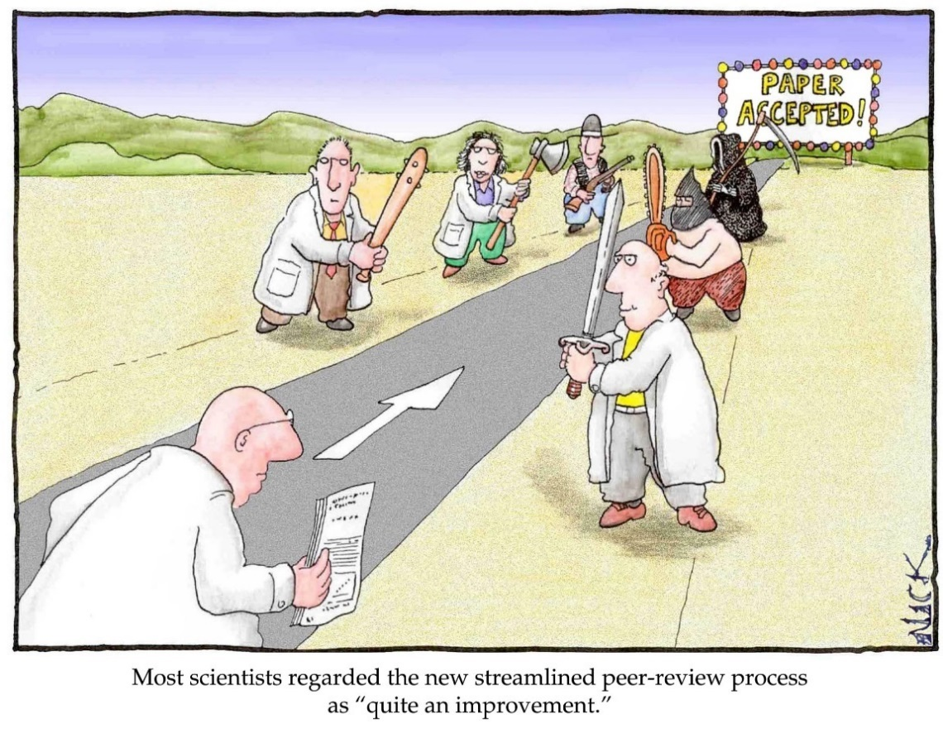
Peer review training workshop - Topics
Topics include
Peer review models
Ethics & responsibilities
Efficient manuscript evaluation
Writing effective reviewer reports
Cartoon by Nick D Kim, scienceandink.com. Used by permission.
Notes:
And the topics covered are:
Peer review models, Ethics & Responsabilities, How to evaluate a manuscript efficiently and how to write an effective review report

Slide 28
Journal editor training
1-day workshop for journal editors
Ethics & responsibilities
Editorial workflows
Author/reviewer experiences
Improving visibility
Identifying trends
Difficult editorial decisions
Activities can include:
Discuss ethical case studies and appropriate actions
Improve editorial workflow to increase efficiency
Prepare future plan based on previous KPIs
Notes:
Finally, our 1-day workshop for Journal editors is also organised for a small group for more interactivity and it covers crucial topics like:
Ethics & responsabilities, Editorial Workflow and Considerations to have in mind when making difficult editorial decisions

Slide 29
Introduction to the Nature Research Products portfolio
4.0
Notes:
So, earlier this morning, Irina talked us through the portfolio of journals from Nature Research and we’ve just looked at the portfolio of services.
I know it has been a long day and we are now almost done for this set of Springer Nature presentations.
And to finish this session, I am now going to present a selection of additional products from the Nature Research portfolio which will be particularly interesting as they are freely accessible on nature.com

Slide 30
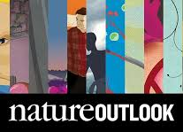
Nature Outlook
Sponsored content
Free for all users during 6 months
Topics of scientific, clinical and societal interest
Valued educational resource for scientific community
Raising public awareness of a disease or a scientific field
News features written by top science journalists
Commentary pieces from leading academic and industry thinkers
www.nature.com/news/outlooks-1.16103
Notes:
First of all, let’s talk about our Nature Outlook program.
This program is for publication of sponsored content which means that it is a piece of scientific information written independently by our Nature editors with the support of a sponsor.
The Nature Outlooks tackle topics of scientific, clinical and societal interest and represent a valued educational resource for the scientific community and they are published alongside pages in Nature.
They are designed to give a comprehensive picture of the current state and the hottest areas of research in a given field and they offer a unique opportunity for sponsors to position themselves as leaders or benefactors in the chosen field.
They are written by top science journalists and offer commentary pieces from leading academic and industry thinkers. As such, they are accessible to a broader audience than a research article for example.
Have a look at the link I am adding here. You will find the list of all Outlooks we have published.
Sorry, I forgot to mention, they are freely accessible only during 6 months so I suggest you keep an eye an those before access is shut.
For those of you who are interested in Physics, and in particular in Astronomy and Astrophysics, look out for the Nature Outlook supplement which will be published on Dark Matter.

Slide 31
Nature Outline
Sponsored content
Same aim and scope than Outlooks
Different format: 2-page infographics and multimedia animations
Simplify technical and scientific concepts for a broader audience
High quality and high impact content to populate social media channels
Scientific and technical concepts through infographics,
Illustrations and short animations
Notes:
Nature Outlines have exactly the same aims and scope as the Nature Outlooks but they just come in a different format which means that they can target a broader audience and have a different impact.
They are also sponsored and tend to show technical and scientific concepts in a simplified way and therefore have an even greater educational value.

Slide 32
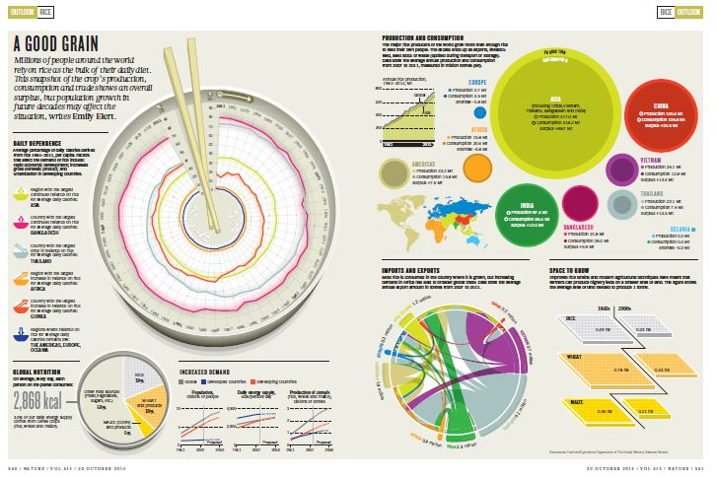
Nature Outline - Example
Nature Outline on Ovarian Cancer
Notes:
As you can see in the example, instead of a 20-page supplement with relatively long journalist articles, they are presented in a catchy 2-page infographics and always come with a multimedia animation which is very to share and has huge impact thanks to social networks.
If we have 3 minutes, we can have a look at the animation and if not, we will share the slides with you so you can have the links to video on nature.com. Or just type in Nature Outline Ovarian Cancer in Google

Slide 33
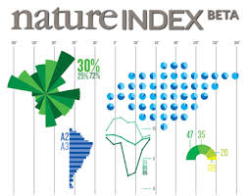
Nature Index
Indicator of high-quality research
Nature Index data freely available
Number of articles published in a group of 68 high-quality science journals
Measure scientific impact of an institution, a country or a region
Editorial supplements analysing the data are produced and distributed with Nature
Database of affiliation drawn from research articles published
Highlights the output and collaborations of an institution or a country
www.natureindex.com
Notes:
The last thing that I wanted to share with you for today is our Nature Index.
It is a database of affiliation drawn from research articles published in high quality science journals; and it highlights the output and collaborations of an institution or a country.
We regularly publish editorial supplements analysing the NI data and all of it is freely accessible on www.naturindex.com

Slide 34
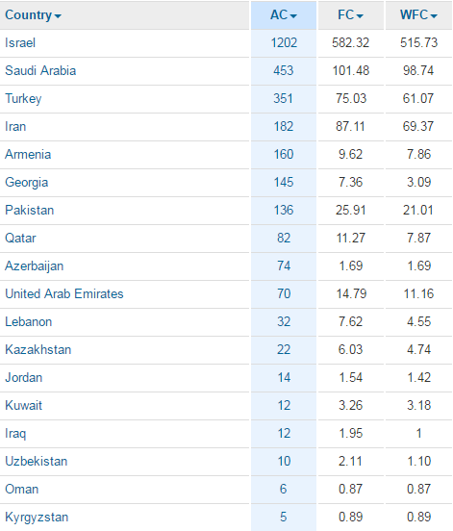
Nature Index – Western Asia
www.natureindex.com
Notes:
Based on the NI data, we are also able to create rankings and this is the ranking of countries for the region that we call Western Asia.
Even Kazakhstan seems to be behind in the AC, if we look at the FC, Kazakhstan would be ahead of Georgia, Azerbaijan.

Slide 35
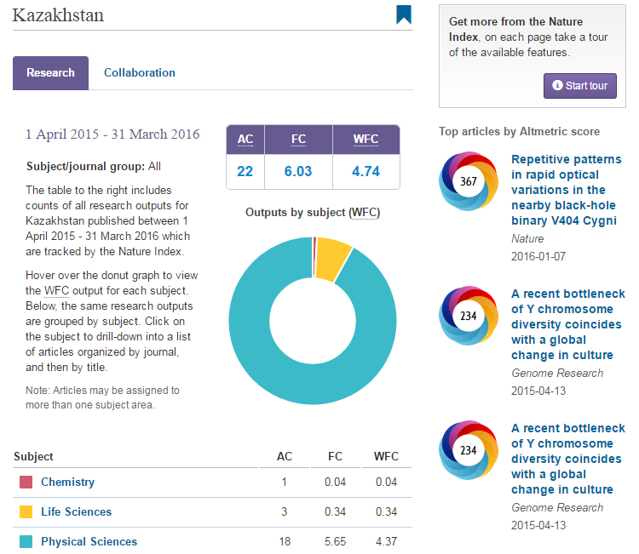
Nature Index - Kazakhstan
www.natureindex.com
Notes:
Finally the Nature Index allows to have a detailed view of the scientific output of the country with the number of articles published in each areas of research
And it also highlights the most impactful papers published in the past twelve months (Altmetrics donuts on the right)

Slide 36
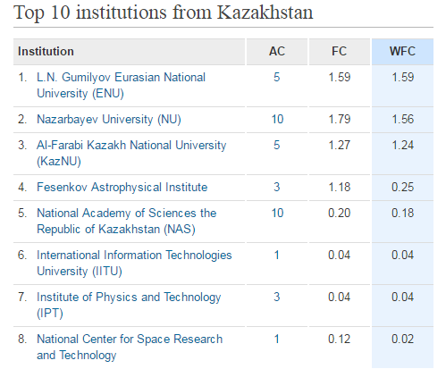
Nature Index – Kazakhstan top institutions
www.natureindex.com
Notes:
And you can also see the top institutions

Slide 37
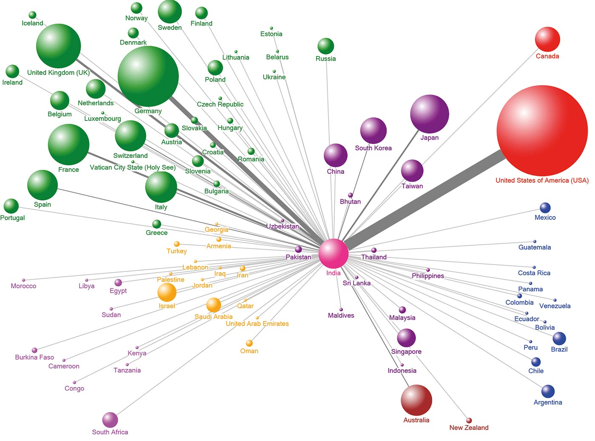
Nature Index – Example of collaborations for India
Notes:
There’s a feature I really like from the Nature Index. It is the report we are able to draw for collaborations as they really highlight in the most graphic way how many collaborations or an institution has had with other countries or institutions.
For example, this is what we have been able to produce when looking at the collaborations from India.

Slide 38
Conclusion
5.0
Notes:
That’s it for me today. Just before leaving you, I just want to do a very quick conclusion and then you will be free to go…

Slide 39
How can we help you…
Publishing
Communicating
Researching
Training
Recruiting
Editing
We put the researcher at the very heart of what we do
Notes:
As I said right at the beginning of this presentation, we put the researcher at the very heart of what we do. This applies to Nature Research and this applies to Springer Nature as a whole.
This means that the complete set of services and products that we have developed, were designed thinking of the needs of scientists at every stage of their career.
Whether it is the journals and contents we publish; the recruiting and the networking platforms we have created or the Training and Editing services, they are always designed to meet your needs.
At Springer Nature, we know very well what it represents to be a researcher and we have the biggest respect for what you do.
The message that I want to send today is that, first we are the best at providing content for academics and researchers but we also offer so many more solutions.
At every stage of your careers, we have solutions for your needs so engage with Irina who is your contact here in Kazakhstan.
Communicate about what you do, build a network of collaborators, go on nature.com and on SpringerLink, engage conversations with your peers. This will participate in building your reputation and that of your institution; and that will help you get the recognition that your deserve.
Thank you

Slide 40
Any questions?
Before leaving...
We have your contact details and we will soon send you a short survey
You just have to answer a few simple questions (less than 5 minutes)
Get access to free content, receive newsletters and alerts in your field and…
Get access to the Sample Course for our Nature Masterclasses Online
So please answer the short survey
Notes:
Do you have any questions?

Slide 41
Thank you!
Joffrey Planchard
Institutional Partnerships Manager
j.planchard@nature.com

