Slide 1
Springer and Kazakhstan:
A perfect match
Asdaa Kotani
October 2014

Slide 2

The Research Cycle and the Role of the Scientist
Develop research idea
Funding
Conduct research
Publish research results
Scientist as creator of scientific information
Scientist as user of scientific information
Registration,
dissemination,
certification and
archival of scientific research
Access to content precondition
Awareness
Literature review
Not redoing existing research

Slide 3
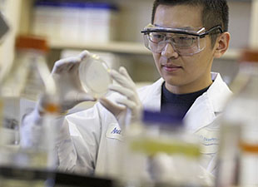
I want to publish in high-quality journals with good Impact Factors
As a creator of
scientific information
I want to disseminate my research globally and foster international collaboration
With publishing in high-quality journals, I want to raise my personal profile, but also the profile of my institution and the national profile of Kazakhstan
It’s becoming increasingly competitive to get accepted in the best journals; therefore I would appreciate help and training on how to best prepare and write my manuscript

Slide 4
I need to stay up-to-date with the current research and get background info on topics related to my core research areas
As a user of
scientific information
Therefore, I want fast and easy access to the full-text of all the research literature I need to do my job
I use a variety of sources, but most of the time I use Google Scholar or Google Web Search to discover content, that’s most convenient

Slide 5
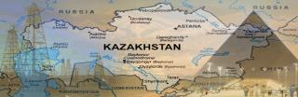



Springer and Kazakhstan: A perfect match!
Kazakhstan's research community
Access to SpringerLink
Author training & services
Support Kazakhstan's ambitious growth strategy
Position Kazakhstan among the top 30
global economies by 2050
Funding for science to increase up to the
level of 3% of GDP

Slide 6
Publishing Services
Editorial guidance and support
Copyediting/language editing/translation services
Editorial training and workshops, including:
  Abstracting and Indexing
  Publishing Ethics
  Production
  Distribution and discoverability
Enhancing your research output

Slide 7


























Our publishing brands

Slide 8
Kazakhstan’s global ranking by bibliometrics
Global Ranking by
Country | # Articles 2013 | # Citations 2013 | H-Index
China | 2 | 2 | 16
Japan | 5 | 8 | 6
India | 7 | 13 | 23
South Korea | 12 | 14 | 19
Taiwan | 16 | 19 | 28
Malaysia | 23 | 38 | 54
Singapore | 29 | 25 | 27
Hong Kong | 35 | 32 | 25
Thailand | 40 | 44 | 39
Kazakhstan | 70 | 92 | 116
Uzbekistan | 100 | 113 | 120
Mongolia | 112 | 115 | 113
Kyrgyzstan | 136 | 135 | 160
Tajikistan | 140 | 155 | 179
Source : SCImago. (2007). SJR — SCImago Journal & Country Rank. Retrieved October 8, 2014, from http://www.scimagojr.com

Slide 9
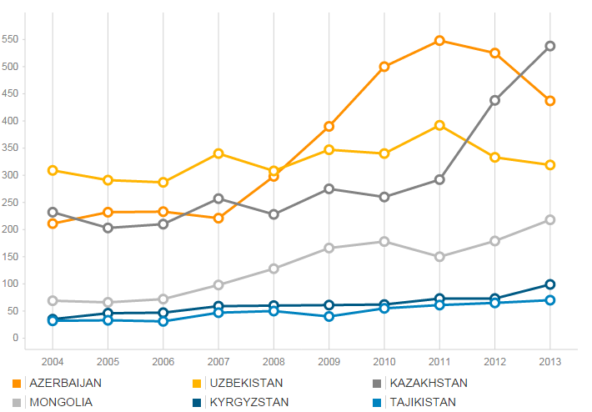
Kazakhstan’s article output in comparison to its neighbors
Source : ThomsonReuters InCites

Slide 10
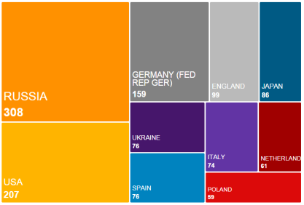
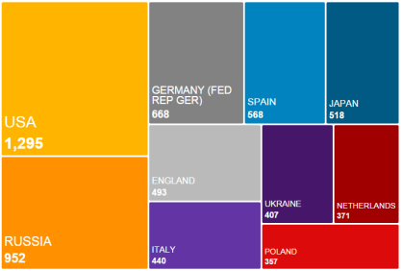
Kazakhstan and international collaboration
# Articles
# Citations
Source : ThomsonReuters InCites; 2010-2013

Slide 11

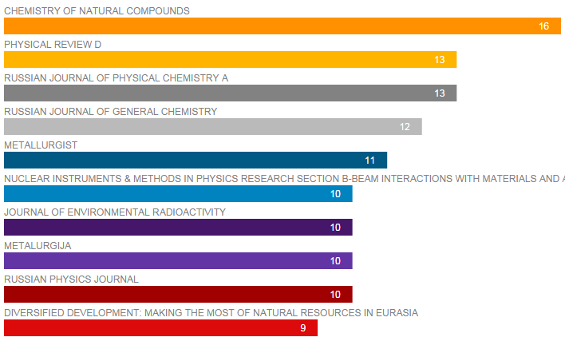
Where do Kazakhstani researchers publish? Top 10 journals
Source : ThomsonReuters InCites; 2013-2014

Slide 12
Kazakhstan: Journal articles and book chapters in Springer publications
CAGR: 20%
AuthorMapper excl. BMC

Slide 13
Kazakhstan: Journal articles in Springer journals by discipline
AuthorMapper excl. BMC

Slide 14
Impact Factors 2013
Number of Springer Journals 2005-12
Springer IF journals from Asia:
      Japan: 55
      China: 53
      South Korea: 27
      India: 27
      Taiwan: 4
      Philippines: 1
      Uzbekistan: 1
      Singapore: 1
CAGR: 11%

Slide 15
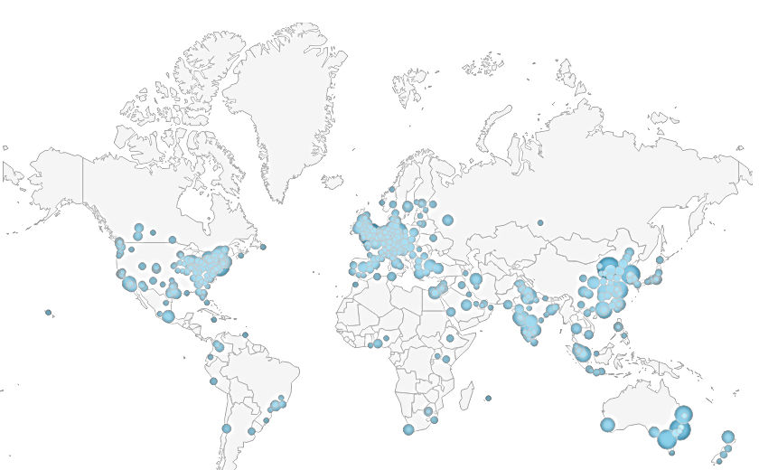
Publishing with Springer makes research results ‘visible’ to the world
SpringerLink Usage
120m visitors, 229m visits and 419m downloads in 2013!

Slide 16
Google Scholar and Google Web Search are heavily used referrers
  More than 60% of users started their search on Google web search or Google Scholar
  Only one out of 10 respondents started their visit to SpringerLink from a Library Website
  Results are very much in line with data from the Springer Link web analytics tool
N=2,554

Slide 17
SpringerLink journal downloads from Kazakhstan
CAGR: 41.6%
(Source: SpringerLink Usage Statistics)
(Downloads from Licensing Institutions Only)

Slide 18
Kazakhstan: How do users come to SpringerLink?
Visitor Referral | Visits to SpringerLink Jan-Sep 2014 | In %
direct | 27,865 | 37%
www.google.kz | 17,584 | 23%
scholar.google.com | 5,582 | 7%
www.google.ru | 4,872 | 6%
www.springer.com | 2,748 | 4%
www.google.com | 2,587 | 3%
www.ncbi.nlm.nih.gov | 1,437 | 2%
nulibrary.summon.serialssolutions.com | 785 | 1%
go.mail.ru | 703 | 1%
apps.webofknowledge.com | 612 | 1%

Slide 19
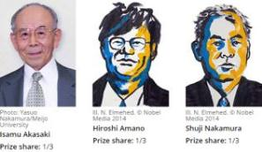
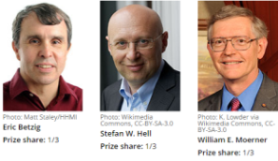
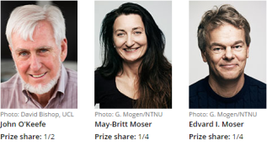
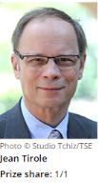
All ten of the 2014 Nobel laureates in medicine, physics, chemistry and economics are Springer authors and editors!
Physics
Chemistry
Physiology and Medicine
Economics

Slide 20

Рахмет
THANK YOU
(Source: SCImago. (2007). SJR — SCImago Journal & Country Rank, Retrieved Oct 26th, 2012, from http://www.scimagojr.com)

