Slide 1
Springer Archives
Sitki Aktas – Regional Sales Director
Turkey, Central Asia
20-21 November Kazakhstan

Slide 2
Springer Archives: the value add for Libraries
Archive content fully integrated with contemporary content on SpringerLink
Enhanced usage by more content per title and more inter-article links
Complete your collection
Accelerate research: easy access to all content, 24/7
Cost reduction: one-time purchase / housing costs / interlibrary loans

Slide 3


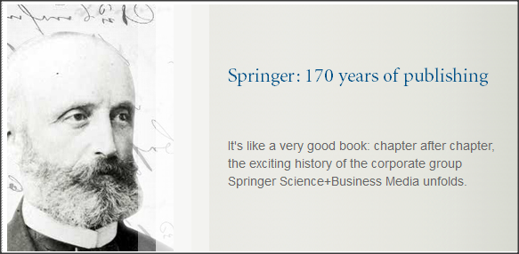
History of Springer’s publishing
Springer was founded as a bookseller in Berlin in 1842 and started publishing soon after
Renowned scientists have published with Springer such as Werner Siemens, and many others including Rudolf Diesel, Werner Siemens, Karl Scheel, Rudolph Virchow and Marie Curie

Slide 4
Historical overview (selected events)
1842: Julius Springer opens book shop in Berlin, and starts publishing soon after
1889: Kluwer established in the Netherlands
1946: Office in Heidelberg opened
1964: Greater international focus and founding of Springer-Verlag New York
1978: Founding of Kluwer Academic Publishers (KAP)
1999: Bertelsmann acquires the majority of Springer-Verlag , combines it with their Professional Information division, and name it: BertelsmannSpringer
2003: The British financial investors Cinven and Candover acquire Kluwer Academic Publishers (KAP) and BertelsmannSpringer
2004: Creation of Springer Science+Business Media through merger of BertelsmannSpringer
with KAP. The result is the second-largest publisher worldwide in the Science, Technology, Medicine (STM) field
2005 – 2008: Acquisitions including Humana Press, Bohn Stafleu van Loghum and BioMed Central
2009: EQT and GIC acquire Springer from Cinven and Candover
2011: Springer acquires MPS from Wolters Kluwer

Slide 5
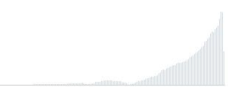
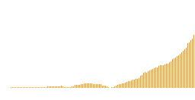



Digitize everything
146,000 articles/yr
1996
2004
“Digitize all journals going forward!”
“Digitize all journals going backward!”
1842
Springer-Verlag founded
Journals
1860
1870
1880
1890
1900
1910
1920
1930
1940
1950
1960
1970
1980
1990
2000
2011
Books
2006
2011
“Digitize most books going forward!”
“Digitize all books going forward and a lot of books going backward!”
7,000 books/yr
Notes:
This slide is showing our activity in archives until now. Note the distribution of the book titles over time, most is published in the past 20-30 years.

Slide 6
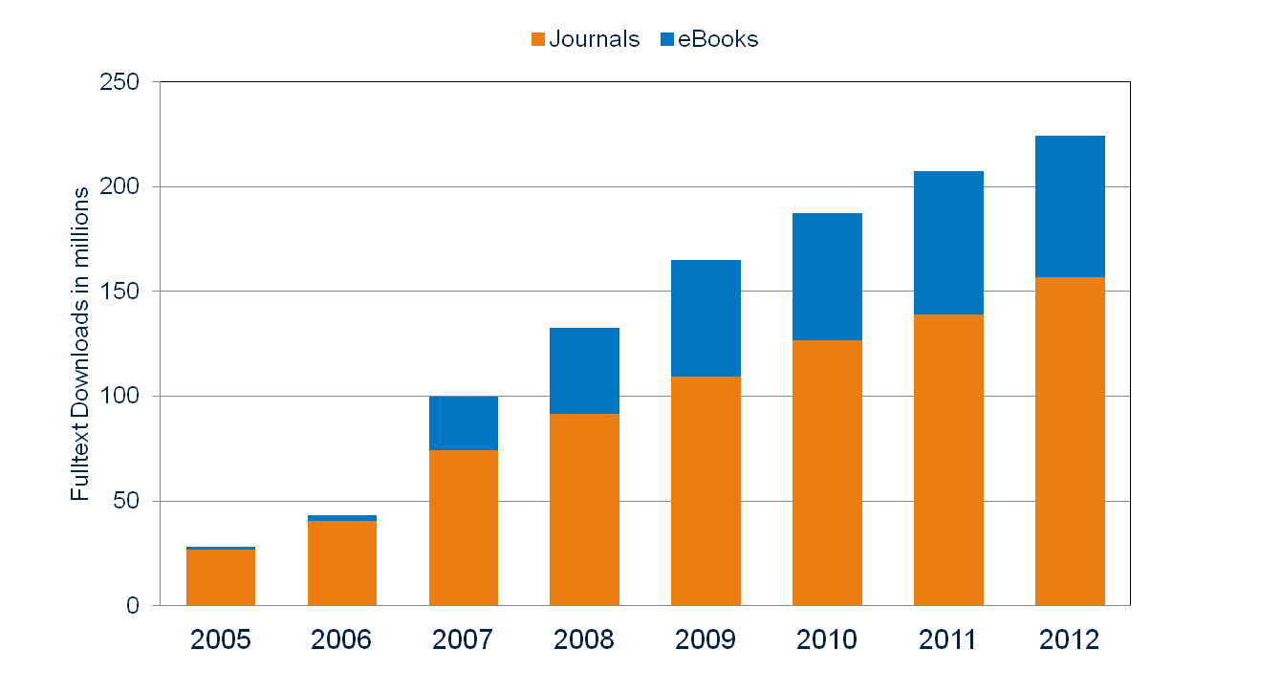
eBooks already make up a third of SpringerLink usage!
SpringerLink Usage: 2005-12
Notes:
Make note of the fact that there is more ebook usage in 2011, than journal usage in 2006, while the amount of content is less, and less customers have access to it: eBooks are very popular product.

Slide 7
Distribution of usage – books and journals
Springer: Distribution Full-Text Downloads by number of titles
journals
100%
90%
80%
70%
eBooks
60%
50%
Top 20% journals account for 80% of total article downloads
# full-text chapter downloads
40%
30%
Top 20% eBooks account for 55% of total chapter downloads
20%
10%
0%
10%
20%
30%
40%
50%
60%
70%
80%
90%
100%
# titles
Notes:
This slide defends the collection model: while there is a concentration on some key titles, many book titles are being used in a large collection, note the long tail.

Slide 8
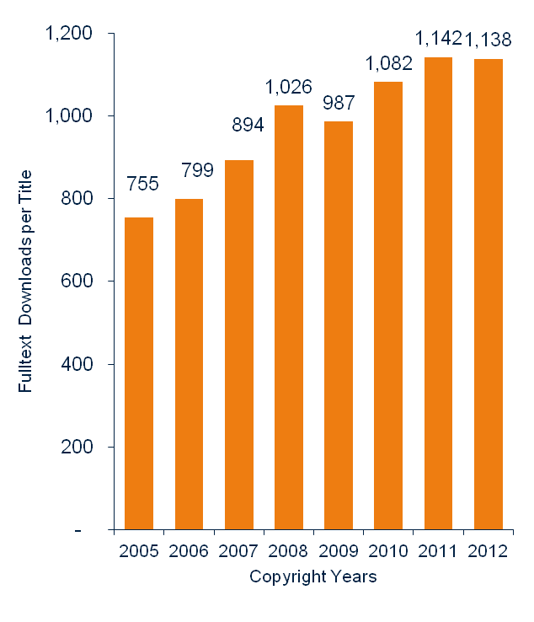
The long tail of Archive usage
Although titles are used slightly less a few years after publication, there is definitely strong interest in ‘older’ book content.
For example, chapters from an English language 2005 title were downloaded 755 times on average in 2012. This compares to ‘just’ 1,142 chapter downloads for an average 2011 title.
2012 titles had slightly fewer downloads on average, since many titles were added to SpringerLink only in the course of the year.
English Language Packages: Average Chapter Downloads 2012 by Title and Copyright Year
(Data adjusted for abnormal usage spikes due to massive downloading)
Notes:
Longtail continued: older content is still popular

Slide 9
Citation Analysis: Archive content is frequently used by Scientists!
Top-ten journals from 11 disciplines
All citations from 2006 vs. respective numbers of pre-1997 content citations

Slide 10
“Shelf life” of eBooks and journals
SpringerLink 2012 Downloads by Content Age (Index, 2012 = 100%)

Slide 11
Springer Book Archives – Age of the content
60% of English/International SBA books published later than 1990
85% of English/International SBA books published later than 1980

Slide 12
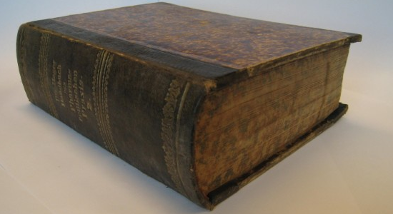
Why?
Contemporary content are highly used
Customers and authors ask when historic titles will become available electronically
Researchers want primary sources
Saves warehouse space as well as library shelf space
Preserve the scholarly record
Increase sales, usage, availability
... why not?

Slide 13



Imagine around 100,000 Books
If stacked one on top of the other, would be ~2.7km high
  Equals 7 times the Empire State Building
  Or “only” 3 times Burj Khalifa
~35 million pages
150,000 authors minimum
~1.5 million new DOIs (titles & chapters)
Notes:
Emphasazing the size

Slide 14

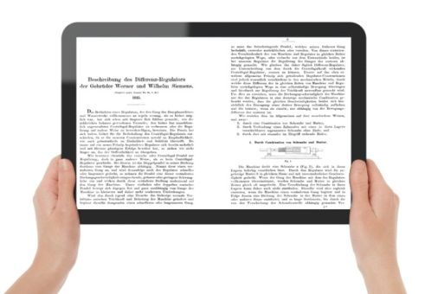
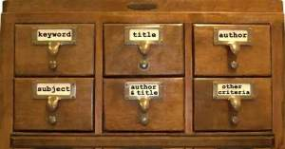
In a few not-so-easy steps…
make (e)book available
rights & royalties
Identify
scanning
& tagging
find
read!
*
* In print (on demand) too
Notes:
Overview of how the various steps in the project, going from a list of titles to actual electronic books

Slide 15

Identifying books
Goal is to digitize as many as possible books, from all Springer’s publishing houses in English and German language
To be as comprehensive as possible, we did not filter or apply selection criteria to content in advance
Long inventory list of Springer books created with Springer catalogues and with help of catalogues from national libraries
Notes:
Argument why only English and German: (in case being asked)
Springer is a global publisher with a vast majority in English and German language. The other language part is very, very small and for a global audience the English and German titles are most interesting.

Slide 16
Included imprints
Springer Berlin-Heidelberg:
  August Hirschwald (integrated into Lange & Springer)
  Behrend & Co.
  F.C.W. Vogel
  Urban & Vogel
  Spamer
  Physica-Verlag Heidelberg
  Steinkopff-Verlag
  J.F. Bergmann-Verlag
  Braun-Verlag
Springer Fachmedien Wiesbaden:
  Gabler Verlag
  Dt. Universitats-Verlag
  Leske und Buderich
  Vieweg-Teubner
  Heinrich Vogel
  B.G. Teubner
  Vieweg Verlag
  Friedr. Viewig & Sohn
  Westdeutscher Verlag
  V.S. Verlag
Springer Netherlands:
  Chapman & Hall
  Kluwer Academic Publishers
  D. Riedel Publishing Company
  Martinus Nijhoff
  W. Junk
Springer US:
  Chapman & Hall
  Kluwer Academic Publishers (Van Nostrand)
  Plenum US
Springer New York (Springer Verlag NY):
  Springer NY
  Praxis
  Copernicus
Springer Vienna
Springer Basel:
  Birkhauser Basel (non-architecture)
Springer London
Birkhauser Boston
Bohn Stafleu van Loghum
Springer Japan
Humana Press (Springer NY)
Springer Milan
Springer Paris
Current Medicine Group (Springer NY)
Notes:
[In the word document there is a note on the ‘as of date’, but I don’t’ see this anywhere?]

Slide 17
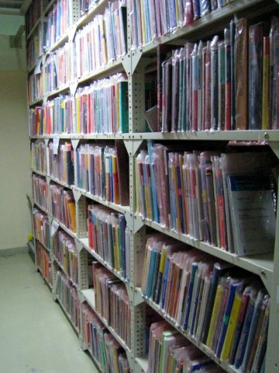
Completeness
A retro-digitization project of this size is impossible to complete down to every last title.
What is not included:
    Most titles that are already digitized (e.g., Landolt Börnstein)
    Works of imprints sold to other publishers
What is included:
    100 top book series -- in all subject areas (English)
    Contemporary (2004-2000) collection
    Flagship disciplines, e.g. mathematics
Notes:
But, we are stribing for completeness, and find as many titles as (economically) possible.

Slide 18
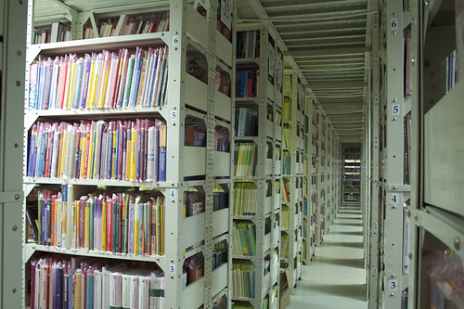
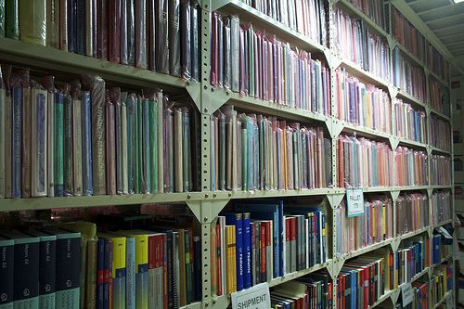
Finding books
We have created our own print book archive
  Containing over 100,000 titles
  To complete the print archive, we contact antique book shops and national libraries and…
  We cooperate with libraries on scanning initiatives

Slide 19


Scanning
Collection contains historic titles that must be treated with much care
Not all titles are in mint condition
  Pages containing pencil under linings, coffee stains and annotations
Springer strives to make books available in the highest possible quality:
  Scanning is done with state-of-the-art equipment
  Each page is digitally cleaned and scanned with text recognition (OCR) to allow for full text searching
  Each image is scanned separately at various resolutions to achieve the
  highest possible reproduction quality
  Non-destructive scanning for rare & fragile books
Additional quality checks are performed
Notes:
Black-and-white 600 dpi 1-bit monochrome (bitonal)
300 dpi grayscale (8-bit) and color (24-bit)
OCR used (also for German Fractura)
Pages cleaned up before scanning
Superimposing for images
1st scanning: only text
2nd scanning: color images
Images are then mounted into full-text PDFs

Slide 20



Once digitized, books will be available in many formats
Springer Book Archives project will make titles available as:
  PDF for softcover print (on demand) including MyCopy
  PDF for web optimization
  XML – metadata: base for many output formats, e.g. HTML, ONIX, MARC
Notes:
The scanning results in various electronic products, that are the basis for the 3 main output products:
eBooks (PDF mainly, selection in ePub/HTML)
Print books (POD)
MyCopyBooks [cover above will change if we have a mycopy image of archive title]

Slide 21

Thank You! – Questions?
Sitki Aktas – Regional Sales Director
Email: sitki.aktas@springer.com
http://www.springer.com/bookarchives

