Slide 1
Increasing the Impact of your Journal a
3 December 2015
Jeffrey Robens, PhD
Editorial Development Manager

Slide 2
What are your goals?
Indexed in Web of Science
Many citations
High Impact Factor!
These are not your goals!
Notes:
This slide is directed at the fact many EiC are overly focused on citations and IF…and I want to emphasize those are not goals but KPIs.
So I think some EiCs will agree with this slide up until the “These are not your goals” comes up, at which point we emphasize those are NOT the goals.

Slide 3
What are your goals?
Goals
KPIs
Publish quality articles
Indexed in Web of Science
Have high visibility
Many citations
Reputable source of high impact research
High Impact Factor!
Notes:
Instead these are the real goals. The others are KPIs of those achieved goals.
I emphasize a REPUTABLE source on the last bullet point to help lead into the next slide (I try to make my slides such that the last point logically leads to the topic of the next slide) about the reputation of the journal. A transition something like “So a reputable source of high impact is really what you want to achieve with your journal. And this makes sense, but a journal’s reputation is one of the most important factors authors use when choosing a journal…”

Slide 4
Author survey: How important are the following factors for you when choosing a journal?
Springer
Nature
Notes:
“Here is an author survey from both Springer and Nature…”
Here I have the red box come up around IF to show it is NOT the most important factor. Instead, for both surveys, journal reputation is the key factor. Aligned with the main goal EiCs should have in developing their journal.

Slide 5
Reaching your goals
Reputable source of high impact research
Strong editorial vision
Positive author and reviewer experience
Improved visibility
Indexed in Web of Science with a good impact factor
Result
Notes:
“So how do you achieve this goal?”
This is my agenda slide. For me, nothing is more boring than a “table of contents” slide…”This is what I’m going to talk about today” The first question from attendees being, “Why do I care?”
So for my agenda slide, I always try to establish WHY this is important to my audience (previous 2-3 slides). Then I say “To achieve this goal, you need to have a strong editorial vision, positive author and reviewer experiences, and improved visibility. The end result being your journal will be widely indexed, including WoS, and will have high citations and a good IF. That is why these are three topics we will discuss today to help you achieve your goal.”
In this way, we’ve internalized in our audience why these points are important to them, and help establish their attention from the very beginning of the talk (one of my good presentation secrets!)

Slide 6
What makes a journal stand out
Editorial vision
Unique platform
Adds value to the field
Positive author and reviewer experience
Increase submissions
Better peer review
Visibility
Better discoverability
Increased reputation

Slide 7
Strong editorial vision
Notes:
First section of the talk.

Slide 8
Editorial vision
Research study
Journal
Identify important problem in the field
Identify important problem in the field
Establish specific aims to address the problem
Establish specific aims to address the problem
Determine appropriate study design to achieve aims
Determine appropriate topics and article types to achieve aims
Notes:
Emphasize the importance of the EiC, as well as their accountability for the journal. If their journal does not achieve the stated goals, it rests on their shoulders (cannot blame others).

Slide 9
Editor-in-Chief
Most important factor for a successful journal is a motivated and productive Editor-in-Chief
Strong desire to improve the journal
Able to achieve results
Accountable for the success of the journal
Notes:
Emphasize the importance of the EiC, as well as their accountability for the journal. If their journal does not achieve the stated goals, it rests on their shoulders (cannot blame others).

Slide 10
Editor-in-Chief – Editorial strategy
Define the vision and direction for your journal
What unique value can your journal add to the field?
Identify current trends
Establish your niche
Who can help you develop your journal?
Editorial board
Advisory committee
How can you improve the visibility of your journal?
Indexing services
Active promotion
Notes:
First thing they have to establish is the journal’s vision and direction, including what is their journal really adding to the field. Try to find a niche that makes the journal unique. If it’s just a cookie cutter journal, there is no reason for authors to submit there.
One example I often tell EiCs is about the Croatian Medical Journal. This journal was started as a basic medical journal…one of many hundreds! However, given the many military conflicts in the region, they often published war-related medical papers. They soon found this to be their niche, along with issues surrounding emerging countries…and developed it further. “The second area is medicine in developing and emerging countries. We pay special attention to this area for 3 reasons: (a) Croatia is an “emerging” country and a country undergoing major socioeconomic changes; (b) authors from such countries need and deserve editorial assistance that we can offer; and (c) we can provide a medium for reporting research worth publishing and preserving from developing and emerging countries that would receive little attention otherwise.” They are now indexed in WoS (IF of 1.373, not high, but for a small regional journal, not bad!), Scopus, and PubMed.
Importance of a strong editorial board and international advisory committee can be very important for helping new journals develop further.
Importance of high visibility to attract author submissions, good reviewers, and citations.

Slide 11
The scope of your journal
Avoid being too broad!
Specialized aims and scope:
Defines a distinct authorship
Defines a distinct readership
Establishes focus of the editors and editorial board
Define specific subject areas of focus
Notes:
I’ve seen some new journals that have these very broad over-reaching aims. I think they hope by having such broad aims, they can increase the number of submissions. This is something they should not do! This basically makes their journal simply a repository for regional authors, and they will not establish the international reputation/credibility they need.
This slide emphasizes the importance of a specialized aims and scope that promotes the niche the journal is trying to fill.
Of course, it cannot be too specialized, otherwise too few authors will submit their manuscripts. This is where an international advisory committee and editorial board can be helpful to achieve the proper balance.

Slide 12
Associate editors
Supports Editor-in-Chief
Editor-in-Chief
Send submitted manuscript
Give recommendation
Associate editor with subject expertise
Choose reviewers
Send reports
Peer review
Notes:
I’ve seen some new journals that have these very broad over-reaching aims. I think they hope by having such broad aims, they can increase the number of submissions. This is something they should not do! This basically makes their journal simply a repository for regional authors, and they will not establish the international reputation/credibility they need.
This slide emphasizes the importance of a specialized aims and scope that promotes the niche the journal is trying to fill.
Of course, it cannot be too specialized, otherwise too few authors will submit their manuscripts. This is where an international advisory committee and editorial board can be helpful to achieve the proper balance.

Slide 13
Associate editors
Supports Editor-in-Chief
Editor-in-Chief
Associate editor
Associate editor
Associate editor
Peer review
Peer review
Peer review
Notes:
I’ve seen some new journals that have these very broad over-reaching aims. I think they hope by having such broad aims, they can increase the number of submissions. This is something they should not do! This basically makes their journal simply a repository for regional authors, and they will not establish the international reputation/credibility they need.
This slide emphasizes the importance of a specialized aims and scope that promotes the niche the journal is trying to fill.
Of course, it cannot be too specialized, otherwise too few authors will submit their manuscripts. This is where an international advisory committee and editorial board can be helpful to achieve the proper balance.

Slide 14
Editorial board
Build a strong editorial board
Dos
Strong publication record
Internationally diverse
Enthusiastic/motivated
Has time!
Don’ts
Few English publications
Not interested in journal promotion
Big name, but no time
Expertise in subject areas of journal
Notes:
Basic slide of what to look for and what to avoid in choosing members of the editorial board.
Especially for regional journals, they may choose well-published researchers…but not well-published in English. These are not the type of researchers they should be targeting (do not have the international reputation the journal needs). Researcher A: 2 English publications and 30 Iranian publications; Researcher B: 8 English publications and 2 Iranian publications. Researcher A is more well-published altogether, but Researcher B is likely more internationally known and would be the better choice.
Another common issue is choosing these big names, well-published and famous! But basically have no time or motivation to actually help the journal. There for name recognition only. This only puts more work on the other members and/or journal editors. Does not help the journal. Members should want to be there to help the journal achieve the journal’s goals (leading into the next slide)

Slide 15
Editorial board responsibilities
Help Editor-in-Chief achieve journal’s goals
Refine/revise aims & scope
Review submitted manuscripts
Identify suitable reviewers
Editorial review
Activity promote journal
Solicit articles and reviews
Write articles and reviews
Journal promotion
Board meetings
Attend and actively participate in yearly editorial board meetings
Notes:
Following on the previous slide, this is the main responsibility of the editorial board.
They can do this by assisting journal editors and providing valuable input on the aims & scope, help with manuscripts where the journal editors are not really sure what to do (accept or reject? Maybe 2 reviewers say okay, 1 gives a strong rejection recommendation…and the journal editor wants another opinion…they can ask an appropriate member of the editorial board). As experts in the field, board members can also help suggest reviewers for a manuscript as well (or review it themselves).
They should also help promote the journal. Discuss with their colleagues or at conferences. Recommend colleagues to submit to the journal and/or write reviews. They should also submit their own articles to the journal (maybe once every couple years or so) as well as write reviews as well. This is a great way to help build up the reputation of the journal worldwide.
Another important responsibility is to attend editorial board meetings (leading into the next slide)

Slide 16
Editorial board meetings
Once per year
Popular conference (e.g., annual society conference)
When/where
Journal’s KPIs
Recent/emerging trends
Action plan for next year
Discussion topics
Tips!
Send out journal evaluation report before the meeting
Have defined agenda and encourage discussion
Follow-up with members throughout the year
Notes:
Ensure you don’t say KPIs, but “key performance indicators like author submissions, citations, downloads, IF…” just to ensure they know what we are talking about.
For action plan, I emphasize forward thinking…need to play what are really the emerging trends and how can the journal capitalize on them to further improve their KPIs. And what are the KPIs the journal should realistically try to achieve next year.

Slide 17
Efficient submission process
Initial submission
Rapidly review (technical checks)
Quickly identify reviewers
Peer review
Prompt reviewer reports
Quickly clarify questions/conflicts
Revision
Clear decision letters
Defined deadlines
Publication
Online review of galley proofs
OnlineFirst publication
Notes:
One of the biggest complaints authors have with journals is time. So it is the EiC’s responsibility to ensure the submission process is as efficient as possible.
Can use technical checks to immediately reject poorly written/formatted manuscripts without wasting the journal editor’s time trying to review the content (cover letters can be especially useful for this step as they not only reveal important aspects about the study, but also the writing style of the author).
Ensure associate editors send potentially suitable manuscripts to peer reviewers quickly (suggested reviewers and editorial board members can help in addition to the journal’s own database of reviewers).
Ensure the reviewers know the deadlines and don’t wait until the last minute to remind. If you give 4 weeks, send a gentle reminder after 2 weeks to ensure the reviewer is not having any problems with the review or questions (nice way to push them a bit), and then another one maybe at the 24-day mark. If any reviewer comments are not clear, or if there are any conflicting comments, follow-up for clarification asap.
Ensure communication with author is clear to avoid author wasting time asking for clarification later. Clear and realistic deadlines for revisions, keeping in mind minor or major revisions. For major revisions, journal editors should use their discretion if they need to go through a second round of peer review (which can really delay the process). If the author really seems to have addressed all the reviewers concerns clearly, then a second round of peer review may not be necessary (again, maybe get input from a member of the editorial board).
Use online review of galley proofs (like what Springer uses) to expedite publication and publish the article online ahead of print (OnlineFirst)

Slide 18
Tips for increasing citations
Content
Publish on recent trends
High quality research & English
Discoverable
Search engine optimization
Widely indexed
Open access
Improve worldwide accessibility
Subscription journal: make high impact articles OA
Additional
Publish review articles
Publish high impact articles at the beginning of the year (IF)
Notes:
“However, in the end, I know all of you are still focused on increasing your citations. Here are some useful tips to do this from an editorial perspective…”
Content is obvious, but always useful to remind EiC that this is the key factor to increase citations.
Discoverable is another obvious but important factor to emphasize. Doesn’t matter how good the paper is, if researchers can’t find it, they won’t know about it (or cite it!).
Usefulness of OA to increase accessibility and downloads, which may lead to increase citations (I personally like to emphasize the “may” part as I think there is no conclusive evidence that it does). For subscription journals, if you are publishing a paper that you have a good feeling about (you think may really have high impact and receive high citations), consider making that article OA and actively promote it online (so people know it is free to download).
Other useful tips I’ve come across include publishing review articles (if they don’t already), as they normally have more citations than original research articles…and because IF considers citations for 2 calendar years (Jan–Dec), if a journal is already in WoS, publishing potentially high impact papers at the beginning of the year can help improve the IF. Wiley capitalizes on this even further by making their first issues each year completely open access (I’m sure to try to increase the citations within that issue).

Slide 19
Positive author experience
Notes:
“Another important way to achieve your goal is to ensure that the authors have a positive experience with your journal”

Slide 20
Positive author experience
Increase high quality submissions
Increase return submissions
Build reputation
Clear aims and scope
Clear author instructions
Efficient submission process
Notes:
A positive experience is important because this will lead to more submissions (allowing the EiC to be more selective in publishing higher quality research), repeat submissions for the author’s next paper, and build the overall reputation of the journal.
To do this, journals should have a clear aims and scope, clear author guidelines, and an efficient easy-to-use submission process

Slide 21
Aims and scope
International Journal of Wastewater Management
The International Journal of Wastewater Management is a peer-reviewed journal that publishes original reports and timely reviews related to the management of wastewater. The journal aims to provide a platform for the dissemination of research worldwide.
Is this a clear aims and scope?
No!
Notes:
Here is a fake journal (I checked!) and a poorly written aims and scope. This is meant to be an interactive slide. Read the aims and scope aloud and ask if they think this is a clear aims and scope (“Raise your hands if you think this is a clear aims and scope…”)
No it is not. Why?

Slide 22
Aims and scope
International Journal of Wastewater Management
The International Journal of Wastewater Management is a peer-reviewed journal that publishes original reports and timely reviews related to the management of wastewater. The journal aims to provide a platform for the dissemination of research worldwide.
Redundant information
What type of research does this journal publish?
Chemistry? Microbiology? Policy?
Notes:
First of all, there is redundant information. Of course papers are related to wastewater management, that’s in the name of the journal! And of course it is worldwide, the journal title says “International”!
The question authors will have is, what type of research does this journal publish? Is this an environmental chemistry journal? Focused on microbial contamination? Or related to policy making? The aims and scope is not clear enough to establish this.

Slide 23
Aims and scope
International Journal of Wastewater Management
The International Journal of Wastewater Management is a peer-reviewed journal that publishes original reports and timely reviews related to wastewater treatment. The journal aims to provide an interdisciplinary platform for the dissemination of research in chemistry, materials science, and microbiology related to the purification of wastewater. Topics of particular interest include:
  Chemical separation processes
  Novel membrane technologies
  Nanotechnological advances
Ensure have associate editors with expertise in these areas
Notes:
This is how we can improve this aims and scope, shown in red. What type of wastewater management? The treatment of wastewater. Emphasize this is an interdisciplinary journal focused in these disciplines. And lastly emphasize which topics this journal is particularly interested in.
Like mentioned earlier, having a more specialized aims and scope helps defines the authors, the readership, and helps the editors and editorial board focus on the development of the journal. (always good to link back to previously presented information if possible)

Slide 24
Author instructions
Most authors want to quickly prepare their manuscripts for submission…
…but many author instructions are long and difficult to navigate
(especially for non-native English authors)
Manuscript rejected because of poor formatting
Result
Notes:
Another common problem authors have is with author instructions. Authors want to quickly prepare their manuscript (they hate being burdened with mundane details such as formatting when trying to communicate the significance and relevance of their study). But many author guidelines are so long and convoluted that for someone seeing them for the first time, will have no clue where to find the information they need! This is especially true for people who cannot read English fluently.
The end result are manuscripts that are not properly formatted and have to be immediately rejected. This wastes everyone’s time. If this happens, and the authors are still not clear on how their manuscript should be formatted, they may then just submit to another journal instead.

Slide 25
Author instructions
Improve your instructions:
Distinct headings
Clear and concise English
Explicit instructions and examples
Provide templates (e.g., Word)
Notes:
How do you improve your author instructions?
Headings in a single document or—even better—tabs to specific sections.
Clear English with short sentences.
Explicit instructions with examples, especially useful for information about titles, keywords, references, etc.
If possible, consider using templates that the author can just download and use to write their manuscript. This often solves many formatting problems quickly for everyone involved.

Slide 26
Submission process
Common author complaints:
Time-to-first-decision took too long
Did not understand editorial decision
What can you do?
Notes:
In addition to problems about formatting their manuscript, another common author complaint is how long it took for their paper to be published. I’ve talked to authors who have waited up to a year until the first decision!
Or even if the decision was quick, the author doesn’t understand the decision…are they rejected? Being asked to revise and resubmit? What do these reviewer comments mean? Why are some conflicting? Is this really a fair revision to ask me to make???

Slide 27
Submission process
Time-to-first-decision:
Efficient editorial workflow
Ensure timely response from reviewers
Unclear editorial decisions:
Clearly state editorial outcome
Ensure reviewer comments are clear
Clearly state next steps
Notes:
First, related to time to first decision, ensure you have an efficient editorial workflow, like talked about earlier (again, linking back to previously presented information). Also ensure reviewers are promptly sending in their reports…again you can follow up 2 weeks later with a gentle reminder to nudge them to send them in earlier if possible. This is especially true if it is getting close to holidays…
Second, related to editorial decisions, make sure it is very clear what the decision is: reject, minor revision, major revision, or accept. Be polite, but be clear. Read all the reviewer comments and ensure clear. Revise those that are verbose and confusing. This will ensure the author knows exactly what to do and won’t waste time later asking for clarification. Or even worse, do the wrong revisions—which wastes everyone’s time! Also make sure the next steps are very clear. How to revise (e.g., highlight revised text in the new manuscript, indicate line numbers in the response letter, etc.), when to resubmit, and how to resubmit the manuscript (which links should they use, which files are necessary, etc.).
Ensuring the authors know what exactly what peer reviewers are asking of them will improve their overall experience with the journal.

Slide 28
Positive reviewer experience
Notes:
And speaking of peer reviewers, you need to ensure they also have a positive experience with your journal as well. High quality peer review is on the most important ways to improve the quality of the articles you publish.

Slide 29
Positive reviewer experience
Increase number of reviewers
Improve peer review quality
Improve manuscript quality
Identify right reviewers
Clear reviewer instructions
Effective communication
Notes:
Ensuring reviewers are happy will increase the number of reviewers in your database (because they will be happy to review for your journal again), improve the overall quality of the review, leading to higher quality articles that will likely be more highly cited.
So you need to identify the right reviewers for the manuscript, ensure they know exactly what is excepted of them, and clearly communicate with them through the review process.

Slide 30
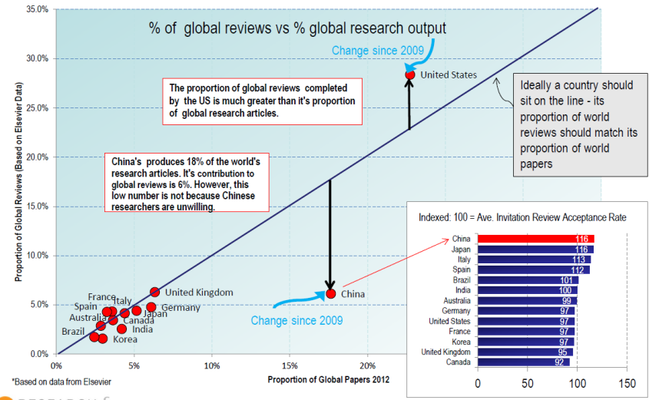
Reviews and articles by country
Adrian Mulligan, Research Director Elsevier: The Peer Review Landscape – What do Researchers think?, Nov 2013
Notes:
Before we talk about identifying the right reviewers, let’s look at this graph that plots total number of reviews from a country on the y-axis against the total number of papers from that country on the x-axis. Optimally, countries should lie along this line—but there are two exceptions.
The US reviews more papers than they publish, so they are under extra pressure from journals. China, however, reviews considerably fewer papers than they publish, which is not really fair to the other countries.
Does this mean that Chinese researchers decline reviewer invitations more frequently? No! Looking at this bar graph, you can see that China actually has the highest reviewer acceptance rate worldwide!
That means…journal editors are simply not asking Chinese researchers to review manuscripts for their journals. That then puts pressure on other countries, like the US, to review these manuscripts.

Slide 31
Tips for identifying the right reviewers
Be open to non-Western countries
Have published in your journal
Balance reviewer pressure
Global impact of study
Familiar with content
More likely to accept invitation
Has expertise in some areas
Ask author to suggest reviewers
Interdisciplinary studies
Clearly explain to reviewer
Do not use only suggested reviewers
Ensure authenticity
Notes:
To avoid this problem, be open to non-Western reviewers! If someone in India or China is most qualified to evaluate the manuscript, ask them to! This not only helps balance reviewer pressure, but gives you a better idea of the global impact of the study you are considering to publish.
A great resource of potential reviewers are your authors. They are familiar with the content and format of the journal, which is useful, but also more willing to accept a reviewer invitation. Why? Well, as long as they had a positive author experience (like we explained earlier), then they will likely be interested in submitting to your journal again. So they want to build their relationship with the journal and you as the journal editor. So if you invite them to review, they may do so to help build this relationship. Use that to your advantage!
Ensure they have expertise in at least some areas. This is a problem with interdisciplinary studies. There may not be a single reviewer qualified to review all aspects of the manuscript. If this is the case, find various reviewers who have expertise is some aspects, and explain this to them in the invitation. “Although this study focuses on the impact of new legislation regarding cadmium contamination in soils, your expertise regarding heavy metal effects on plant growth rates and yields will be invaluable to ensure the data this study is based on is valid and relevant.”
Lastly, you can also request authors to suggest reviewers who are qualitied to evaluate their study. As they are most familiar with their work, authors often have the best ideas who in the field is best qualified to review it. However, I strongly encourage to not only use suggested reviewers. Maybe 1 out of the 3 reviewers you use can come from the suggested list to avoid potential bias. Also ensure the authenticity of the suggested reviewer—visit their university website and verify the email address, ask authors to include ORCID or Scopus ID numbers, or ask editorial board members if they are familiar with that researcher. With the recent peer review scandals that have been occurring worldwide with many publishers, it is the EiC’s responsibility to ensure the authenticity of the review.
Related to this, you should ask your authors to suggest any researchers to exclude from review. This can help avoid negative biases during the review process (delayed reviews, unfair comments, etc.) that only prevents you from maintaining an efficient editorial workflow (again building on what we told them before).

Slide 32
Clear reviewer instructions
Ethical responsibilities
Timeliness
Conflicts of interest
Confidentiality
Ensure reviewer has time
Report deadlines
Which factors to evaluate
Constructive & clear comments
Novelty and impact
Technically sound
Writing clarity
Helpful comments
Explicitly state what needs to be revised
Notes:
Please be aware that regardless of who you choose, reviewers may not evaluate the manuscript in the same way. Or they may not have much experience in evaluating manuscripts. Peer review is like any other activity, you get better with training and practice!
To ensure consistency and quality in the reviewer reports, provide clear instructions for your reviewers.
Their ethical responsibilities related to review.
Ensure they can do the review on time. Make sure it is clear that if they don’t have time to submit the report by the deadline, they should decline the invitation. Sometimes, reviewers feel obligated to accept—even if they don’t have time—leading to delayed peer review and frustrated authors.
Let them know exactly what you expect them to evaluate. I strongly encourage you to use a reviewer checklist to help ensure consistency among reviewers and nothing is forgotten.
It is important to remind your reviewers to be constructive, not negative. It’s easy to point out what is wrong, it is much more difficult to give helpful advice on how they can improve it—but that’s exactly what reviewers should be doing. Don’t just say “the statistical analyses used in the study were not correct”, explain why they were not correct and what the author should do, “the authors used parametric statistical tests—ANOVA—to evaluate data that are not normally distributed. The authors should repeat their analyses with non-parametric tests such as the Kruskal–Wallis test…”
Also, remind them, particularly if the author is not a native English speaker, to use clear English in their comments. This can save you time from having to revise them later on!

Slide 33
Effective communication
Invitations
Unclear comments
Provide essential information
No more than twice/year
Immediately contact reviewer
Explicit clarification
Conflicting comments
Thanking your reviewers
Clarify with both reviewers
Make editorial decision
Give constructive feedback
Inform of editorial decision
Notes:
Another important way to provide a positive reviewer experience is too communicate with them effectively.
Make sure your invitations are polite but also provide enough information for the reviewer to consider the request thoroughly. Even if a reviewer does a great job, don’t have them review more than 2 manuscripts per year so they don’t feel overwhelmed.
If there are any comments that are unclear, contact the reviewer immediately and politely ask for clarification. Let them know what is unclear to you, what you think the comment means, and see if that is correct or not.
You will likely run into conflicting comments at times from different reviewers. Clarify with each why they made their comment, and then make an editorial decision as to which one you agree with. Consider compromising conflicting comments if appropriate (instead of all or none). For example, if one reviewer says Figure 2 is important and should be expanded, while another reviewer says Figure 2 is not necessary and should be moved to supplementary information; you may ask the author to expand on what is presented in Figure 2, but place that expanded analysis in the supplementary information.
Once the submission process is completed, be sure to thank the reviewer for their time and comments. Provide constructive feedback on how they did (again, peer review needs training and experience!), how they could be improved, and it is also useful to inform them of the final editorial decision. If they recommended reject, but you ended up accepting the manuscript (because the other two recommended accept), you may wish to explain why you decided to accept.

Slide 34
Positive reviewer experience
Improved peer review
Improved manuscript quality
More citations!
Notes:
In the end, a positive reviewer experience leads to improved peer review, improved manuscript quality, and finally to increased citations for your journal (and improved visibility/reputation in the field, which is really your true goal!).

Slide 35
Improved visibility
Notes:
Lastly today, let’s discuss about improving the visibility of your journal. With improved visibility, you will have more submissions to choose from, more page views and downloads, and hopefully resulting in more citatoins and more impact in the field.

Slide 36
How to improve visibility?
Be properly indexed and discoverable
Be a hub for your field
Conferences
Social media
Notes:
There are 4 key ways to improve visibility:
Be widely indexed in databases your authors use to find articles
Be a useful resource of information for researchers in the field
Promote your journal at conferences
And use social media to further promote your journal and published articles

Slide 37



Abstracting and indexing services
~14,000 journals
~21,000 journals
~5,000 journals
Why should you want to be indexed?
Increase discoverability among researchers
Benchmark performance against other journals
Notes:
First let’s discuss indexing services.
There are many available, some broadly focused and others specific for a narrow discipline.
Three popular ones many journals strive to be indexed in include Web of Science containing approximately 14,000 journals across fields, Scopus containing about 21,000 journals across disciplines, and PubMed containing about 5000 journals focused on biomedicine and clinical research.
Why should you want to be indexed by these or other indexes? First, it is an important way for researchers to find recently published articles to download and read—increasing your discoverability. Second, it is a useful way to see how you are performing compared with other journals in your field. It can help you identify popular or emerging trends that can influence your editorial direction and provide valuable KPIs to determine your strengths and weaknesses.

Slide 38
Abstracting and indexing services
Number of journals submitted to Scopus per month
Not all submitted journals will get reviewed!
Number of journals
http://files.sciverse.com/documents/pdf/Advice_to_journal_editors_and_publishers_v2.pdf
Notes:
Is it easy to be indexed? In reputable indexes like Web of Science or Scopus—no!
Here is a graph showing the number of submitted journals to be indexed in Scopus per month. On average, less than half of submitted journals are even suitable to be reviewed!

Slide 39
Abstracting and indexing services
Number of reviewed journals and acceptance rate in Scopus
Only ~1/3 reviewed journals are accepted in Scopus
Number of journals
http://files.sciverse.com/documents/pdf/Advice_to_journal_editors_and_publishers_v2.pdf
Notes:
And of the ones that have been reviewed, only about 1/3 of them are accepted. Not a high acceptance rate.

Slide 40
Abstracting and indexing services
Only ~1/3 reviewed journals are accepted in Scopus
Web of Science:
Reviews ~2000 journals per year
10–12% acceptance rate!
http://wokinfo.com/essays/journal-selection-process, accessed 27 Aug 2015
What are these indexes looking for?
Notes:
For Web of Science, as might be expected, this acceptance rate is even lower! Only about 10% of reviewed journals are accepted each year.
So why is the acceptance rate so low? What journal factors are these indexes evaluating?

Slide 41
What indexing services are looking for
Quality
Consistency
Transparency
Coverage
Notes:
There are four main factors being evaluated:
The quality of the journal
Consistency of publication
Transparency in the editorial process
And content coverage—is this journal adding value to the index?

Slide 42
Quality
Content
Adds value to the field
In line with aims & scope
English
Title, abstract, keywords
Clear, correct and concise
Production
Consistent printing layout
Clear figures/graphics
Citations
Articles, authors, editorial board
Self-citations < 20%*
*Testa J. Int Microbiol. 2006; 9: 135–138.
Notes:
Let’s first talk about journal quality.
Indexes will review the content that you publish. They want to ensure you are publishing papers that are adding value to the field (not simply replicating what other have done) and they are consistent with the aims and scope of your journal. If your journal aims to publish research about neural regeneration, but you actually publish any papers related to neuroscience—that will not look good!
Indexes also want English language journals. They will accept some non-English journals (although they will be at an immediate disadvantage), but at least the title, abstract, and keywords need to be in English as the indexing database itself is English. Further, they will review the quality of the English, making sure it is clear, correct and concise.
Indexes will review the production quality of your journal as well. They want to ensure the printing layout is clear and consistent among articles and issues, and they evaluate the clarity of your figures and graphics.
Lastly, of course, they will look at the number of citations that your journal has received. For newer journals that have less of a citation history, they will also review the citations of published authors and members of the editorial board to get an idea of the quality of the researchers involved with the journal (which they will take for predictive value). However, don’t think artificially inflating your citation number with self-citations will help! Most reputable indexes look down upon self-citations. Most journals in Web of Science, for example, have self-citation rates less than 20%. So try to keep below that value.

Slide 43
Consistency
Publish according to stated frequency
Continuous models: steady publishing
Timeliness
Similar number of articles per issue
Consistent article types per issue
Content
Informative titles and abstracts
Bibliographic reference information
Funding acknowledgements
Article information
Notes:
In addition to quality, consistency of publishing is also important.
Indexes will evaluate how consistently you publish according to the stated frequency. Journals with many issues that are published late will have a hard time to get indexed. For journals that publish continuously, as it common for many online-only open access journals, indexes will evaluate how steady are the publications over the last year or so.
Consistency also related to published content. Are you publishing similar numbers of articles per issue? And are your publishing similar article types in each issue? If you publish 8 original articles and 2 reviews in some issues, and then 6 reviews, 1 editorial, and 1 original article in others—that will not look good!
Lastly, consistency refers to article information as well. Ensuring you have consistently informative titles and abstract, bibliographic reference information, and funding acknowledgements will demonstrate a strong editorial role at your journal and build confidence in your journal by the index.

Slide 44
Consistency
International Journal of Wastewater Treatment
Editor-in-Chief Dr. Wei Zhang, China
Associate Editors Dr. Fang Yu, China
Dr. Min Wang, China
Dr. Jing Lu, China
Dr. Jun Qi, China
…
Editorial Board Dr. Yan Chen, China
Dr. Jie Wang, China
Dr. Qiang Li, China
Dr. Ping Yang, China
Dr. Yong Zhou, China
…
Notes:
So let’s say we worked at Scopus and we came across this journal that wanted to be included in our database.
Who here sees anything wrong? Please raise your hand. You sir, what is inconsistent with this journal?

Slide 45
Consistency
International Journal of Wastewater Treatment
Editor-in-Chief Dr. Wei Zhang, China
Associate Editors Dr. Fang Yu, China
Dr. Min Wang, China
Dr. Jing Lu, China
Dr. Jun Qi, China
…
Editorial Board Dr. Yan Chen, China
Dr. Jie Wang, China
Dr. Qiang Li, China
Dr. Ping Yang, China
Dr. Yong Zhou, China
…
Should have international editors
and editorial board!
Notes:
Exactly! The title suggests this is an international journal, but all the editors and members of the editorial board are from China! Not very international, is it?
If you have “international” in the title, you should have an international list of editors and editorial board members as well!

Slide 46
Consistency
Chinese Journal of Wastewater Treatment
Editor-in-Chief Dr. Wei Zhang, China
Associate Editors Dr. Fang Yu, China
Dr. Min Wang, China
Dr. Jing Lu, China
Dr. Jun Qi, China
…
Editorial Board Dr. Yan Chen, China
Dr. Jie Wang, China
Dr. Qiang Li, China
Dr. Ping Yang, China
Dr. Yong Zhou, China
…
Notes:
Otherwise, to be consistent, change your title to reflect the editorial input of your journal.

Slide 47
Indexes like internationally diverse editors and editorial board members
International Journal of Environmental Science and Technology
Editor-in-Chief Dr. Majid Abbaspour, Iran
Associate Editors Dr. CA Alo, United States
Dr. J Aravind, India
Dr. M Borghei, Iran
Dr. HW Chen, Taiwan
…
Editorial Board Dr. NT Abdel-Ghani, Egypt
Dr. GN Demirer, Turkey
Dr. C Diamantini, Italy
Dr. HS Park, South Korea
Dr. MET Sillanpaa, Finland
…
Notes:
This is an excellent example by a IAU journal that is published by Springer, “International Journal of Environmental Science and Technology”. Is their list of editors and board members international? Yes!
Further, they demonstrate international diversity as well—Iran, US, Taiwan, Turkey, Finland—something indexes really like. This shows true international editorial input to the journal.

Slide 48
Transparency
Website should include:
Editors and Editorial board members
Aims and scope
Author guidelines
Peer review process
Publication ethics statement
Open access – pricing and licensing information
How to access full-text articles
Notes:
Indexes always want to ensure that all editorial processes are clearly stated on the journal’s website.
This includes the list of editors and editorial board members, aims and scope of the journal, author guidelines, how manuscripts are peer reviewed, statement regarding publication ethics and how malpractice is dealt with, if you are an open access journal, pricing information and which CC-BY license is being used, and how readers can access the full-text articles from your journal.

Slide 49
Coverage
Editorial coverage
Enriches already indexed topic
Adds new topic(s) to index
Regional journals
Adds regional perspective to topic
Worldwide interest
Institutional journals
Rarely indexed in main databases
Narrow focus and authorship
Notes:
Lastly, indexes review the topic of your journal and what is already covered in their database. If your topic is already adequately covered, they will be less likely to accept your journal for inclusion.
So be sure to explain how your journal enriches an already indexed topic, or if it is a new topic, why this topic should be indexed by their database.
If you a regional journal covering a topic already indexed, but sure to emphasize the value of your regional perspective and why this would be of international interest (to other similar regions worldwide).
In general, most popular databases like Web of Science and Scopus do not index sub-regional (i.e., institutional) journals. They view these journals more as repositories for that institution with too narrow of a focus and authorship. So if you are an institutional journal, please be aware of this.

Slide 50
Additional tips on getting indexed
Emphasize…
…what’s special about your journal
  Regional journal but adds unique perspective
  Regional journal but many international citations
…efficient submission process
  Online submission system
  Short publication times
…variety of article types/special issues
  Editorially thorough journal
  Important for Web of Science
Notes:
Additional tips I recommend you to use to get your journal index include…
Emphasize what is unique or special about your journal, especially those of you with regional journals. Discuss the unique regional perspective your journal offers, or the high number of international citations your journal receives—suggesting it is of interest to researchers worldwide.
You can also emphasize the efficient submission process of your journal. If you are using an online submission system, make sure that is clear—indexes like this. If you have good publication times compared with other journals in your field, that is another good point to emphasize in your application.
Lastly, indexes such as Web of Science like editorially thorough journals. So be sure emphasize that in addition to original articles, you also publish reviews, editorials, special issues, etc.

Slide 51
Special issues & Editorials
Establish your journal as a hub for the field
Focus on current hot topic/meeting
Well-respected guest editor
Invited reviews and original articles
Special issues
Editorials
Highlight recent articles/trends
Discuss new technologies
Review policy changes & impact
Stay up-to-date on recent trends in your field!
Notes:
Speaking of special issues and editorials, this is another great way to improve the visibility in the field.
By doing so, you are establishing your journal as a hub—that is, a useful resource for researchers in the field to identify new trends and technologies that will be useful for them.
Special issues can focus on a emerging trend or a recent meeting in the field. I recommend you invite a well-respected researcher to be a guest editor as this can often help increase higher quality submissions to that issue. Invite researchers focusing on that topic to submit their research papers or write reviews for the issue. Emphasize that by bringing together the top researchers in this issue will help improve their own visibility and citations (something authors are also very concerned with).
You can also write editorials or invited guest editors who are big names in the field to write editorials for your journal. These can be about recently published articles or emerging trends, discussing new technologies that can help advance the field, or review new policy changes that may impact researchers in the field.
By publishing these types of special issues and editorials, researchers will be more drawn to your journal to stay up-to-date in their field. This will then not only improve your visibility, but also establish your position as an authority in the field.
Please be aware, however, this means you need to stay up-to-date in the field!

Slide 52
Attending conferences
Trends
Stay up-to-date in the field
Adjust editorial direction
Networking
Meet with researchers
Solicit articles and reviews
Visibility
Set up booth with sample issues
Participate in events/workshops
Notes:
And a great way to stay up-to-date is by attending conferences.
You will see the hot topics and emerging trends in the field. This may help you adjust or redefine your editorial direction. If you attend a popular conference in your field, but very few people are presenting research in line with your aims and scope—that suggests you may need to update your aims and scope to attract more submissions.
Attending conferences is also a great way to network with researchers and your editorial board members. If you see someone presenting research in line with the scope of your journal, invite them to submit their next paper to your journal (they may not have known about your journal yet), or perhaps to write a review article about that topic. Many up-coming researchers that are working hard to establish their credibility in the field will feel honored to be approached in this way (personally rather than a spammed email).
Lastly, of course, set up a booth if possible. Publishers like Springer can help you with this with our extensive network and contacts with conferences worldwide. Also be sure have sample issues and flyers for attendees to take home with them for review. If there are any events or workshops, try to participate as this can also help you get noticed and establish your credibility as a reputable journal in the field. Remember, your reputation is most important to authors!

Slide 53

Press releases
Attract widespread attention to your journal!
Human interest (e.g., psychology)
New discovery (medicine/science)
Topic currently in the news
Topics
What to do
Contact your publisher/institute
Prepare press release
Post story about the paper
Accessed by 8000 registered journalists from 75 countries
Notes:
Let’s say you are about to publish an article that you feel would be very interesting to the public. This is a great opportunity to issue a press release, which can help attract widespread attention to your journal.
Topics that are usually appropriate for press releases are those related to human interest (e.g., psychological research), new discoveries in medicine or science, or even topics that just so happen to be currently in the news.
If you are publishing a topic like this that you think will have interest to the general public, contact your publisher or the public relations department at your institute. Have them issue a press release online and to their contact list of journalists and media agencies.
You can also do so yourself with websites like EurekaAlert. After registering, you can post a story about your study. Not only is EurekaAlert open to the public, they currently have over 8000 registered journalists looking for stories to write about!
If a paper published by your journal is picked up a mainstream news agency—you can expect a flood of visitors to your journal and really improve your visibility. Remember we discussed making selected articles open access for greater accessibility? This is a good example of a time to do so.

Slide 54
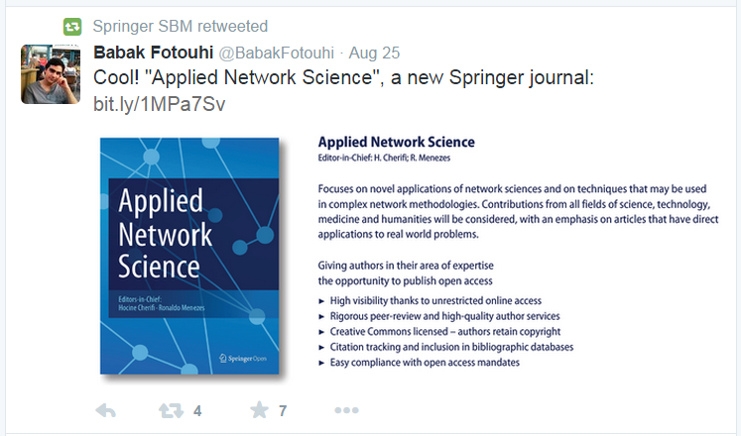


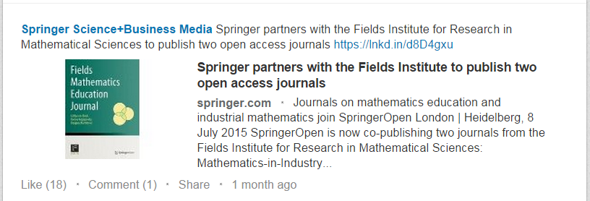


Online promotion
Use social networks to promote your
journal and articles!
Twitter
Actively participate in topical discussions
Facebook
Notes:
Lastly, don’t be afraid of using social media to promote your journal and articles online. Most publishers and reputable journals are already doing this, so should you!
You can use Facebook, Twitter, or LinkedIn. Please keep in mind Facebook and Twitter are banned in certain countries like China. So if you think your journal may be of particular interest there, you may also consider Chinese social networks like Weibo to promote your journal.
However, please always remember to link back to you journal and/or the article in your posts!
Particularly on Twitter and LinkedIn, there may be discussions about currently hot topics in the field. Be sure to actively participate in these discussions. This is another useful way to build your credibility and reputation in the field.

Slide 55
Reaching your goals
Reputable source of high impact research
Strong editorial vision
Positive author and reviewer experience
Improved visibility
Indexed in Web of Science with a good impact factor
Result
Notes:
In the end, please remember your goal—to be a reputable source of high impact research in the field.
To do this, you need to have a strong editorial vision, positive author and reviewer experiences, and improve the visibility of your journal worldwide. If you follow my advice today to do this, the end result will be that your journal will be widely indexed, receive more citations, have a higher impact factor, and importantly have more impact in the field.

Slide 56
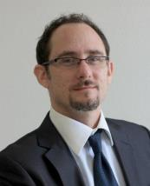
Any questions?
Break
Dr. Jeffrey Robens
Editorial Development Manager
jeffrey.robens@springer.com
Notes:
Thank you very much for your time and attention today, and I would now like to take any questions that you might have.
Okay, thank you again everyone, and I would like to wish you the best of luck!

Slide 57
Case study of new journal from Tunisia
Courtesy of Nabil Khelifi
Notes:
Now that we have talked about what journal editors are looking for and how to effectively communicate your ideas in English, let’s now discuss choosing the right journal for your study.

Slide 58
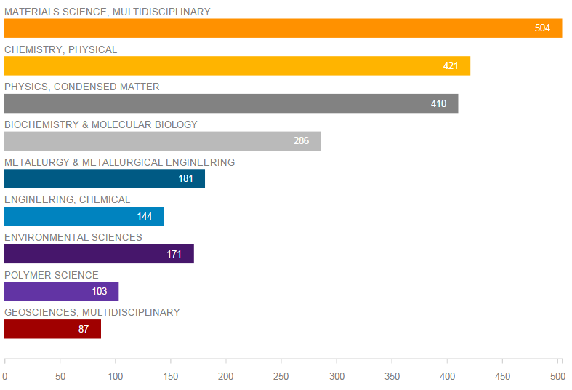
Establish fields of expertise
Source: Web of Science (2000–2015)

Slide 59
Identify clear title and focus
Tunisian Journal of Environmental Research
Environmental Research Journal of the University of Sfax
Good title and focus?
No!
Notes:
However, your goal should not only to be published, but also to be widely read in your field. It is in this way that you have impact and influence the advancement of your field. When your papers have more impact, they will be more highly cited. You will build your reputation worldwide, and that of your institution and Kazakhstan. You will establish new international collaborations. All of which will help you advance your career. To do this, you need to be more than just an author, you need to be an effective communicator. That means you ensure that all the information your readers are looking for can be found and understood quickly and efficiently. This is really the focus of my talk today.
Today, we will first discuss what you need to know about academic publishing to achieve your publication goals.
We will then discuss how to effectively communicate your ideas clearly in English.
Then we will discuss how to choose the most appropriate journal for your manuscript.
Finally, we then discuss how to logically organize your ideas in both your manuscript and cover letter.

Slide 60
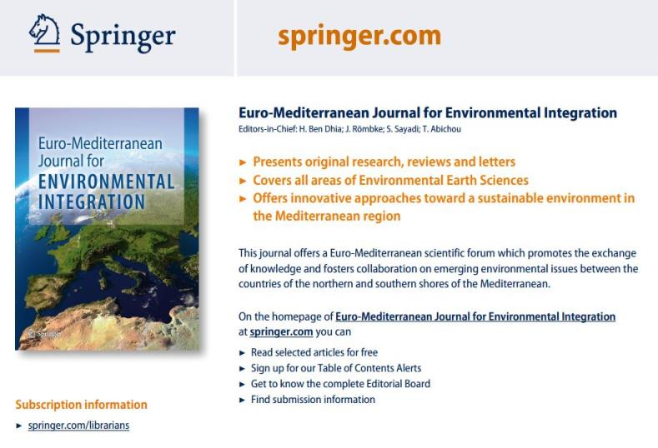
Identify clear title and aims and scope
New, unique & relevant title
Novelty?
Clear & focused
aims & scope
Notes:
However, your goal should not only to be published, but also to be widely read in your field. It is in this way that you have impact and influence the advancement of your field. When your papers have more impact, they will be more highly cited. You will build your reputation worldwide, and that of your institution and Kazakhstan. You will establish new international collaborations. All of which will help you advance your career. To do this, you need to be more than just an author, you need to be an effective communicator. That means you ensure that all the information your readers are looking for can be found and understood quickly and efficiently. This is really the focus of my talk today.
Today, we will first discuss what you need to know about academic publishing to achieve your publication goals.
We will then discuss how to effectively communicate your ideas clearly in English.
Then we will discuss how to choose the most appropriate journal for your manuscript.
Finally, we then discuss how to logically organize your ideas in both your manuscript and cover letter.

Slide 61
Novelty
  The first journal that aims to launch a (North/South) Euro-Mediterranean scientific forum to promote the exchange of knowledge and to foster collaborations between the countries of the northern and southern shores of the Mediterranean regarding emerging environmental issues...

Slide 62
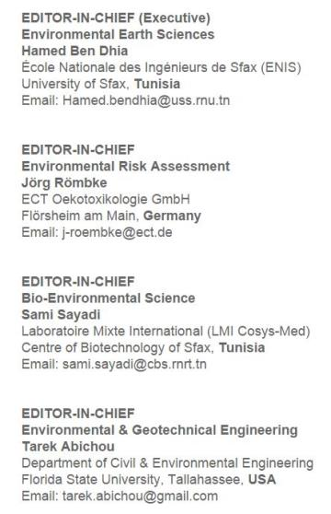
Appropriate Editor(s)-in-Chief
Four major subject areas

Slide 63
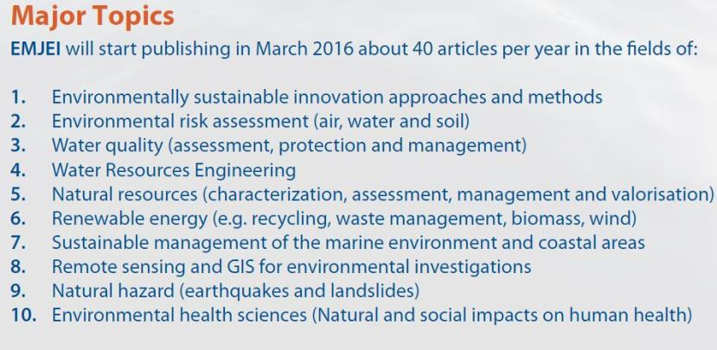
Identify specific topics for the journal

Slide 64
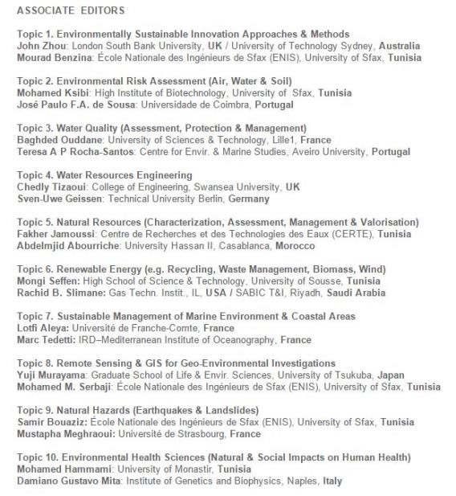
Associate Editors
2 for each topic
1 from northern shore that handles submissions from the south
1 from southern shore that handles submissions from the north

Slide 65
Establishing a successful journal
Identify a suitable topic that adds value to the field
Develop a strategic aims and scope about that topic
Identify specialized experts for each sub-topic
Establish an efficient editorial workflow
Funds for sponsored open access

Slide 66
Review of Kazakh Journals
Notes:
Now that we have talked about what journal editors are looking for and how to effectively communicate your ideas in English, let’s now discuss choosing the right journal for your study.

Slide 67
Brief review of Kazakh journals
Editorial vision
Editorial workflow
Author experience
Publication quality and consistency
Notes:
In the end, please remember your goal—to be a reputable source of high impact research in the field.
To do this, you need to have a strong editorial vision, positive author and reviewer experiences, and improve the visibility of your journal worldwide. If you follow my advice today to do this, the end result will be that your journal will be widely indexed, receive more citations, have a higher impact factor, and importantly have more impact in the field.

Slide 68
Brief review of Kazakh journals
Editorial vision
Editorial workflow
Author experience
Publication quality and consistency
Notes:
In the end, please remember your goal—to be a reputable source of high impact research in the field.
To do this, you need to have a strong editorial vision, positive author and reviewer experiences, and improve the visibility of your journal worldwide. If you follow my advice today to do this, the end result will be that your journal will be widely indexed, receive more citations, have a higher impact factor, and importantly have more impact in the field.

Slide 69
Editorial vision
Novel and unique title
Concise and clear aims and scope
Notes:
In the end, please remember your goal—to be a reputable source of high impact research in the field.
To do this, you need to have a strong editorial vision, positive author and reviewer experiences, and improve the visibility of your journal worldwide. If you follow my advice today to do this, the end result will be that your journal will be widely indexed, receive more citations, have a higher impact factor, and importantly have more impact in the field.

Slide 70
Editorial vision
The Central Asian Journal of Global Health
Central Asian Journal of Global Health is a biannual journal aimed at everybody working in the fields of public health and medicine. Specifically, it aims to focus on the geographic region that is oftentimes not sufficiently highlighted by existing journals, Central Asian countries. In addition to research in Central Asia, the journal will be opened to submissions from other countries. In addition to the highest-quality reviews and perspectives covering the field of health in Central Asia, each issue will include news stories and investigate hottest topics and new research practices in the field of public health.
Notes:
In the end, please remember your goal—to be a reputable source of high impact research in the field.
To do this, you need to have a strong editorial vision, positive author and reviewer experiences, and improve the visibility of your journal worldwide. If you follow my advice today to do this, the end result will be that your journal will be widely indexed, receive more citations, have a higher impact factor, and importantly have more impact in the field.

Slide 71
Editorial vision
The Central Asian Journal of Global Health
Regional journal (Central Asia)
Relationship to global health unclear
Which aspect of global health?
Title
Concise, easy to understand
Which aspect of global health?
Specific topics of interest?
Open to other countries? Only those related to Central Asia?
Aims and scope
Notes:
In the end, please remember your goal—to be a reputable source of high impact research in the field.
To do this, you need to have a strong editorial vision, positive author and reviewer experiences, and improve the visibility of your journal worldwide. If you follow my advice today to do this, the end result will be that your journal will be widely indexed, receive more citations, have a higher impact factor, and importantly have more impact in the field.

Slide 72
Editorial vision
Kafu Academic Journal
The journal is published once in a year and each issue includes the following headings (all articles are published in English):
1) Education and Training. Topics of articles in the section cover general issues of education, electronic technologies in education, pedagogy and teaching methods, psychological aspects of education, education in schools, education and health, education and environment, etc.;
2) Problems of Linguistics and Intercultural Communication. Topics of articles in the section cover the methodology of language teaching, interactions of languages, culture, society, world literature and practice of translation, the history of languages, general philology, etc.;
Cont.
Notes:
In the end, please remember your goal—to be a reputable source of high impact research in the field.
To do this, you need to have a strong editorial vision, positive author and reviewer experiences, and improve the visibility of your journal worldwide. If you follow my advice today to do this, the end result will be that your journal will be widely indexed, receive more citations, have a higher impact factor, and importantly have more impact in the field.

Slide 73
Editorial vision
Kafu Academic Journal
3) Problems of legislation. Topics of articles in the section cover civil and family law, administrative law and public administration, criminal and criminal procedural law, international law and foreign countries, labor and tax law, and other aspects of political and legal problems;
4) Business administration and society development. Topics of articles in the section cover issues of management and marketing, quality management system, crisis management, finance and taxes, general economics, sociology and social psychology, and other aspects of social and economic, environment, and health issues;
According to international standards in publishing, the articles, published in the journal, recommended for publication, consist of theses and research results of PhD students, candidates of different levels, and scientists, residing outside the United States.
Notes:
In the end, please remember your goal—to be a reputable source of high impact research in the field.
To do this, you need to have a strong editorial vision, positive author and reviewer experiences, and improve the visibility of your journal worldwide. If you follow my advice today to do this, the end result will be that your journal will be widely indexed, receive more citations, have a higher impact factor, and importantly have more impact in the field.

Slide 74
Editorial vision
Kafu Academic Journal
Title
Unrelated to aims and scope
Too broad, unclear
Concise, easy to understand
Clearly lists specific topics
Unclear about underlying focus
Covers unrelated areas
Only directed at students?
Aims and scope
Notes:
In the end, please remember your goal—to be a reputable source of high impact research in the field.
To do this, you need to have a strong editorial vision, positive author and reviewer experiences, and improve the visibility of your journal worldwide. If you follow my advice today to do this, the end result will be that your journal will be widely indexed, receive more citations, have a higher impact factor, and importantly have more impact in the field.

Slide 75
Editorial vision
Journal of Central Asian Health Services Research
Journal of Central Asian Health Services Research (JCAHSR) is an interdisciplinary journal that promotes systems thinking and provides a single forum for researchers and practitioners of public health, health care services and management to exchange ideas and elucidate important developments. The aim is to disseminate knowledge rapidly across traditional disciplinary boundaries.
JCAHSR will publish high quality papers in the areas of theory, applications, novel ideas, and new tools for investigating and producing solutions to complex public health and health care management problems. Contributions from a wide range of international perspectives are welcome.
Cont.
Notes:
In the end, please remember your goal—to be a reputable source of high impact research in the field.
To do this, you need to have a strong editorial vision, positive author and reviewer experiences, and improve the visibility of your journal worldwide. If you follow my advice today to do this, the end result will be that your journal will be widely indexed, receive more citations, have a higher impact factor, and importantly have more impact in the field.

Slide 76
Editorial vision
Journal of Central Asian Health Services Research
Examples of applicable interdisciplinary areas include: environmental and occupational health, health promotion and education, productivity analysis and operations analysis in health care, health information systems, health care financial management, strategic management in health care, managed care, health care economics, forecasting, simulation, data measurement, cost containment, international comparisons, risk and uncertainty, health insurance systems applications, epidemiology and biostatistical and econometric analysis in health care.
JCAHSR publishes work from a variety of disciplinary perspectives and institutional settings. The only two criteria for inclusion are: a rigorous scientific approach towards a health care problem; and a concern with the policy implications of the work. The journal therefore offers researchers, managers and policy makers a unique perspective on leading developments in scientific health care management.
Notes:
In the end, please remember your goal—to be a reputable source of high impact research in the field.
To do this, you need to have a strong editorial vision, positive author and reviewer experiences, and improve the visibility of your journal worldwide. If you follow my advice today to do this, the end result will be that your journal will be widely indexed, receive more citations, have a higher impact factor, and importantly have more impact in the field.

Slide 77
Editorial vision
Journal of Central Asian Health Services Research
Title
Clear and unique
Regional journal
Not concise, Central Asia not mentioned
Lists important information
  Interdisciplinary
  Specific topics & interdisciplinary research
  Specific authorship & readership
Aims and scope
Notes:
In the end, please remember your goal—to be a reputable source of high impact research in the field.
To do this, you need to have a strong editorial vision, positive author and reviewer experiences, and improve the visibility of your journal worldwide. If you follow my advice today to do this, the end result will be that your journal will be widely indexed, receive more citations, have a higher impact factor, and importantly have more impact in the field.

Slide 78
Editorial vision
International Student’s Journal of Medicine
A quarterly international peer-reviewed open access journal for medical students and young doctors. It publishes original research papers, reviews, case reports, interviews and editorials, that are up to high quality and priority standards. The journal was founded in 2014 by its sponsor, Asfendiyarov Kazakh National Medical University, Almaty, Kazakhstan. Undergraduate and postgraduate students, interns, residents of medical and pharmaceutical universities and young scientists are welcome to submit their best works. All items are subject to internal and external review and quality control. There are no processing and publication charges for authors. The main objective of the journal is to provide a medium of communication for medical students who wish to present their best works to the global scientific community.
Notes:
In the end, please remember your goal—to be a reputable source of high impact research in the field.
To do this, you need to have a strong editorial vision, positive author and reviewer experiences, and improve the visibility of your journal worldwide. If you follow my advice today to do this, the end result will be that your journal will be widely indexed, receive more citations, have a higher impact factor, and importantly have more impact in the field.

Slide 79
Editorial vision
International Student’s Journal of Medicine
Student’s journal?
International journal? Editors & most editorial board from Kazakhstan
Title
Very broad, no specific topics
Appears like a repository, an outlet for student’s to publish their papers
Aims and scope
Notes:
In the end, please remember your goal—to be a reputable source of high impact research in the field.
To do this, you need to have a strong editorial vision, positive author and reviewer experiences, and improve the visibility of your journal worldwide. If you follow my advice today to do this, the end result will be that your journal will be widely indexed, receive more citations, have a higher impact factor, and importantly have more impact in the field.

Slide 80
Editorial vision
International Journal of Mathematics and Physics
The most significant scientific achievements are attained through joint efforts of different sciences, mathematics and physics are among them. Therefore publication of the Journal, which shows results of current investigations in the field of mathematics and physics, will allow wider exhibition of scientific problems, tasks and discoveries.
One of the basic goals of the Journal is to promote extensive exchange of information between scientists from all over the world. We propose publishing service for original papers and materials of Mathematical and Physical Conferences (by selection) held in different countries and in the Republic of Kazakhstan. We are glad to publish papers of scientists from all the continents
Cont.
Notes:
In the end, please remember your goal—to be a reputable source of high impact research in the field.
To do this, you need to have a strong editorial vision, positive author and reviewer experiences, and improve the visibility of your journal worldwide. If you follow my advice today to do this, the end result will be that your journal will be widely indexed, receive more citations, have a higher impact factor, and importantly have more impact in the field.

Slide 81
Editorial vision
International Journal of Mathematics and Physics
.
The Journal will publish experimental and theoretical investigations on Mathematics, Physical Technology and Physics. Among the subject emphasized are modern problems of Calculus Mathematics, Algebra and Mathematical Analysis, Differential Equations and Mechanics, Informatics and Mathematical Modeling, Calculus of Approximations and Program Systems, Astronomy and Space Research, Theoretical Physics and Plasma Physics, Chemical Physics and Radio Physics, Thermophysics, Nuclear Physics and Nanotechnology.
Notes:
In the end, please remember your goal—to be a reputable source of high impact research in the field.
To do this, you need to have a strong editorial vision, positive author and reviewer experiences, and improve the visibility of your journal worldwide. If you follow my advice today to do this, the end result will be that your journal will be widely indexed, receive more citations, have a higher impact factor, and importantly have more impact in the field.

Slide 82
Editorial vision
International Journal of Mathematics and Physics
International journal? Publications are in Russian
Too broad, unclear
Title
Not concise, contains unnecessary words and information
Interdisciplinary?
Lists specific topics within physics or mathematics
Aims and scope
Notes:
In the end, please remember your goal—to be a reputable source of high impact research in the field.
To do this, you need to have a strong editorial vision, positive author and reviewer experiences, and improve the visibility of your journal worldwide. If you follow my advice today to do this, the end result will be that your journal will be widely indexed, receive more citations, have a higher impact factor, and importantly have more impact in the field.

Slide 83
Editorial vision
International Journal of Biology & Chemistry
The most significant achievements of the modern science are joined by different sciences among them are chemistry and biology. Therefore publication of the Journal, which is showing results of current investigation in the field of chemistry and biology, will allow widely exhibiting scientific problems, tasks and discoveries.
One of the basic goals of the Journal is to promote extensive exchange of information between scientists from all over the world. We propose publishing service for original papers and materials of Chemical and Biological Conference (by selection) held in different countries and in the Republic of Kazkahstan.
Creation of the special International Journal of Biology and Chemistry is of great importance because a vast amount of scientists are willing to publish their articles and it will help to widen the geography of future dissemination. We will also be glad to publish papers of scientists from all the continents.
Cont.
Notes:
In the end, please remember your goal—to be a reputable source of high impact research in the field.
To do this, you need to have a strong editorial vision, positive author and reviewer experiences, and improve the visibility of your journal worldwide. If you follow my advice today to do this, the end result will be that your journal will be widely indexed, receive more citations, have a higher impact factor, and importantly have more impact in the field.

Slide 84
Editorial vision
International Journal of Biology & Chemistry
The Journal will publishes experimental and theoretical investigation of Chemistry, Chemistry Technology and Biology. Among the subject emphasized are modern problems of organic synthesis technologies; scientific basis of the production of physiologically active preparation; modern problems of the processing technologies of raw materials, production of new materials and technologies; investigation of chemical and physical properties and structures of oil and coal; theoretical and practical problems of hydrocarbons processing; the modern achievement in the field of nanotechnology; results of investigations in biology, biotechnology, nano-biology, genetics and etc.
The Journal is issued on the base of al-Farabi Kazakh National University. Leading scientists from different countries of the world agreed to join the Editorial Board of the Journal.
The Journal publishes two times a year by al-Farabi Kazakh National University. We hope to receive papers from many laboratories which are interested in application of the scientific principles of chemistry and biology and are carrying out researchers on such subjects as production of new material or technology and ecology problems.
Notes:
In the end, please remember your goal—to be a reputable source of high impact research in the field.
To do this, you need to have a strong editorial vision, positive author and reviewer experiences, and improve the visibility of your journal worldwide. If you follow my advice today to do this, the end result will be that your journal will be widely indexed, receive more citations, have a higher impact factor, and importantly have more impact in the field.

Slide 85
Editorial vision
International Journal of Biology & Chemistry
International journal? Publications are in Russian
Too broad, unclear
Title
Not concise, contains unnecessary words and information
Interdisciplinary?
Lists specific topics within biology or chemistry
Aims and scope
Notes:
In the end, please remember your goal—to be a reputable source of high impact research in the field.
To do this, you need to have a strong editorial vision, positive author and reviewer experiences, and improve the visibility of your journal worldwide. If you follow my advice today to do this, the end result will be that your journal will be widely indexed, receive more citations, have a higher impact factor, and importantly have more impact in the field.

Slide 86
Editorial vision
Industrial Technology and Engineering
Scientific journal “Industrial Technology and Engineering” is scientific edition and publishes actual themes (Theoretical Fundamentals of industrial technology, Chemical technology and nanotechnologies, Complex processing of natural and technogenic raw materials, Biotechnology, Engineering of environmental health protection, Engineering and commercialization of technologies). The journal was founded in 2011. The purpose of our journal is to develop academic and scientific cooperation, dissemination of modern scientific knowledge, professional communication between students, candidates for Master’s degree, doctoral students – PhD and young scientists.
Notes:
In the end, please remember your goal—to be a reputable source of high impact research in the field.
To do this, you need to have a strong editorial vision, positive author and reviewer experiences, and improve the visibility of your journal worldwide. If you follow my advice today to do this, the end result will be that your journal will be widely indexed, receive more citations, have a higher impact factor, and importantly have more impact in the field.

Slide 87
Editorial vision
Industrial Technology and Engineering
Title
Clear and descriptive
Applied research for industry
Concise and easy to understand
Lists specific topics of interest
Only directed at students?
Aims and scope
Notes:
In the end, please remember your goal—to be a reputable source of high impact research in the field.
To do this, you need to have a strong editorial vision, positive author and reviewer experiences, and improve the visibility of your journal worldwide. If you follow my advice today to do this, the end result will be that your journal will be widely indexed, receive more citations, have a higher impact factor, and importantly have more impact in the field.

Slide 88
Editorial vision
Herald of the Kazakh-British Technical University
The Scientific Journal "Herald of the Kazakh-British Technical University" is an international, peer-reviewed journal covering the research areas of Oil and gas engineering; Chemical, technological and environmental sciences; Physical, mathematical, and technical sciences; Economics and social sciences.
The Journal publishes reviews and full research articles. All submitted manuscripts are peer-reviewed by the members of the Editorial Board.
The International Journal "Herald of the Kazakh-British Technical University" was included in the list of publications for the purpose of publishing the results of doctoral and master's theses in the following specialty groups: Chemical Sciences, Engineering Sciences, and Earth Sciences.
Notes:
In the end, please remember your goal—to be a reputable source of high impact research in the field.
To do this, you need to have a strong editorial vision, positive author and reviewer experiences, and improve the visibility of your journal worldwide. If you follow my advice today to do this, the end result will be that your journal will be widely indexed, receive more citations, have a higher impact factor, and importantly have more impact in the field.

Slide 89
Editorial vision
Herald of the Kazakh-British Technical University
Title
Appears to be institutional journal
Herald used for news, not research
Too broad
No specific topics
Appears to publish student’s theses rather than academic articles
Aims and scope
Notes:
In the end, please remember your goal—to be a reputable source of high impact research in the field.
To do this, you need to have a strong editorial vision, positive author and reviewer experiences, and improve the visibility of your journal worldwide. If you follow my advice today to do this, the end result will be that your journal will be widely indexed, receive more citations, have a higher impact factor, and importantly have more impact in the field.

Slide 90
Editorial vision
Eurasian Mathematical Journal
Eurasian Mathematical Journal publishes carefully selected original re­search papers in all areas of mathematics written by mathematicians first of all from Europe and Asia. However papers by mathematicians from other continents are also welcome. From time to time Eurasian Mathematical Journal will also publish survey papers.
Subscription-based journal, but articles appear to be freely available as PDFs.
Notes:
In the end, please remember your goal—to be a reputable source of high impact research in the field.
To do this, you need to have a strong editorial vision, positive author and reviewer experiences, and improve the visibility of your journal worldwide. If you follow my advice today to do this, the end result will be that your journal will be widely indexed, receive more citations, have a higher impact factor, and importantly have more impact in the field.

Slide 91
Editorial vision
Eurasian Mathematical Journal
Title
Clear and distinct
Regional journal
Does not state which topics within mathematics
States regional journal, but accepts from other regions
No Asian editorial board members
Aims and scope
Notes:
In the end, please remember your goal—to be a reputable source of high impact research in the field.
To do this, you need to have a strong editorial vision, positive author and reviewer experiences, and improve the visibility of your journal worldwide. If you follow my advice today to do this, the end result will be that your journal will be widely indexed, receive more citations, have a higher impact factor, and importantly have more impact in the field.

Slide 92
Editorial vision
Eurasian Chemico-Technological Journal
The Eurasian Chemico-Technological Journal is an international, peer-reviewed journal covering all branches of chemistry and chemical technology. The Journal articles are included to Scopus - largest abstract and citation database containing both peer-reviewed research literature and quality web sources. The Journal particularly welcomes papers on new materials and chemical technologies, modern problems of organic synthesis, physical chemistry and chemical physics, solid state and soft matter research, electro-, photo-, radiation- and plasma-chemistry, colloids and nanotechnology, catalysis and surface science, polymers.
The Journal publishes reviews and full research articles. We also welcome contributions based on the research presented at the conferences held in Europe and Asia. All submitted manuscripts are peer-reviewed by the members of the Editorial Board and international referees.
Notes:
In the end, please remember your goal—to be a reputable source of high impact research in the field.
To do this, you need to have a strong editorial vision, positive author and reviewer experiences, and improve the visibility of your journal worldwide. If you follow my advice today to do this, the end result will be that your journal will be widely indexed, receive more citations, have a higher impact factor, and importantly have more impact in the field.

Slide 93
Editorial vision
Eurasian Chemico-Technological Journal
Title
Clear and descriptive
Regional applied science journal
States international journal?
Lists specific topics within chemical technologies
International editorial board, may wish to distinguish what “Eurasian” refers to
Aims and scope
Notes:
In the end, please remember your goal—to be a reputable source of high impact research in the field.
To do this, you need to have a strong editorial vision, positive author and reviewer experiences, and improve the visibility of your journal worldwide. If you follow my advice today to do this, the end result will be that your journal will be widely indexed, receive more citations, have a higher impact factor, and importantly have more impact in the field.

Slide 94
Editorial vision
Journal of Clinical Medicine of Kazakhstan
Journal of Clinical Medicine of Kazakhstan (ISSN 1812-2892) is a multi-field dedicated peer-reviewed medical journal. The main thematic scope is the publication of materials on medical science and practice, education and public health. The Journal of Clinical medicine of Kazakhstan is designed to increase the depth of the object in these areas, with the ultimate aim of expanding knowledge of the subject. We encourage researchers for contributing and presenting manuscripts with online system www.clinmedkaz.org in English, Kazakh and Russian languages.
Cont.
Notes:
In the end, please remember your goal—to be a reputable source of high impact research in the field.
To do this, you need to have a strong editorial vision, positive author and reviewer experiences, and improve the visibility of your journal worldwide. If you follow my advice today to do this, the end result will be that your journal will be widely indexed, receive more citations, have a higher impact factor, and importantly have more impact in the field.

Slide 95
Editorial vision
Journal of Clinical Medicine of Kazakhstan
JSC “National Scientific Medical Research Center” publishes the journal quarterly (in January, April, July and October). The Journal of Clinical medicine of Kazakhstan encourages provision of material from authors all over the world. All articles sent to editors will undergo to double-blind peer review process. Manuscripts are judged by two experts exclusively on the basis of their contribution to initial data, ideas and their scientific fields. All articles should correspond with instruction for authors.
All of the submitted manuscripts are reviewed and published free of charge.
Following articles will be considered for publication: editorial articles, review articles, original articles, short communications, case reports, letters to the editor.
Notes:
In the end, please remember your goal—to be a reputable source of high impact research in the field.
To do this, you need to have a strong editorial vision, positive author and reviewer experiences, and improve the visibility of your journal worldwide. If you follow my advice today to do this, the end result will be that your journal will be widely indexed, receive more citations, have a higher impact factor, and importantly have more impact in the field.

Slide 96
Editorial vision
Journal of Clinical Medicine of Kazakhstan
Title
Clear and descriptive
Regional medical journal
Long, but thorough
Lists specific topics and article types
Encourages international submissions, which is not in line with title (published in Russian & Kazakh as well as English)
Aims and scope
Notes:
In the end, please remember your goal—to be a reputable source of high impact research in the field.
To do this, you need to have a strong editorial vision, positive author and reviewer experiences, and improve the visibility of your journal worldwide. If you follow my advice today to do this, the end result will be that your journal will be widely indexed, receive more citations, have a higher impact factor, and importantly have more impact in the field.

Slide 97
Editorial vision
Bulletin of Surgery in Kazakhstan
The "Bulletin of Surgery of Kazakhstan" journal is a forum for the exchange of scientific information in areas such as cardiosurgery, angiosurgery, abdominal surgery, oncology, urology, anaesthesiology-critical care medicine, otorhinolaryngology, traumatology, transplantation, microsurgery, plastic surgery.
The main goal of the journal is broad coverage of scientific achievements in the field of clinical and experimental medicine. The journal publishes articles that have scientific and practical value for a wide range of surgeons and covering different areas of this specialty.
The distinguishing feature of the journal is that it publishes not only clinical but also experimental studies, which subsequently can become the basis for the development of new methods of diagnosis and treatment of surgical diseases. The journal publishes full-length original articles, reviews, lectures, short reports, recommendations to practitioners, description of case studies, information on scientific forums.
Cont.
Notes:
In the end, please remember your goal—to be a reputable source of high impact research in the field.
To do this, you need to have a strong editorial vision, positive author and reviewer experiences, and improve the visibility of your journal worldwide. If you follow my advice today to do this, the end result will be that your journal will be widely indexed, receive more citations, have a higher impact factor, and importantly have more impact in the field.

Slide 98
Editorial vision
Bulletin of Surgery in Kazakhstan
Preference is given to research works containing new results of clinical and experimental studies in different areas of surgery. Editorial staff welcome the reviews, in which there is an analysis of contemporary international publications to assess the condition of the problem. Particular attention is given to reports of clinical cases that deserve interest of the international scientific medical community. For practitioners the journal publishes papers in which innovative methods of treatment patients, new technological developments are offered. The journal also analyzes international congresses and conferences with a summary of the most important messages.
Notes:
In the end, please remember your goal—to be a reputable source of high impact research in the field.
To do this, you need to have a strong editorial vision, positive author and reviewer experiences, and improve the visibility of your journal worldwide. If you follow my advice today to do this, the end result will be that your journal will be widely indexed, receive more citations, have a higher impact factor, and importantly have more impact in the field.

Slide 99
Editorial vision
Bulletin of Surgery in Kazakhstan
Title
Specific and clear
Too narrow in scope?
Not concise
Relevant information is split over two pages
Specific topics are highlighted
No mention of Kazakhstan
Aims and scope
Notes:
In the end, please remember your goal—to be a reputable source of high impact research in the field.
To do this, you need to have a strong editorial vision, positive author and reviewer experiences, and improve the visibility of your journal worldwide. If you follow my advice today to do this, the end result will be that your journal will be widely indexed, receive more citations, have a higher impact factor, and importantly have more impact in the field.

Slide 100
Editorial vision
Novel and unique title
Concise and clear aims and scope
Notes:
In the end, please remember your goal—to be a reputable source of high impact research in the field.
To do this, you need to have a strong editorial vision, positive author and reviewer experiences, and improve the visibility of your journal worldwide. If you follow my advice today to do this, the end result will be that your journal will be widely indexed, receive more citations, have a higher impact factor, and importantly have more impact in the field.

Slide 101
Any questions?
Thank you!
Dr. Jeffrey Robens
Editorial Development Manager
jeffrey.robens@springer.com
Notes:
Thank you very much for your time and attention today, and I would now like to take any questions that you might have.
Okay, thank you again everyone, and I would like to wish you the best of luck!

