Slide 1
Publishing scientific research in journals
Dr Jeffrey Robens
Editorial Development Manager
Download at: tinyurl.com/springer-kazakhstan2015
Notes:
Good morning everyone, how is everyone doing today?
First, I would like to thank the organizers for their kind invitation to be here today.
But I would also like to thank all of you for taking your time this morning to come to our seminars. We hope you will find the information presented today to be both useful and informative to achieve your publication goals.

Slide 2
Be an effective commiunicator
Your goal is not only to be published, but also to be widely read in your field
Academic publishing
Write effectively
How to choose an appropriate journal
Logically organize your ideas in your manuscript and cover letter
Notes:
However, your goal should not only to be published, but also to be widely read in your field. It is in this way that you have impact and influence the advancement of your field. When your papers have more impact, they will be more highly cited. You will build your reputation worldwide, and that of your institution and Kazakhstan. You will establish new international collaborations. All of which will help you advance your career. To do this, you need to be more than just an author, you need to be an effective communicator. That means you ensure that all the information your readers are looking for can be found and understood quickly and efficiently. This is really the focus of my talk today.
Today, we will first discuss what you need to know about academic publishing to achieve your publication goals.
We will then discuss how to effectively communicate your ideas clearly in English.
Then we will discuss how to choose the most appropriate journal for your manuscript.
Finally, we then discuss how to logically organize your ideas in both your manuscript and cover letter.

Slide 3
Academic publishing
Notes:
Let’s begin by discussing academic publishing.

Slide 4
Cycle of Academic Research
Researcher reads journals & books
Get published
Comes up with a research project
Publishing is essential in scientific research
Passes peer review
Gets funding
Writes article or books
Does research
Notes:
Publishing is an essential part of academic research. It is through reading published articles that researchers come up with new ideas and projects for their grant proposals. Getting funded is often dependent on how thoroughly you have evaluated the literature to identify an important and relevant problem in your field. Once you complete your research project, you will then write a book or article to share your novel findings with the field, which then directly feeds back into stimulating new hypotheses for research. In this way, publishing is essential in the advancement of science.
Of course, we not only publish to advance the field, but also to advance our careers. “Publish or perish” is often used to describe the importance of publishing to advance your career. Most universities and funding agencies will look at your publication record to measure your success in the field.

Slide 5
Publication success = academic success
Publication Metrics and Success on the Academic Job Market
van Dijk et al. Current Biology. 2014; 24: R516–R517.
>25,000 researchers in PubMed
Determined which factors positively correlated with academic success
Number of publications
Impact factor of the journal
Number of citations
University ranking
Gender
Notes:
In fact, it is has been shown that publication success is directly correlated with academic success.
In this paper published last year, the authors evaluated which factors were positively correlated with the academic success of over 25,000 researchers. They found 5 main factors:
The strongest factor was the number of publications the researchers published.
Next was the impact factor of the journals the researchers published in.
Third was the number of citations that the researchers received from their publications.
Fourth was the ranking of the university where the researcher did their research.
And finally fifth, I’m sorry to say, was gender. Men generally have an easier time advancing in their career as women.
But this emphasizes the importance of publishing, which accounts for the first three most important factors. So regardless of your gender or the ranking of your university, if you publish well, you will have greater academic success.
So how easy is it to get published? Not at all. You need to convince journal editors that your work is important. And to do that, you need to know what journal editors are looking for.

Slide 6
What do journal editors want?
High quality
research
Increase
impact
Original and novel research
Well-designed study
Transparent reporting
Useful for the field
Interesting to journal’s readership
Well-written manuscript
Notes:
So what do journal editors want? Not surprisingly, they are interested in high quality research. They understand that these are the types of articles that are widely read and have more impact in the field. These articles will then be more highly cited, improving both the visibility and the impact factor of the journal. And when journals have higher visibility and impact factors, that will increase the number of high quality submissions that the journal will receive. Then, the journal editor can be even more selective to ensure they are publishing high quality research. It is in this way that journal editors improve the visibility and status of their journal in the field, which is one of the main goals journal editors have.
So what do I mean by “high quality research”? Well, journal editors will often evaluate three key aspects about your study.
First, they want to ensure your study is original, novel, and is useful for the field. So others in your field can build on what you have done.
Second, they are interested in manuscripts describing well-designed studies and explain exactly what was done. Of course, these manuscripts need to be well-written to clearly communicate the authors’ ideas.
Lastly, journal editors understand that to have impact, your paper needs to be interesting to the journal’s readers.
So please keep these points in mind when preparing your manuscript to ensure this information can be clearly evaluated by the journal editor.
But in addition to these three key points, journal editors are also interested in one more thing: publication ethics.

Slide 7
Publication ethics
Do not plagiarize
Do not fabricate or falsify data
Authorship:
Study design, data analysis
Writing the manuscript
Final approval (responsible)
Declare conflicts of interest:
Financial
Personal
Notes:
Journal editors want to be sure that you have followed the ethical guidelines that are followed worldwide. If you have not, your paper will be rejected.
So you can cannot plagiarize, meaning that you cannot copy and paste published text into your manuscript. To avoid plagiarism, you need to do two things: (1) paraphrase the idea of that text and (2) cite the source of that idea.
Although you may be under pressure to publish, you cannot fabricate or falsify data. If journal editors or reviewers ever suspect that you have, they will ask to see the raw data to validate that figure.
Journal editors also want to ensure that everyone that is listed as an author on your manuscript, qualifies to be an author. For most journals, there are three criteria people need to satisfy to qualify as an author:
They should have participated in the design of the study or the analysis of the data
They should have helped write the manuscript or revise it for intellectual content
And they should have given final approval before submission, meaning they are willing to be responsible for all the published content.
It is only when someone satisfies these three criteria, can they be listed as an author.
Lastly, you will need to declare any conflicts of interest you might have, either financial or personal. A conflict of interest is anything that may bias your interpretation of the data. So if you are studying a new device, and the company that makes the device funded your study, you have to disclose this information to the journal editor.

Slide 8
Why publish in English?
International language
of academics
International impact
International reputation
Funding
Career advancement
Notes:
So there are a lot of things to consider then when publishing your work. So you may wonder, “Is it really necessary to publish in English? Isn’t it just easier to publish my work in my own language instead?”
Well, there are a number of reasons you should strongly consider publishing in English.
First, English is the international language of academics. So if you want to have international impact, you need to publish in English.
When you do this, you will build your reputation worldwide. You will establish new international collaborations and be invited to speak at international conferences.
An international publication record will also increase your chances of obtaining funding for your research.
All of this will help you advance in your career. So if you want to be successful in your field, you need to publish in English.
However, I understand that publishing in English is a challenge for many non-native English speaking authors. So in the next section, I will give you some advice on how to write more effectively in English.

Slide 9
Effective English
Notes:
Now, when I say “Effective English”, I’m not talking about spelling and grammar, Microsoft Word can help you with that!
I mean how to clearly communicate your ideas in English, improve your readability.

Slide 10
Improve readability
Use short sentences
Limit your sentences to 15–20 words
One idea per sentence
Use active voice
More simple, direct, and easier to read
Passive:
The models comparing the economic growth and diversification of Southeast Asia and Central Asia were evaluated.
Active:
We evaluated the models comparing the economic growth and diversification of Southeast Asia and Central Asia.
Notes:
There are two quick tips you can use to immediately improve the readability of your manuscript.
First is to use short sentences. Long sentences are difficult to read, often with too many ideas for the reader to remember. To be an effective communicator, use 15 to 20 words per sentence to communicate one idea.
The second tip is to use active voice. Sentences written in the active voice are simply easier and more direct to understand.
For example, let’s look at this passive voice sentence, “The models comparing the economic growth and diversification of Southeast Asia and Central Asia were evaluated.” Because this is in passive voice, the verb is placed at the end of the sentence. That means that the reader doesn’t know what the action is until they have already finished the sentence…and in many cases, will forget what the topic was! Then they’ll have to go back to the beginning to remind themselves what was being evaluated. Furthermore, because this is passive voice, the subject has been removed. Now the reader is left wondering, “Who evaluated these models? The authors? Or a different research group?” It is not clear.
To be an effective communicator, use active voice. “We evaluated the models comparing the economic growth and diversification of Southeast Asia and Central Asia.” Now at the very beginning of the sentence, the reader knows exactly what the action is and who is doing it. Much more direct and clear for the reader.

Slide 11
Use active voice
AMA Style
“In general, authors should use the active voice…”
APA Style
“Use the active voice rather than the passive voice…”.
Chicago Style Guide
“As a matter of style, passive voice is typically, but not always, inferior to active voice”.
ACS Style Guide
“Use the active voice when it is less wordy and more direct than the passive”.
SPE Style
“Use active voice. The use of active rather than passive voice produces clearer, more concise writing”
ASCE Style
“Wherever possible, use active verbs that demonstrate what is being done and who is doing it…”
IEEE
“Use active voice by default; research shows readers comprehend it more quickly than passive voice…”
Notes:
UNPRESENTED SLIDE
Note: I have many attendees argue that their field prefers passive voice. So I have accumulated a variety of different style guides from various fields in case someone asks me.

Slide 12
Sentence structure
Which sentence suggests that you
will get a raise?
You deserve a raise, but the budget is tight.
Stress position
The budget is tight, but you deserve a raise.
Readers focus at the end of the sentence to determine what is important.
http://writingcenter.unc.edu/handouts/flow/
Notes:
Another way to effectively communicate your ideas is to use sentence structure.
For example, I am going to show you two sentences, and I want to see if you can tell me which one suggests you will get a raise:
“You deserve a raise, but the budget is tight.”
“The budget is tight, but you deserve a raise.”
Who here thinks the first sentence suggests you will get a raise? Who here thinks it’s the second sentence?
Most people worldwide would think the second sentence. But why? If you look at these two sentences, you will see they contain the exact same words. The only difference is the order in which these words are presented.
This is called the stress position: readers focus at the end of the sentence to determine what is important.
Native English authors do this naturally. But as non-native English authors, you can use this as a valuable technique to emphasize what is important about your idea to your reader.

Slide 13
Logical flow of ideas
The stress position also introduces
the topic of the next sentence
The budget is tight, but you deserve a raise. Your salary will increase at the beginning of next year.
Stress position
Topic position
The topic position introduces the idea of the current sentence
Notes:
But the stress position doesn’t only emphasize what is important, it also helps to introduce the topic of the next sentence to the reader.
Let’s look at these two sentences. The first one is from the previous slide, “The budget is tight, but you deserve a raise.” The end of the sentence not only emphasizes what is important, but also introduces the topic of the next sentence about “your salary.”
The information given at the beginning of the sentence is called the topic position, and should introduce the topic of that sentence to the reader.

Slide 14
Logical flow of ideas
idea
idea
idea
idea
Topic link
TiO₂ surface modification of the scaffold considerably improved its catalytic efficiency. The increased efficiency was prominent early in the reaction but decreased over time. The lack of long-term effects of TiO₂ surface modification was likely due to the reaction being conducted in an aqueous environment. Evaluating additional solvents to improve the catalytic efficiency over time is currently being investigated.
Notes:
So if this oval is a sentence that is communicating a single idea, the beginning of the sentence not only introduces that idea to the reader, but should link back to previously given information. In this way, you can logically link all your ideas together in your writing to guide your readers through your ideas.
Let’s look at these 4 sentences here. In each case, I have highlighted the topic position in blue, which introduces the topic of that sentence. And I have highlighted the stress position in red. Not only does the stress position emphasize what is important about that idea, but in each case logically introduces the topic of the next sentence.

Slide 15
Logical flow within your manuscript
Topic sentence
Following early breakthrough reports on vacuum-deposited small molecule and solution-processed conjugated polymer organic light-emitting diodes (OLEDs),¹ tremendous progress has been made in commercializing smartphone, tablet, and television display products. OLED lighting offers additional challenges including very demanding efficiency requirements set by the ≈100 lm W^{–1} luminous power efficiency of fluorescent lamps. Vacuum-processed OLEDs have recently passed this 100 lm W^{–1} target,² thereby stimulating continued interest in large area lighting applications. However, vacuum processing at scale, especially where shadow-masked pixellation is required, remains challenging and costly. Strong and growing interest has consequently been shown in solution-based processes to address these limitations and achieve the ultimate potential of plastic electronics in large-area, low-cost, high-throughput device fabrication.
Realizing solution-processed multilayer OLEDs with efficiency comparable to vacuum-deposited devices remains extremely challenging,⁴ and Table 1 summarizes the performance of a selection of state-of-the-art devices fabricated using different approaches. We focus here…
Supporting sentences
Stress sentence
Topic sentence
Perumal et al. DOI: 10.1002/adma.201403914.
Notes:
But the topic and stress positions are not only useful for structuring your sentences, they are also useful for logically structuring your paragraphs as well.
Let’s look at these paragraphs here. The first sentence is called the topic position and introduces the topic of that paragraph to the reader, in this case about OLEDs. This is followed by supporting sentences to further develop this topic. The last, or concluding, sentence is the stress sentence. Like the stress position, it not only emphasizes what is important about this topic, in this case about the strong interest in solution-based processes for OLEDs, but also introduces the topic of the next paragraph, further discussing these solution-processed OLEDs.
So to be an effective communicator, use the topic and stress position to logically link your ideas throughout your manuscript.

Slide 16
Simple language
“I should use complex words to make my writing more impressive.”
Use simple language!
Your ideas and findings are already complex
Explain these complex ideas simply to your reader
“The definition of genius is taking the complex and making it simple.”
– Albert Einstein
Notes:
One of the most common misconceptions that non-native English authors have is thinking that they need to use complex words to make their writing sound more impressive.
That is not true!
Your ideas and findings are already complex. What makes you an effective communicator is being able to explain these complex ideas simply to your reader.
Even Albert Einstein preached this long ago, saying “The definition of genius is taking the complex and making it simple.”

Slide 17
Simple language
To ascertain the efficaciousness of the program, we interrogated the participants upon completion.
Notes:
Let’s look at an example.
“To ascertain the efficaciousness of the program, we interrogated the participants upon completion.”
This is nothing wrong with this sentence. It is grammatically correct. However, I am guarantee you that many readers worldwide will have no idea what I am trying to say because of these complicated words…

Slide 18
Simple language
To ascertain the efficaciousness of the program, we interrogated the participants upon completion.
To determine the success of the program, we questioned the participants upon completion.
Notes:
…shown in yellow.
I can more simply communicate this idea like this, “To determine the success of the program, we questioned the participants upon completion.” Now my idea can be more clearly understood worldwide.
When I say “simple language”, I do not mean elementary school English. I mean using the words that are commonly used in your field. To know the best words to describe your ideas, you need to read a lot in your field to be able to learn these words.

Slide 19
Simple language
ASCE Style
IEEE
http://pcs.ieee.org/communication-resources-for-engineers/style/write-clearly-and-concisely/
Notes:
UNPRESENTED SLIDE
Note: Some people from engineering and computer science have told me that this does not apply to them. So I have found these guidelines online specifically for these fields if attendees ask me about it.

Slide 20
Choose the right journal
Notes:
Now that we have talked about what journal editors are looking for and how to effectively communicate your ideas in English, let’s now discuss choosing the right journal for your study.

Slide 21
When to choose a journal?
After you have decided how much data you wish to publish
Short communication
Original research article
After you have decided how novel your findings are
High, medium, or low impact
After you have decided how broadly relevant your findings are
International vs. regional journal
Broadly or narrowly focused journal
Notes:
So when is the best time to choose a journal?
Well, you first need to decide how much data you want to publish. Do you have a small amount of data that you want to publish quickly? Then you will likely want to publish a short communication. However, if you have much more data and a more complete story, then an original research article is more appropriate. Different journals publish different article types, so this will be important to decide.
You will also need to determine how novel your findings are. The more novel your research is, you will be able to target a higher impact factor journal.
Lastly, you will need to decide who will benefit for your study, to whom are your findings relevant for? If your findings are very regional, it could be difficult to convince the journal editor of an international journal that their worldwide readership will be interested in your work–so a regional journal may be the best choice. Further, if you have very specialized findings, broad-focused journal editors may not think your work will be interesting to their journal’s broad readership–so a more specialized journal may be more appropriate. Remember, journal editors want to publish papers that are interesting to their journal’s readership.
So once you have evaluated these factors, it can help decide the type of a journal that may be best for your study–for example, a specialized regional journal that publishes brief communications. That helps to narrow down which journals you should be evaluating.

Slide 22
But always before you write your manuscript!
Author guidelines
Manuscript structure
Word limits
Reference style
Aims and scope
Topics
Readership
Be sure to emphasize
Relevant references
Writing style
Notes:
However, you should always choose a journal before you begin writing your manuscript! There are several important reasons for doing this.
First, you need to be familiar with the author guidelines. Each journal will format their articles in specific ways, so you need to know how to format your manuscript properly.
Check the manuscript structure that journal uses; for example, do they have a separate Results and Discussion sections? Or do they have a combined Results–Discussion section?
Check the limits that journal has on the number of words, figures, and references you can use in your manuscript.
Lastly, check the reference style that journal uses. I strongly encourage you to use reference management software, like Papers, to format your references; but if you do not, you need to know how to format your references properly for your target journal.
In addition to the author guidelines, you also need to be familiar with the aims and scope of the journal. Why? You have a lot of competition! You need to ensure that the journal editor thinks that your manuscript is more suitable for their journal than your competitors’. How do you do this? Well, in the aims and scope, journal editors will often emphasize which topics and readers that journal is interested in. You should mention these topics and these readers in your manuscript to help emphasize its suitability for the journal.
These are the two most important reasons to choose a journal first, but there are a couple more useful tips as well.
First, journal editors will often look at your reference list to see if you have cited articles published by their journal. Why? It again demonstrates suitability. If they see that you have cited recently published articles, it suggests that your work is building on research that journal has recently published, and therefore, your work is likely suitable to be published by their journal as well. So choose a journal first, identify 2 or 3 recently published articles and be sure to include them in your manuscript.
Lastly, although I discussed some general guidelines for writing well, some journal editors will have their own writing preferences. They may prefer active voice, but maybe they prefer third person over first person active voice. So instead of saying “We showed…”, they prefer you to say “This study showed…” Look at recently published articles in the journal and see if you may need to modify your writing style to suit the preferences of the journal editor. Again, this can help emphasize suitability for that journal.
So there are many reasons to choose a journal before you write your manuscript. And previously we discussed how to identify which type of journal will likely be best; such as a regional specialized journal that published short communications. So now it is time to start evaluating individual journals.

Slide 23
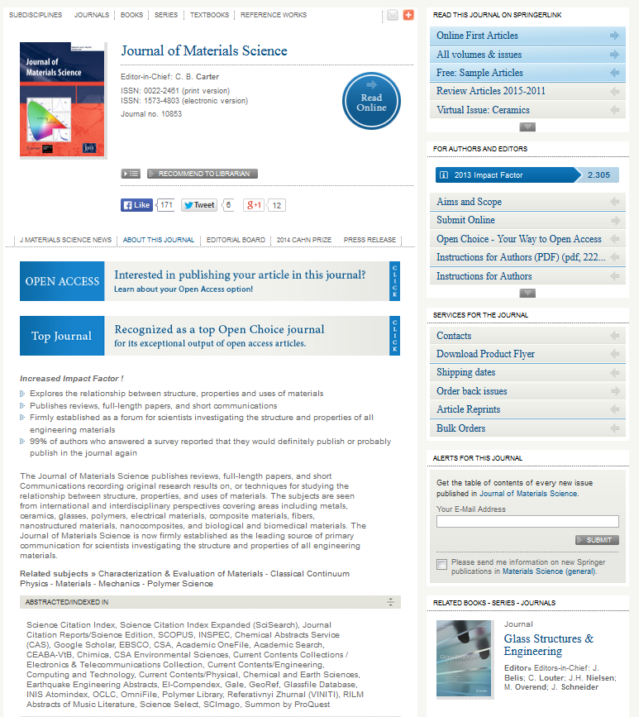
Factors to consider
Aims and scope
Readership
Indexing
Open access
Impact factor
Notes:
There are many different factors to consider, all of which will be accessible from the journal’s website.
First, the aims and scope. Be sure the journal published research similar to yours. But your goal is not only to be published, but also to be widely read.
So you need to also ensure your target audience makes up the readership of that journal. This information will often be included in the aims and scope as well.
To ensure that these readers can find your work, you need to make sure that the journal is indexed in the online databases these readers use to find articles. This will help improve the visibility of your research online.
In addition to improving visibility, you may also wish to improve the accessibility of your findings by publishing open access. That means, readers do not need to pay to read your article, it is publically available online.
Lastly, you may also wish to consider the impact factor of the journal and ensure it is suitable for the novelty of your findings.
In the next few slides, I would like to discuss open access and impact factor in a bit more detail.
Let’s first begin with open access.

Slide 24
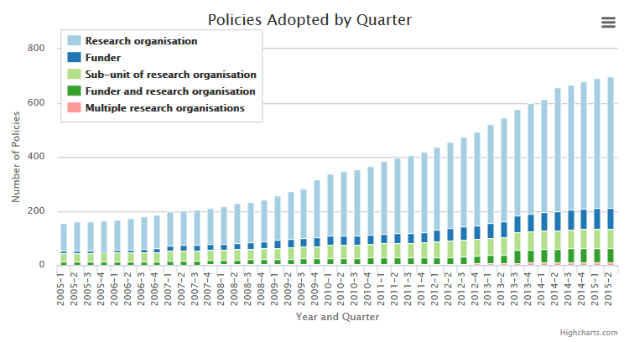
Open access to research output is becoming mandatory
The Registry of Open Access Repositories Mandatory Archiving Policies (ROARMAP) is a searchable international registry charting the growth of open access mandates adopted by universities, research institutions and research funders that require their researchers to provide open access to their peer-reviewed research article output by depositing it in an open access repository.
Source: http://roarmap.eprints.org/
Notes:
Worldwide, ensuring your work is open access is becoming more and more common, as shown here. Many research organizations and funding agencies are requiring their researchers to make their findings publically available. Although Kazakhstan currently does not have open access mandates, it may in the near future if it follows the worldwide trends–so this is something you should be aware of.

Slide 25
Benefits of open access
Increased accessibility
Researchers worldwide can download/read your paper
Government/industry¹
Emerging markets
Increased downloads
OA articles downloaded more often²
Social network advantage³
More impact in the field
Author retains copyright
Published immediately online
Less restrictions on word/figure limits (online only)
Davis PM. Faseb J. 2011; 25: 1–6.
http://www.nature.com/press_releases/ ncomms-report2014.pdf
Allen et al. PLoS ONE. 2013; 8: e68914
Notes:
But in addition to being forced to publish open access, you should actually want to publish open access anyway. There are many benefits to you!
First of all, your findings will be more accessible worldwide.
More people around the world will be able to download and read your article. The more people that read your work, the more impact it will have on the field.
It will also have broader reach as well. If your findings are useful for people outside of academia; for example, in government or industry, they may not have subscriptions to many journals. So publishing open access ensures that all readers be able to read about your study.
Lastly, remember that many universities in emerging markets do not have a lot money to buy subscriptions to all these academic journals. A common problem that researchers in countries like Vietnam or Indonesia have told me is that they often want to read about a study, but their university doesn’t have access. So if you want to have more impact worldwide, publishing open access is a great way to do so.
Publishing open access has also been shown to increase the number of downloads your article may have.
Not only are open access articles more often downloaded,
But they have a social network advantage. That means, if you share your article on social networks like Twitter, people around the world can immediately click on the link and read your article. This is a great way to promote your article worldwide after publication.
When more people are aware of the work you’ve done and they have increased access to that work, you will have more impact in the field and build your reputation and that of your institution and Kazakhstan.
Another advantage of open access is that the author, not the publisher, retains the copyright to the article.
Furthermore, because open access journals are published exclusively online, you often don’t have to wait for the next issue to be printed before your work is published, Instead, it will be available immediately online.
Lastly, because these journals are online only, they have often have much less restrictions on word and figure limits. These word and figure limits are originally meant to keep articles of a certain length so each printed issue is not so big. But when there are no printed issues, this is not a problem. So if you have a longer manuscript you would like to write, or have more figures that most printed journals will allow, open access may again be a good option.
So as you can see, there are many benefits to you to publish open access!

Slide 26
Springer’s open access platforms
345+ Journals
200+ Journals
Any Journal
Notes:
And at Springer, open access is our expertise! We publish hundreds of open access journals under BioMed Central or SpringerOpen. But for all the others that we publish, we offer open access options; which means that although it is a subscription journal, you can still pay to have your article published open access.
So if open access is such a great publishing model with so many opportunities available, why doesn’t everyone publish open access?
Well, one common reason is a common myth many people have…

Slide 27
Open access myths
The quality of OA journals is not good
OA journals have the same peer review process as subscription-based journals
IFs are lower partly because they are newer
Less visibility in the field
Fewer citations
Notes:
…and that is that open access journals are not good quality.
But that is simply not true. All reputable open access journals, such as all of those published by Springer, have the same rigorous peer review process as subscription journals.
So why are the impact factors often lower? Simply because the journals are newer. Many have only been established in the last few years, compared with the 50 or 100 years of many subscription journals.
Therefore, they are not as well known in the field…yet…
Which leads to fewer citations, and consequently a lower impact factor.
However, this trend is changing.

Slide 28
164 BMC journals have a 2013 IF
Notes:
For example, 164 journals published by BioMed Central have impact factors, many of which are very respectable in the field.
So as these journals become more visible and receive more citations, you will see the impact factors of open access journals increasing over time. I expect that in the next 10-15 years, many open access journals will have impact factors similar to those of their subscription journal counterparts.

Slide 29
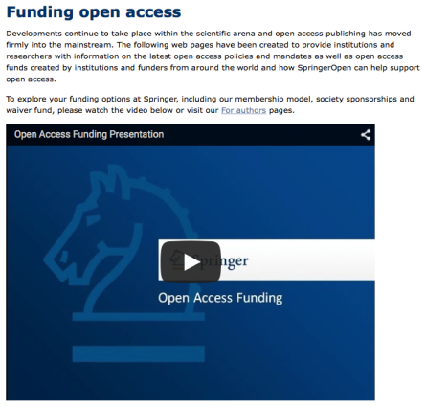
More about open access funding
http://www.springeropen.com/funding
Notes:
One common question authors often ask, however, is about funding–how to pay for the open access fees. There are many options available to authors worldwide, often using their grants or funding provided by their institutions. We don’t have time to go into a lot of detail today, but I strongly encourage you to visit this site to get more information on how pay for the open access fees, if there are any. Please keep in mind that not all open access journals charge publication fees!

Slide 30
Factors to consider
Aims and scope
Readership
Indexing
Open access
Impact factor
Notes:
Now that we have covered open access, I would now like to discuss impact factor in more detail for you.

Slide 31
Impact factor
What is it?
Average number of citations a journal has from articles published in the previous 2 years
Formula for the 2014 Impact Factor:
Number of citations in 2014 to items published in 2012 + 2013
------------------------------------------------------------------------------------
Articles and reviews published in 2012 + 2013
Example:
120 citations in 2014 (to items published 2012 or 2013)
------------------------------------------------------------------------------ = 1.5
80 articles and reviews published in 2012 and 2013
Notes:
So what is the impact factor?
Essentially it is the average number of citations a journal has from articles published in the previous 2 years.
How is this calculated? Well, the total number of citations to all published items in 2014 is divided by the total number of articles and reviews published in 2012 and 2013. As you can see, the type of items in the numerator and denominator are different…which leads to the quotient problem I’ll discuss a couple of slides later.
Also important to remember that impact factors are only generated for journals indexed by Thomson Reuter’s Journal Citation Reports (for example, SCI).

Slide 32
Impact factor
Is it important?
Higher IF may mean higher visibility
Frequent website visits
Emailed table of contents (eTOCs)
Often used as metric for success
Funding agencies
University committees
Notes:
So why is the impact factor important? A couple of reasons.
First, journals with higher impact factors are often more widely read in the field. People will visit those websites more often and may even receive the table of contents emailed to them when new issues are published. So publishing your paper in a higher impact factor journal may help increase the visibility of your work.
Second, impact factors are often used as a metric of success by both funding agencies and university committees. So publishing in higher impact factor journals, if it is suitable for the novelty of your findings, can help your careers.

Slide 33
Impact Factor
Is it the best or only option?
No!
Problems
Other options
Limited sample source
Quotient problem
Editorial influence
Self-citations
Field specific
Article Influence Score
SCImago Journal Rank
Source-Normalized Impact per Paper (SNIP)
H-index, Altmetrics
Notes:
Is this the best or only option to measure impact in the field? No!
First of all, there are several problems with the impact factor.
As mentioned earlier, impact factors are only generated for journals indexed in Web of Science; such as SCI, SSCI, and AHCI. So it is has a limited sample source.
I also mentioned the quotient problem earlier. Although citations from ALL items, including editorials or letters, are included in the numerator, only original and review articles are included in the denominator. Therefore, impact factors are subject to editorial influence. Review articles are cited more often, so if a journal starts to publish more reviews, that can increase the impact factor of the journal. Also, journal editors can change which items they wish to include in the denominator as well, which also influences the impact factor calculation.
Another problem with impact factors is that they include self-citations. So if a journal editor requires that all publications cite a certain number of articles from that journal, that will again influence that journal’s impact factor.
Lastly, citation frequencies change dramatically among fields, so you cannot compare impact factors from physics journals with those from biomedical journals.
Luckily, there are also other options to choose from.
The Article Influence Score from Eigenfactor is similar to the impact factor, but excludes self-citations and uses a much more complex algorithm to weigh the citations in the numerator. Citations in journals with higher prestige are weighed heavier than those in journals with lower prestige. This basically uses the same page rank algorithm Google uses to rank websites.
There is also SCImago Journal Rank that uses Scopus as a data source, and therefore includes many more journals than impact factor or Eigenfactor. Another big difference is the items in the numerator and denominator, which includes the same items—only those that are peer reviewed. This helps avoid the quotient problem. Lastly, like Eigenfactor, SJR uses a similar Google-like algorithm to weight citations based on the prestige of the citing journal.
Like SCR, Source-Normalized Impact per Paper is based on Scopus, so it also has a larger sample source. What is unique about SNIP is that it attempts to normalize citation frequency across fields, making it possible to compare journals from different fields.
Lastly, there are individual metrics as well, such as H-index, which attempts to measure a researcher’s productivity, and altmetrics, which attempts to measure impact of individual articles (as opposed to journals).

Slide 34
Journal metrics
 | Publication window | Citation window | Include self-citations? | Numerator | Denominator | Database
IF | 2 years | 1 year | Yes | All cited items | Articles, reviews | JCR
AIS | 5 years | 1 year | No | All cited items (weighted) | Articles, letters, reviews | JCR
SJR | 3 years | 1 year | <33% | Weighted cited peer reviewed articles | Peer reviewed articles | Scopus
SNIP | 3 years | 1 year | Yes | Cited peer reviewed articles | Field-normalized peer reviewed articles | Scopus
IF, Impact Factor; AIS, Article Influence Score (Eigenfactor); SJR, SCImago Journal Rank; SNIP, Source-Normalized Impact per Paper; JCR, Journal Citation Reports
Notes:
Here is a useful table comparing some of the commonly used journal metrics currently available with unique features highlighted in red.

Slide 35
Finding the right journal
How many journals are there?
Total journals
>40,000
Springer journals
>2500
Too many to choose from!
OA journals
10,586¹
SCI journals
8739²
DOAJ.org (accessed 29/5/15)
http://ip-science.thomsonreuters.com/cgi-bin/jrnlst/jlresults.cgi?PC=D (accessed 29/5/15)
Notes:
However, there is a problem. There are many journals available that you need to evaluate!
There are over 40,000 journals published across publishers worldwide in different fields.
Springer alone publishes over 2500 journals.
Open access journals? Over 10,000!
And if you even just wanted to look at journals indexed in SCI, you still have over 8700 journals.
How can you possibly determine which of these thousands of journals are right for you?

Slide 36
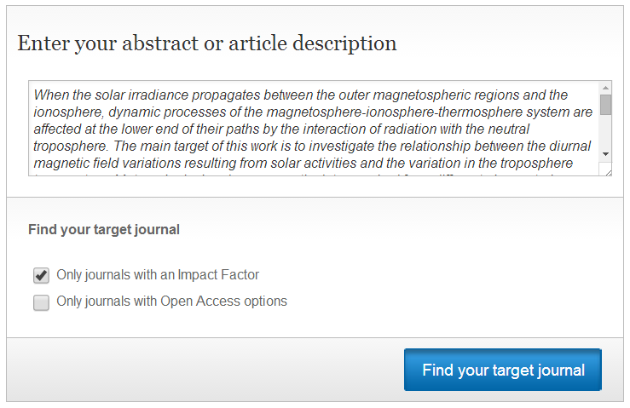
Springer Journal Selector
A free online tool to find suitable
journals for your manuscript
springer.com/gp/authors-editors/journal-author
Research summary
Notes:
Luckily, Springer offers a free online tool that you can use to quickly find the right journal.
Simply, you input a summary of your research into this text box, and then the Springer Journal Selector will match the key words with all the abstracts from our journals to determine which ones have published similar research.

Slide 37
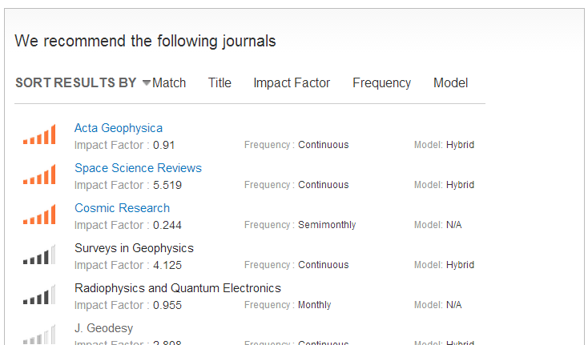
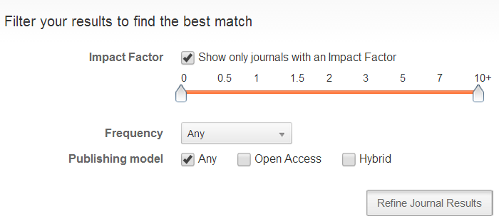
Springer Journal Selector
Recommended journals
Filter by:
Impact factor
Publishing frequency
Open access
Notes:
You will then get a list of potential journals, those highly recommended at the top and those less recommended at the bottom. You can even filter your results by impact factor, publishing frequency. and open access.
When you find a journal that looks appropriate for your findings, you simply click that link…

Slide 38
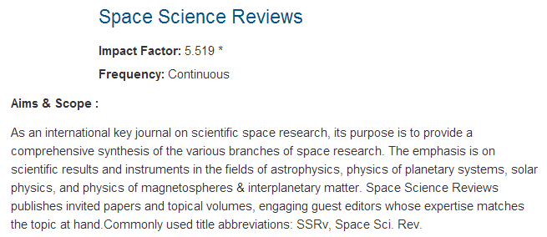
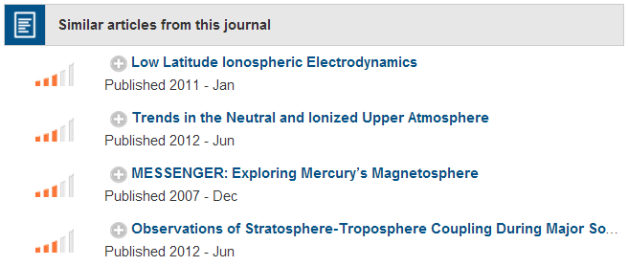
Springer Journal Selector
Journal’s aims & scope, IF,
and publication frequency
Published recently?
Cited in your paper?
Notes:
…and the Springer Journal Selector will quickly give you all the information you need to evaluate that journal; including the aims and scope, impact factor, and publication frequency.
But it will also tell you which articles were published in this journal similar to your research. Why is this important for you? For two reasons:
You need to ensure the journal is recently publishing this topic. Just because your research is within the broad aims and scope of the journal does not mean that the journal editor is currently interested in your topic. Maybe they were 5 or 10 years ago, but not now. So look at the dates of these published articles and ensure they have been published in the last couple years.
Secondly, I told you earlier that journal editors will often check if you have cited articles from their journal to help establish suitability. Well, this is a great place to find them! Choose 2 or 3 recently published articles and be sure to include them in your manuscript.
Once you have evaluated these factors, if you decide this journal is right for you, simply click on this link and it will bring you to the journal’s website where you can now carefully read the author guidelines before writing your manuscript, which is the topic of the next section.

Slide 39
Preparing your manuscript
Notes:
Now that we have chosen the most appropriate journal, and we have carefully read the author guidelines, we can now write our manuscript.

Slide 40
Logical organization of ideas
You need to answer 4 key questions for your readers:
Why did your study need to be done?
What did you do?
What did you find?
How will your study advance the field?
Introduction
Methods
Results
Discussion
Notes:
In your paper, readers expect you answer 4 key questions about your research:
Why your study needed to be done.
What you did.
What you found.
And how your study will contribute to the field.
Therefore, most manuscript are structured to logically answer these 4 questions, with Introduction, Methods, Results, and Discussion sections. While there are variations in manuscript structure across fields, they all address these 4 important questions in their own way.

Slide 41
Introduction
Why does your study need to be done？
Background information
Worldwide relevance?
Broad/specialized?
What is currently known
Up-to-date
International
Problem in the field
Aims
Specific aims
Notes:
The first question that your readers want answered is why your study needed to be done. This is generally answered in the Introduction section.
You should start off broad, and then guide your readers down to your specific aims.
You begin with the basic background information your readers need to understand the context of your study. Please keep in mind the type of journal you are submitting to! If you are submitting to an international journal, be sure to emphasize the worldwide relevance of your topic. Further, if you are submitting to a broad-focused journal, you will need to provide more background information so people outside your immediate field can more clearly understand the context of your research. However, if you are submitting to a specialized journal, you will not need to give so much background information because most of the journal’s readers will likely already be familiar with your topic.
Once you have provided context, you now need to tell your readers what is currently known about your topic. So you will need to discuss what has been recently published about this topic, making sure you cite studies that are up-to-date and broadly distributed worldwide. This is especially important if you are submitting to an international journal.
Once you have told your readers what is known about your topic, now you can tell them what is NOT known—this is the research problem that serves as the basis for your study.
This will then lead into your specific aims. Be sure that your aims directly address the research problem you identified. It is in this way that your readers will clearly understand why your study needs to be done.

Slide 42
Methods/Experimental
Study design
Who/what was used
Samples or participants
Materials
Where obtained
How it was done
General methods
Specific techniques
Discuss controls
How it was analyzed
Quantification methods
Models/equations
Statistical tests
Notes:
The next question you need to address is what you did—often answered in the Methods section.
Please keep in mind that this section is not only essential for reproducibility, but it is also one of the first sections carefully evaluated during peer review. If reviewers see that you did not use an appropriate and up-to-date methodologies, they will often usually recommend the journal editor reject the manuscript.
So be sure to include all the information your readers need to critically evaluate your study design.
First you will need to discuss who and what was used in your study.
You will then need to describe how you performed the experiments, including any controls necessary to validate these techniques.
Lastly, you need to describe how you analyzed your data—the quantification methods you used, if you used models and equations, you will need to define all variables and assumptions, and identify the statistical tests that you used to determine significance.
If you logically organize all the relevant information about your study design, you will have successfully answered the second key question.

Slide 43
Results
Initial observation
Characterization
Application
Logical presentation
Example:
Fabricate new membrane for water treatment
Evaluate physical and chemical properties (e.g., under different temperatures/pressures)
Efficacy in removing particulate contamination
Notes:
The third question your readers want answered is what you found. This is done in the Results section.
Keep in mind, however, that although you are very familiar with all of your findings, your readers are not. So if you do not logically present your findings, they can become easily confused.
For many fields, a nice logical presentation includes:
Your initial observation
Characterization of that observation
And finally how this observation is useful for the field, what is its application.
Let me give you an example.
Let’s say you fabricate a new membrane that can be used in wastewater treatment. Well, that is your initial observation, so those findings should be presented first.
But now your readers want more information about this membrane, they want you to characterize it for them in more detail. So you will then present your findings characterizing the physical and chemical properties of this membrane under different conditions.
Lastly, your readers want to know why this membrane is useful, what is its application? So you will then present findings comparing the efficacy of this membrane with those of other membranes.
In this way, you can logically guide your readers through your findings.

Slide 44
Results
Initial observation
Characterization
Application
Logical presentation
Each subsection corresponds to
one figure
Subsections
What you found, not what it means
Factual description
Notes:
In additional to logically presenting your findings, I also recommend that you write your Results in subsections, where each section corresponds to a single figure. This makes reading this section much easier. Furthermore, most readers when they first download your article will actually look at your figures first. Then, if they want more information about those figures, they will then refer to your Results section. So if you organize it in subsections, it makes it much easier for your readers to find the information they are looking for—making you a more effective communicator.
Lastly, please remember that if you have separate Results and Discussion section, you only want to factually describe what you found, not what those findings mean.
These interpretations belong in the next section…

Slide 45
Discussion
How your study contributes to the field
Summary of findings
Relevance
Similarities/differences
Unexpected/negative results
Limitations
Conclusion
Implications
Notes:
…the Discussion.
In this final section, you will answer the last key question—how your study contributes to the field.
I like to think of this section as the opposite of the Introduction. In the Introduction, you start broad, and then narrowly guide your readers down to your specific aims.
In the Discussion, you want to start narrow, summarizing your key findings, and then guide your readers back out to the general implications these findings have for the field.
To do this, you need to discuss the relevance of your findings.
You will have to describe how your findings are similar or different compared with those that have already been published.
You will have to discuss any unexpected or negative results. You should never hide results from your readers! Just be sure to describe why you think you observed these findings and how future research can further address them if necessary.
Lastly, be sure to describe any limitations in your study design. Your ability to identify your limitations and what measures were taken to control for them, establishes your expertise in the field. If you do not, peer reviewers, who are also experts in your field, will. And if they have to tell you what your limitations were, then their confidence in your credibility will decrease—and this may negatively influence their evaluation of your manuscript.
At the end of your Discussion, sometimes as a separate section, is the Conclusion. Please remember that this is the last section that will be read, meaning it is likely to be what is remembered most by your readers. Be sure to discuss what is most important about your study, including the main conclusion, key implications, and potential future directions.
If you logically organize your Discussion in this way, it will be clear for the reader how your study contributes to the field.

Slide 46
Linking your ideas
Answer the four key questions for your reader
Background information
Why this study
needs to be done
Current state of the field
Problems in the field
Objectives
What you did
Methodology
What you found
Results and figures
Summary of findings
How your study will advance the field
Relevance of findings
Implications for the field
Logically link your ideas throughout your manuscript
Notes:
In the end, you will have logically structured manuscript that answers the 4 key questions:
Why this study needs to be done
What you did
What you found
And how your study contributes to the field
But in addition to a nice linear flow of information, I strongly encourage you to link your ideas together throughout your manuscript. I already mentioned that your objectives should be directly related to the research problem. But this also means that your key findings should be only those that are related to your objectives. Finally, be sure that your conclusion answers the question you identified in the Introduction.
Think of your manuscript like a story. If you highlight an important problem in the beginning of your story, your readers expect an answer to that question by the time they finish. That answer is your conclusion. Linking your ideas together throughout your manuscript will help emphasize the significance and relevance of your study for your readers.

Slide 47
Abstracts
Concise summary of your paper
Background
Why the study was done
Aims
Your hypothesis
Methods
Techniques/analyses
Results
Most important findings
Conclusion
Conclusion/implications
Notes:
Up to now, I have only been discussing the main text, but we can’t forget one of the most important parts of your manuscript, the abstract!
The abstract will be the first impression readers have about your work, so you need to give the best first impression possible to encourage people to download and read your article.
How do you do this? Well, you need to provide the information necessary for them to evaluate those same key questions. That’s why your abstract is a summary of your paper.
You need to give background information so readers understand why the study needed to be done.
You need to state your aims to address an important research question.
You need to briefly describe your methodology to address your aims.
You need to highlight the key findings of your study. Please remember, that for many readers, this will be the only thing they read about your study. It’s not that they don’t want to read your article, they just don’t have time to read everything in the field! What they will do is read abstracts regularly to stay up-to-date in the field. Because of this, you need to make sure your key findings are clearly communicated in your abstract.
Lastly, be sure to state your main conclusion, which should answer the important question, and the key implications your study has in the field. This will help emphasize the relevance of your study and encourage readers to download and read your article.
Remember, your goal is not only to be published, but also to be widely read in the field. This is how you have impact. And a well-written abstract is an important way to achieve this goal.

Slide 48
Chosen an appropriate journal
Written a clear and logical manuscript
Ready to submit!
Notes:
So we have discussed how to choose an appropriate journal and how to write a clear and logical manuscript.
We are now ready to submit!

Slide 49
Journal editors are busy!
Notes:
Please remember, journal editors are very busy people!
You need to quickly communicate the significance and relevance of your manuscript to them…and the best way to do this is through an impressive cover letter.

Slide 50
Write an impressive cover letter
Editor’s name
Manuscript title
Dear Dr García-Fernández,
Please find enclosed our manuscript entitled “Prediction of the largest peak nonlinear seismic response of asymmetric structures under bi-directional excitation,” which we would like to submit for publication as an Original Article in the Journal of Seismology.
Assessing the seismic performance of asymmetric structures is challenging because of their elevation irregularities. Various methods have been proposed to estimate the peak response of asymmetric structures to seismic motion, with considerable progress seen over recent decades in methods that combine non-linear static (pushover) analysis of a multi-degree-of-freedom (MDOF) mathematical model with the response spectrum analysis of an equivalent single-degree-of-freedom (SDOF) model.
In this study, we improve an earlier nonlinear analysis method by determining the nonlinear properties of two independent equivalent SDOF models based on the principal direction of the first modal response of the structure in each nonlinear stage. This is determined based on the results of the pushover analysis of the structure. The largest peak response is then estimated by combining the analysis of the two modal responses. Previous methods rely on the elastic mode shape for estimating the seismic response, where a change in mode shape can markedly alter the results. By contrast, the current method takes into account changes in the principal direction of the first modal response, allowing for a more reliable estimation of the response of asymmetric structures to ground motion acting at an arbitrary angle of incidence.
We believe the findings presented here would be of considerable interest to the readers of the Journal of Seismology. The implementation of seismic performance evaluation is expanding worldwide, and the evaluation methods are improving with the progress of computational methods. These recent advancements, including those presented here, have implications in many fields related to seismology including building engineering, mining and exploration, and seismic hazards, all of which are of interest to your readers.
Article type
Why study needs to be done
What was done and what was found
Interest to journal’s readers
Recommend reviewers
We would also like to suggest the following reviewers for our manuscript…
Notes:
So what do you need include for an impressive cover letter?
First, begin with the journal editor’s name. It’s not only polite and professional, but shows the journal editor that you have taken the time to carefully review the journal's website.
Next, state the title of your manuscript, but also tell the journal editor the type of article it is. Journals publish a variety of article types (research articles, short communications, review articles, letters to the editor), and each is evaluated differently. Let the journal editor know the type of article your manuscript is at the beginning of your cover letter.
You next need to briefly describe why the study needs to be done. Introduce the topic of the study and what challenges researchers are facing regarding this topic.
Then concisely discuss your study. Your aims, your methodology, and highlight the one or two most important findings. This is to emphasize why your study is important to the field.
Next, you need to convince the journal editor that your manuscript will be interesting to the journal's readers. Remember, that is an important issue for the journal editor! I recommend to review the aims and scope of the journal, and be sure to include any key topics or readers that are emphasized. This will help establish the suitability of your manuscript, and why the journal editor should choose your manuscript over the many others that have also been submitted.
Finally, it is also a good idea to recommend 3 or 4 potential reviewers for your manuscript. Some journals require this, so be sure to read the author guidelines carefully. But even if they don’t require it, it’s always a good idea and can help speed up the submission process because finding qualified reviewers can often take time for the journal editor.
In the end, you will have a logically written cover letter emphasizing the significance and relevance of your study for the journal editor—increasing your chances of publication success.

Slide 51
Be an effective commiunicator
Your goal is not only to be published, but also to be widely read in your field
Academic publishing
Write effectively
How to choose an appropriate journal
Logically organize your ideas in your manuscript and cover letter
Notes:
Today we have focused on being an effective communicator—ensuring that the information your readers are looking for can be found and understood quickly and efficiently.
Doing this, you will not only be published, but also more widely read in your field. This will lead to increased citations and build your reputation in the field, as well as that of your institution and Kazakhstan, worldwide.
We briefly described academic publishing and what journal editor’s are looking for when they evaluate submitted manuscripts.
We discussed how to effectively communicate your ideas in English.
We then covered choosing an appropriate journal for your manuscript and which factors you should be considering in this process.
Lastly, we discussed how to logically organize your ideas throughout your manuscript and cover letter to effectively communicate them to your readers.
Together, this should help you write a higher quality manuscript and achieve your publication goals.

Slide 52
Publication development services
Improve your publication output and impact
…at a country, institutional, and author level
Editorial Services
Improve the quality and visibility of existing journals
Develop new journals to address needs in a particular country
Training workshops
Provide hands-on interactive workshops
Academic publishing
Writing high quality articles
Giving effective presentations
Notes:
At Springer, we understand the challenges you are facing to compete with other institutions and journals worldwide. It is not easy! However, we are here to help.
We want to help you improve your publication output and impact at a country, institutional, and author level.
We can help in two ways.
First, we can provide editorial services for journals in your country.
For journals already being published, we provide individual consultation as to how that journal can improve its quality and visibility in the field. We will then tailor a plan with associated workshops and webinars to help these journals achieve their goals, which may include being better indexed in the field, increasing the number of international submissions, or increasing the number of citations that journal receives. Building on our many years of expertise in academic publishing, we can help ensure your journals increase the impact they have in the field.
However, we can also work to develop new journals to address the needs in a particular country. Establishing a broad-focused journal that publishes everything is usually not a good idea for countries like Kazakhstan. You need to build on your specific expertise. What makes you different from other regions. By capitalizing on these unique perspectives, we can help develop new journals that are adding real value to the field.
Second, we can provide training workshops for researchers in Kazakhstan. These hands-on interactive workshops cover a number of topics such as
Academic publishing, including peer review, open access, and publication ethics.
How to write high quality articles to improve the publication output of Kazakhstani institutions.
And how to prepare give effective academic presentations at international conferences, which is an essential skill you need to develop to build your reputation worldwide.
Together, the publication development services at Springer can not only help improve the overall publication output of Kazakhstan, but also the reputation of Kazakhstan worldwide.

Slide 53
Any questions?
Thank you Good luck!
Download this presentation at:
http://tinyurl.com/springer-kazakhstan2015
Notes:
Thank you very much for your time and attention today, and I would now like to take any questions that you might have.
Okay, thank you again everyone, and I would like to wish you the best of luck!

Slide 54
Extra slides

Slide 55
Navigating peer review
Notes:
Once you have convinced the journal editor that your manuscript may be suitable for their journal, your manuscript will then be sent to peer review. Successfully navigating peer review is an essential step to manuscript acceptance.

Slide 56
Recommending reviewers
Where to find them?
From your reading/references, networking at conferences
How senior?
Aim for mid-level researchers, Associate Professors
Who to avoid?
Collaborators (past 5 years),
researchers from same institution
International list:
1 or 2 from Asia, 1 or 2 from Europe, and 1 or 2 from North America
Have they published in your target journal?
Notes:
Earlier, I mentioned that it can often be difficult for the journal editor to identify qualified reviewers for your manuscript. Although they have databases of reviewers, many often decline reviewer invitations because of time or other commitments. For many journal editors I have spoken to, they often need to contact 10 researcher to find 3 reviewers for a manuscript!
Because of this, it can be helpful for the journal editor if you recommend some reviewers for them as well.
Where do you find them? Well, this is your manuscript! You should know who is qualified in your field to evaluate your work. They likely come from your reading, and you should have referenced them in your manuscript. You may have also presented your work at a conference and met someone in your field who seemed interested in your study. That’s an excellent person to recommend as a reviewer of course!
How senior should you choose? Should you be choosing the heads of departments and deans of universities? No! Although they certainly have expertise, they don’t have time. They are far too busy to do peer review. So I recommend mid-level researchers like Associate Professors. Do we have any Associate Professors here today? These are great people to recommend! They have the expertise you are looking for, but they also have more time than Full Professors and Department Heads.
However, you actually can’t recommend them. Why? Well, there are certainly people you should avoid. Do not recommend anyone you have published with over the last few years, and do not recommend anyone from your institution. Journal editors will see these researchers as biased.
If you submit to an international journal, journal editors like to see an international list of reviewers. This shows them that you are familiar with the work being down on your topic worldwide.
Lastly, another great tip is to recommend people who have previously published in the target journal. Journal editors like them because they are already familiar with the content the journal publishes, and they are often more likely to accept a reviewer invitation. Authors always like to build a good relationship with the editors of the journals they publish in.
So following this advice, you should be able to identify 3 or 4 reviewers who are qualified to evaluate your manuscript and help speed up the submission process for the journal editor.

Slide 57
Writing response letters
Read by the journal editor,
not the reviewers
Respond to every reviewer comment
Refer to line and page numbers
Easy to see changes
Use a different color font
Highlight the text
Highlight the text
Strikethrough font for deletions
Notes:
After the review process, you are often given the opportunity to revise your manuscript according to the reviewer comments. You will then have to write a response letter to the journal editor to communicate the revisions you have made.
So be sure to respond to every reviewer comment, never assume the revision is obvious so the journal editor will find it. They won’t. They are too busy to search for changes in your revised manuscript.
In fact, you should make all the changes easy to see for the journal editor. You can do this by referring to line and page numbers in the response letter, but you can also indicate the revised text in your manuscript with a different color font or even highlighting the text. This makes the changes easy to find for the journal editor and speeds up the evaluation process.

Slide 58
Writing response letters
Dr Mariano García-Fernández
Editor-in-Chief
Journal of Seismology
24 July 2014
Dear Dr García-Fernández,
Re: Resubmission of manuscript reference No. WJS-07-5739
Please find attached a revised version of our manuscript originally entitled “Prediction of the largest peak nonlinear seismic response of asymmetric structures under bi-directional excitation,” which we would like to resubmit for consideration for publication in the Journal of Seismology.
The reviewer’s comments were highly insightful and enabled us to greatly improve the quality of our manuscript. In the following pages are our point-by-point responses to each of the comments.
Revisions in the manuscript are shown as highlighted text. In accordance with the first comment, the title has been revised and the entire manuscript has undergone substantial English editing.
We hope that the revisions in the manuscript and our accompanying responses will be sufficient to make our manuscript suitable for publication in the Journal of Seismology.
Address editor personally
Manuscript ID number
Thank reviewers
Highlight major changes
Notes:
So what information should you include at the beginning of the response letter?
Well, like the cover letter, address it personally to the editor to be professional and polite.
Also indicate the manuscript ID number you were given during submission.
It is always nice to start positive and thank the reviewers, saying something like “We would like to thank the reviewers for their insightful comments that helped us improve the quality of our manuscript.”
Before going into the point-by-point responses, it is also good to highlight any major changes. For example, let the journal editor know how to find the revised text and any other overall changes, such as English editing, that the manuscript has undergone.
After this introduction, you can then go into the point-by-point responses to each of the reviewer comments.

Slide 59
Agreeing with reviewers
Reviewer Comment: In your analysis of the data you have chosen to use a somewhat obscure fitting function (regression). In my opinion, a simple Gaussian function would have sufficed. Moreover, the results would be more instructive and easier to compare to previous results.
Response: We agree with the reviewer’s assessment of the analysis. Our tailored function, in its current form, makes it difficult to tell that this measurement constitutes a significant improvement over previously reported values. We describe our new analysis using a Gaussian fitting function in our revised Results section (Page 6, Lines 12–18).
Agreement
Why agree
Revisions
Location
Notes:
In many cases, you will be agreeing with reviewers. You have to make them happy!
But the journal editor doesn’t just want you to say “We agree!” They want to know why you agree, showing that you have understood the reviewer’s concern. They want to know what revisions were made to the manuscript, and where these revisions can be found.

Slide 60
Disagreeing with reviewers
Reviewer Comment: In your analysis of the data you have chosen to use a somewhat obscure fitting function (regression). In my opinion, a simple Gaussian function would have sufficed. Moreover, the results would be more instructive and easier to compare to previous results.
Response: Although a simple Gaussian fit would facilitate comparison with the results of other studies, our tailored function allows for the analysis of the data in terms of the Smith model [Robens et al., 2012]. We have now explained the use of this function and the Smith model in our revised Discussion section (Page 12, Lines 2–6).
Evidence
Revisions
Location
Notes:
Sometimes, however, it is acceptable to disagree with a reviewer. This is your study after all.
But if you do decide to disagree, you need to provide evidence to support your claim. In many cases this should be published evidence, even better if this publication is from your target journal.
Keep in mind, however, if a reviewer was confused about something you have done, which is likely why you have a disagreement—there is a confusion—it is likely others in your field will be confused as well. So it is a good idea to still revise your manuscript to clarify this confusion, and tell the journal editor where these revisions can be found.

Slide 61
“Unfair” comments
Reviewer comment: Currently, the authors’ conclusion that this questionnaire is appropriate for cross-cultural analyses is not completely valid because their participants all resided in Kazakhstan. They should also show the questionnaire’s validity in participants living in other countries.
Reasons why reviewers might make these comments
Current results are not appropriate for the scope or impact factor of the journal
Reviewer is being “unfair”
Notes:
Sometimes, you may even get what you feel are unfair comments.
For example, these authors conducted a questionnaire study in Kazakhstan, but the reviewer is asking for this questionnaire to be validated in other countries too. What if you don’t have the resources to conduct this study in other countries? That is an unfair request to make!
Well, it is important to understand why reviewers might make these comments. It’s usually for one of two reasons.
Most commonly, your results are not appropriate for the scope or impact factor of the journal. This is why it’s important to choose the right journal! In this case, maybe you have chosen an international journal to publish your regionally specific findings. So they are telling you that if you want to publish in an international journal, it needs to be clear that this questionnaire is valid for the worldwide readership of the journal.
More rarely, the reviewer might simply be unfair—maybe they are a competitor trying to make it difficult for you to publish. Luckily, you can often avoid these conflicts. IF you know of any competitors the journal editor should avoid, tell them in your cover letter! You can not only recommend reviewers, but you can ask the journal editor to exclude reviewers as well because of a conflict of interest.

Slide 62
“Unfair” comments
What you should do
First, contact the journal editor if
you feel reviewer is being unfair
Do the experiments, revise, and resubmit
Withdraw submission and resubmit current manuscript to a journal with a different scope or lower impact factor
In this example, a regional journal may be better
Notes:
So what should you do in these cases?
First, contact the journal editor as soon as possible. Explain to them why you feel the comment is unfair, and support your claim with published evidence if possible. For example, showing that this journal has previously published papers conducting a questionnaire in a single country.
The journal editor will consider your claim and may even contact the reviewer for further clarification.
Sometimes, the journal editor may agree with you and tell you that you don’t have to worry about the comment.
More commonly, however, they will side with the reviewer and tell you the revision still needs to be made.
In this case, you have two options:
First, you simply do the new experiments, revise the manuscript and resubmit. In this example, you may need to establish a new international collaboration to conduct the questionnaire in another country and add those names as authors on your manuscript.
Second, if you do not have the time or resources to do these new experiments before the deadline, then you may wish to formally withdraw your submission and resubmit elsewhere. In this case, maybe resubmitting to a regional journal may be a better choice to increase your chances of acceptance.

Slide 63
Increasing and tracking your impact
Notes:
After these seminars, you will have hopefully increased your chances of acceptance. So what’s next? You should actively promote and track your research in the field!

Slide 64
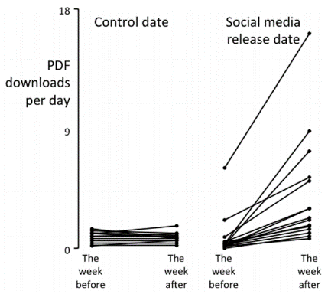
Promoting your work
Social networks
16 PLOS ONE articles were promoted on social networks on one randomly chosen date
16 PLOS ONE articles were not
 | Views* | Downloads*
Promoted | 18±18 | 4±4
Not promoted | 6±3 | 1±1
*per day
Allen et al. PLoS ONE 2013; 8: e68914.
Notes:
In addition to presenting at your work at conferences, and publishing conference proceedings will be discussed in much more detail after lunch by Alex, you can also promote your work online with social networks. This is especially helpful for open access articles as we discussed earlier.
In this study conducted by PLOS ONE, they found a significant increase in downloads after promoting articles on social networks like Twitter and Facebook compared with those not promoted. The more people who know about the work you’ve done, the more downloads you will have, and the more impact you will have in the field. So don’t sit back and passively wait for people to find your work—actively promote it!

Slide 65
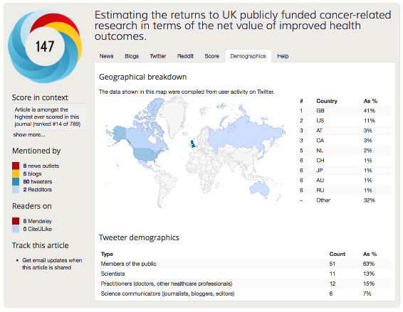
Altmetrics
Article level metrics
Impact is more than just citations!
News sites
Blogs
Social networks
Notes:
How many people here are familiar with altmetrics? Please raise your hand…
Unlike impact factor and SJR that evaluate the potential impact of journals, altmetrics is an article-level metric—attempting to measure the impact of individual articles.
Further, unlike the other metrics we discussed that only consider citation, altmetrics understand that impact is not only citations, but also discussion in the field. How often is your article being discussed? Therefore, they attempt to measure this by looking how many times your article has been discussed on social networks, blogs, and news sites. You can even see the demographic breakdown of where your article is being discussed as well, which may be useful for some of you.
So tracking altmetrics can give you more immediate information about the impact your article is having in the field in addition to the number of citations, which normally won’t be seen for maybe a year or two after publication.

Slide 66
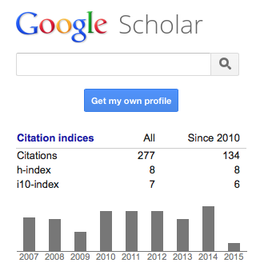
H-index
Research productivity
Number of articles that have been cited by that number of articles
H-index of 8 means that you have 8 articles cited at least 8 times
Note: may be influenced by age and does not take into account total number of citations
 | H-index | Total citations
Researcher 1 | 8 | 64
Researcher 2 | 8 | 224
Notes:
Another metric to monitor your productively is the H-index, which is based on the citations your articles have received.
Simply put, the H-index is the number of articles that have been cited by that number of articles. For example, an H-index of 8, as shown here, means this author has 8 articles that have been cited at least 8 times.
Please keep in mind that this will of course be influenced not only by impact, but also by age. The longer an article is around, the higher probability it will be to be cited more often.
Further H-index does not take into account the total number of citations, which may be a better indication of article impact. For example these two researchers here both have an H-index of 8 because they both have 8 articles that have been cited at least 8 times. For researcher 1, each was only cited 8 times (for a total of 64 citations), but for researcher 2, each one was cited many more than 8 times. As you can see, the H-index is not useful for comparative analysis, so please be careful.

Slide 67
Publication development services
Journal Key Performance Indicators (KPIs)
Indexing | Editorial | Content | Readership | Authorship
Broad indexes | International board | Up-to-date, trending | International subscription | International submissions
Field-specific | Online submission | Consistency | International downloads | Rejection rates
Under consideration | Clear protocols | Review articles | International citations | Repeat submissions
Expelled | Quality peer review | Editorials | Site visits | Consistent formatting
 | Efficient publication times | Special issues, Conferences
 | Clear aims & scope, author guidelines
Notes:
At Springer, we understand the challenges you are facing to compete with other institutions and journals worldwide. It is not easy! However, we are here to help.
We want to help you improve your publication output and impact at a country, institutional, and author level.
We can help in two ways.
First, we can provide editorial services for journals in your country.
For journals already being published, we provide individual consultation as to how that journal can improve its quality and visibility in the field. We will then tailor a plan with associated workshops and webinars to help these journals achieve their goals, which may include being better indexed in the field, increasing the number of international submissions, or increasing the number of citations that journal receives. Building on our many years of expertise in academic publishing, we can help ensure your journals increase the impact they have in the field.
However, we can also work to develop new journals to address the needs in a particular country. Establishing a broad-focused journal that publishes everything is usually not a good idea for countries like Kazakhstan. You need to build on your specific expertise. What makes you different from other regions. By capitalizing on these unique perspectives, we can help develop new journals that are adding real value to the field.
Second, we can provide training workshops for researchers in Kazakhstan. These hands-on interactive workshops cover a number of topics such as
Academic publishing, including peer review, open access, and publication ethics.
How to write high quality articles to improve the publication output of Kazakhstani institutions.
And how to prepare give effective academic presentations at international conferences, which is an essential skill you need to develop to build your reputation worldwide.
Together, the publication development services at Springer can not only help improve the overall publication output of Kazakhstan, but also the reputation of Kazakhstan worldwide.

Slide 68
Publication output of Kazakhstan
% increase 2012 | % increase 2008
4.6 | 119.4
462.2 | 670.4
71.3 | 418.4
24.3 | 155.6
34 | 88.1
27.6 | 278.8
60.7 | 1300
69.1 | 151.4
-4.2 | 81.6
SCImago

Slide 69
Publication output of Kazakhstan
Total documents
Year
SCImago

Slide 70
Publication output of Kazakhstan
Total citations
Year
SCImago

Slide 71
Publication output of Kazakhstan
Cited documents
More articles being cited, but fewer times each
Year
SCImago

