Slide 1
Publishing scientific research in books and conference proceedings
Aliaksandr Birukou
Senior Editor

Slide 2
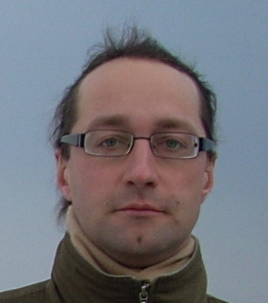
A little about me…
Александр Бирюков
Aliaksandr (Alex) Birukou Senior Editor, Computer Science PhD in Computer Science aliaksandr.birukou@springer.com With a focus on publishing Conference Proceedings Supervise the following series:

Slide 3
Outline
All about books
All about conference proceedings
Author services and new developments
Predatory publishing
download this presentation at http://tinyurl.com/springer-kz

Slide 4
Books

Slide 5
Books vs. Journals
Academic books have a different purpose from academic journals
An academic book is a complete scholarly work on a specific topic
Book chapters fulfill a similar role to review articles, with books representing a collection of manuscripts on related topics
By contrast, review articles published in journals are usually unrelated to all of the other articles in the same issue
Book includes large bibliography, recommended readings, summaries, exercises, index

Slide 6
Different types of books (i)
Monographs
Edited Volume
Textbook
Professional Texts
MRW – Major Reference Works
Handbooks (Springer Reference)
SpringerBriefs
SpringerTheses
Popular Science
...also proceedings

Slide 7
Different types of books (ii)
Monographs
Scientific presentation of a field or topic, usually with new scientific results, usually written by one or only a few authors
Textbooks
Systematically and didactically well prepared introduction to a certain (scientific) field. With examples, exercises etc. Usually written by one or few authors
Contributed Volume
A collection of chapters around a specific topic written by more authors and edited by a team. Different voices to present a field in a unified and consistent way
Notes:
Textbook levels: For advanced undergraduates, graduates and advanced professional training (e.g. specialist training)
They can also be very basic, for students starting university. Textbooks can also be very country specific; depending on the specific curri
Edited volume: compared to a journal: consistency, unified approach. Shouldn‘t be a random selection of papers which vaguely address the same topic. Sometimes, it is difficult to write a monograph on a new, very diversfied topic and you need the knowledge and expertize of different people. The work of the editor

Slide 8
Different types of books (iii)
Proceedings
Collection of lectures or papers from a scientific meeting (e.g. LNCS http://www.springer.com/series/558)
Professional Texts
Scientifically founded presentation of one field for the advanced training of persons working in this field
SpringerBriefs
Concise summaries of research and practical applications across a wide spectrum of fields. Featuring compact volumes of 50 to 125 pages
Notes:
Professional texts: is a transition from the graduate textbook, bit is mainly addressed to experienced professional, with already experience in the field. No tailoring for specific university programs/courses. It helps in the day-to-day job

Slide 9
Book Series
a collection of volumes on a particular subject
Vs standalone publications: a one-off publication on a particular subject
There is no rule on what is best! Series often have very special requirements
Talk with your publisher and ask advice – you want your book to be well placed in order to reach a wide audience
Notes:
e.g. are meant for only a specific format of publication and reject valid and interesting titles.

Slide 10
I have an idea for a book…
What type of book shall I write?
How do I get started?

Slide 11
How to prepare a book proposal
a short (3-5 pages, no special format) description of the planned book, its aims & scope, main emphasis, main target group (and how this group will benefit from the book), prerequisites needed to understand the book, and its relation to other publications in the area (if there are any).
a table of contents, incl a rough page estimate and a short summary of the main chapters (like for a conference paper).
some information about the book authors/editors
if it's an edited book, a list of contributors, and if their contributions are already confirmed or still have to be asked for.
some information about your intended writing schedule, i.e. by when you plan to make a manuscript version available for review and copy-editing.

Slide 12
How Springer helps you to publish a book
When you submit a book (proposal)
Proposals are externally reviewed
Springer provides style guides and detailed writing instructions
Springer carries out all the typesetting, formatting, etc.
Springer Editors guide you through the process
Publishing with Springer is free of charge
Complementary copies for participating authors and editors
33% discount on all other Springer books
Submit proposal to Publishing Editor
Book proposal review
Invite authors, prepare manuscript
Submit manuscript
Editing, typesetting and formatting
Print proofs: minor changes and corrections
Book published!

Slide 13
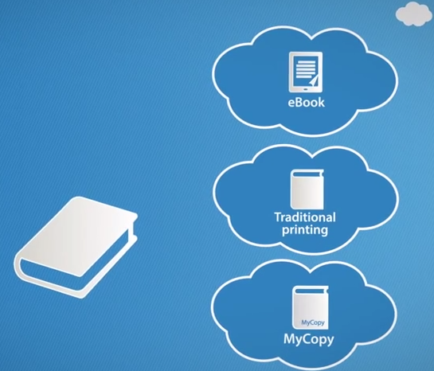
One book - Different Formats
eBook available 24/7 on SpringerLink as pdf/epub, and goes to iTunes, Google Books, Amazon
Traditional printing with PTO technology: your book will never go out of print
MyCopy: an title for only 24.99
https://www.springer.com/gp/eproducts/springer-ebooks/mycopy
https://www.springer.com/gp/authors-editors/book-authors-editors/your-book-available-in-all-feasible-formats/19876
Notes:
eBook: full book download but also chapterwise! You cn buy single chapters etc
MyCopy edition exclusively for eBook licensees

Slide 14
What makes a good manuscript?
Summarizes the current state of the field
Presents various research streams in a balanced manner
Describes the limitations of individual studies
Provides possible developments for the field in the next 5-10 years
Proposes research that will advance the field
Shows a presentation style tailored to the target audience
Includes helpful additional features like recommended reading, index, exercises, etc.
Take home message – what this book is about, what to do with all this info

Slide 15
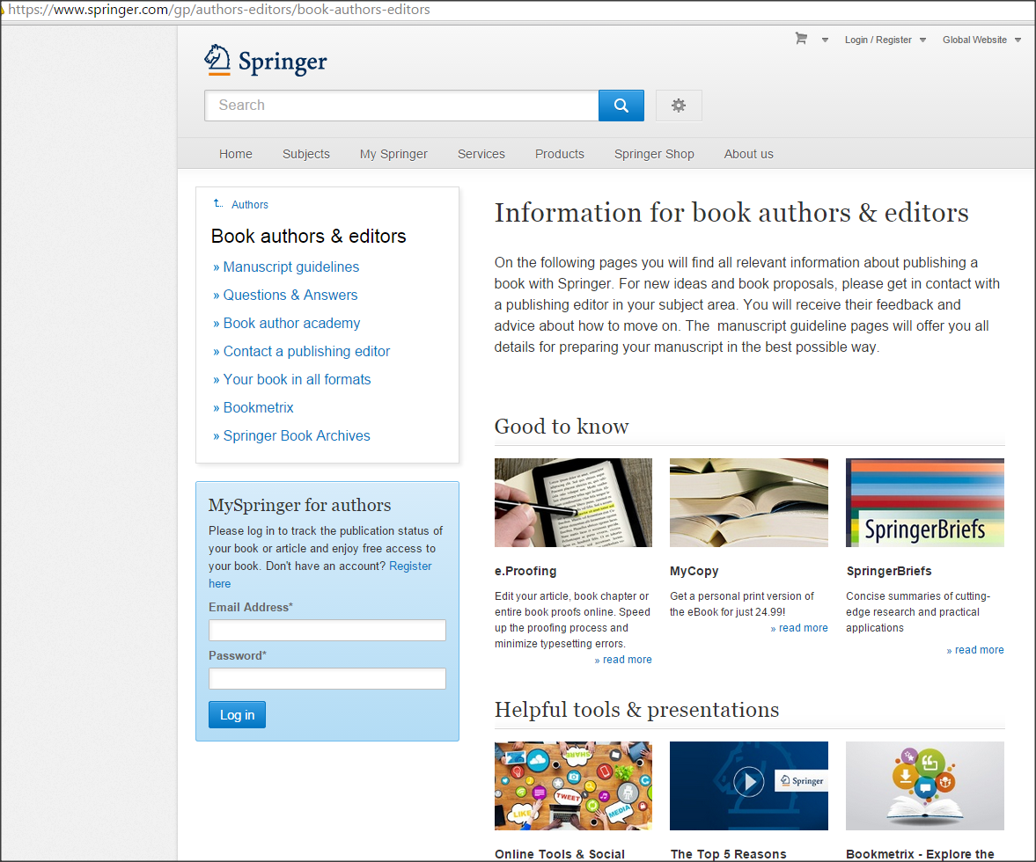
Publisher websites Tools and templates
http://www.springer.com/authors/book+authors
Notes:
There are tools that can help you with your writing. And these are supplied to you by publishers. Go to the Springer website and there are numerous guidelines to help you with putting a manuscript together. There may also be templates available for you to download and use.

Slide 16
Books from Kazakhstan
Affiliations:
L.N. Gumilyov Eurasian National University, Astana, Kazakhstan
Kazakh-British Technical University, Almaty, Kazakhstan
Kazakh Research Institute of Soil Science
Kazakh National Technical University
Al-Farabi Kazakh National University, Almaty, Kazakhstan

Slide 17
Conference proceedings ... for an author

Slide 18
Conferences vs journals
Pros
Old, well-reputed conferences in computer science have higher status than many journals
Higher visibility and greater impact – direct contact with your peers
More timely
Cons
Acceptance rate for top conferences is often 8-15%
Hard deadlines and page limits. NO MAJOR REVISION
Reviews are less detailed
Sometimes journals value more for your promotion/funding
adapted and extended from:
http://homes.cs.washington.edu/~mernst/advice/conferences-vs-journals.html

Slide 19
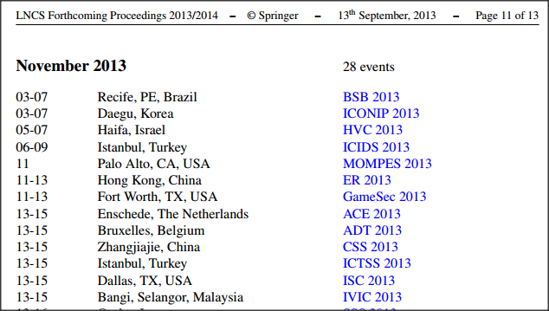
How to know about conferences?
Springer LNCS forthcoming proceedings list: http://www.springer.com/computer/lncs?SGWID=0-164-12-73665-0
CCIS forthcoming proceedings list: http://www.springer.com/series/7899
LNBIP forthcoming proceedings list: http://www.springer.com/series/7911

Slide 20
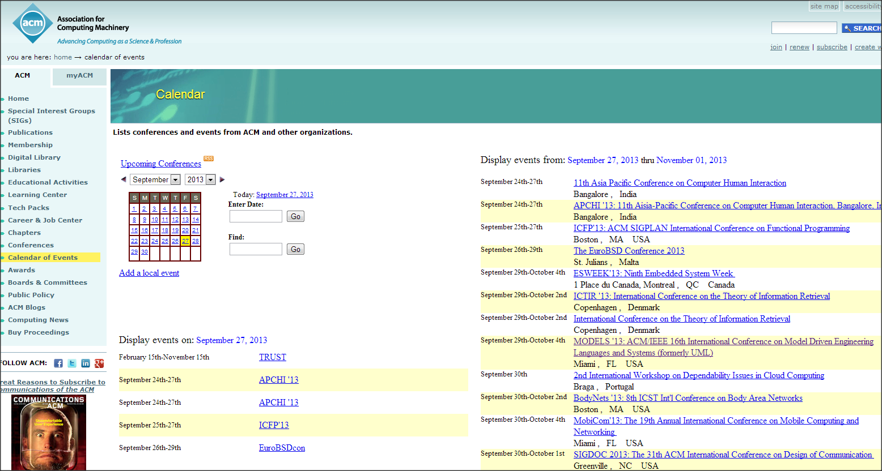
How to know about conferences?
ACM calendar: http://www.acm.org/calendar-of-events

Slide 21
Other resources
IEEE list of events: http://www.ieee.org/conferences_events/index.html
Mailing lists
DBWorld https://research.cs.wisc.edu/dbworld/
AISWorld http://www.aisnet.org/AIS_Lists/publiclists.aspx
ACM SIG-IR list http://www.sigir.org/sigirlist/
ECOOP info list http://web.satd.uma.es/mailman/listinfo/ecoop-info
...

Slide 22
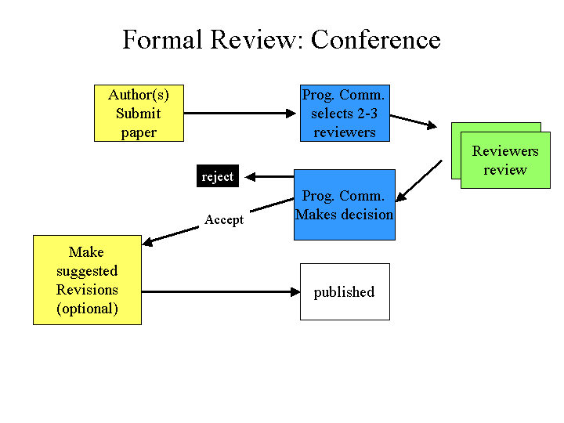
What happens with your conference submission?
diagram from: http://www.cs.ucsb.edu/~ebelding/courses/284/papers/ReviewingPapersStudentGuide.html

Slide 23
Conference proceedings ... for an editor

Slide 24
Недавние сборники трудов конференций, проходивших в России и Казахстане

Slide 25
Conference proceedings publication
We are looking for:
peer-reviewed content
of potential interest to international audience
scope: anything in computer science, but must be FOCUSED!, interdisciplinary content is also welcome
Process (see next slides)

Slide 26
1. Submission of the proposal
Key elements of the proposal
Event history (for the last 3 editions)
number of submissions
number of accepted papers
number of participants
Expected number of submissions/accepted papers/participants for current edition
Topics (Call For Papers)
Program committee
How international the event is? OR Indicators of regional importance of the event
Description of the review process and deadlines

Slide 27
2. Selecting conference proceedings series
780 titles per year
(78% of CS titles)

Slide 28
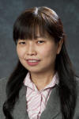
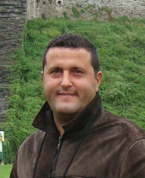
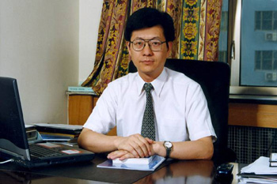
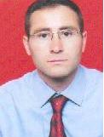
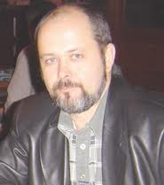
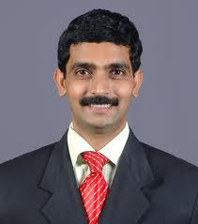
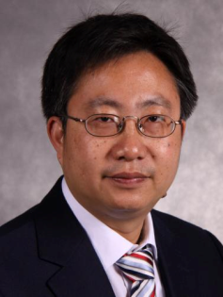
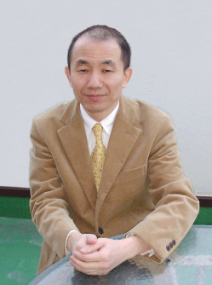
3. Evaluation example: CCIS editorial board
Simone Diniz Junqueira Barbosa, PUC-Rio, Rio de Janeiro, Brazil
Phoebe Chen, La Trobe University, Melbourne, Australia
Alfredo Cuzzocrea, ICAR-CNR and University of Calabria, Italy
Xiaoyong Du, Renmin University of China, Beijing, China
Joaquim Filipe, Polytechnic Institute of Setúbal, Portugal
Orhun Kara, TÜBİTAK BİLGEM + Middle East Technical University,Turkey
Igor Kotenko, St. Petersburg Institute for Informatics and Automation of the Russian Academy of Sciences, Russia
Krishna M. Sivalingam, Indian Institute of Technology Madras, India
Dominik Ślęzak, University of Warsaw and Infobright, Poland
Xiaokang Yang, Shanghai Jiao Tong University, China
Takashi Washio, Osaka University, Japan

Slide 29
4. Decision
Accept
Conditional accept
Reject

Slide 30
5. Prepare files and select publication options
Post/pre- proceedings
Open Access (for a fee) / Subscription-based model (FREE)
Springer provides author/editor instructions, templates
Online Conference Service (free) for managing submissions
Integration with EasyChair
Upload files electronically

Slide 31
6. Production process
Typesetting
Copyediting
Reference check
Proofs sent to the authors for confirmation
Authors get lifetime 33.33% discount for ordering books at www.springer.com

Slide 32
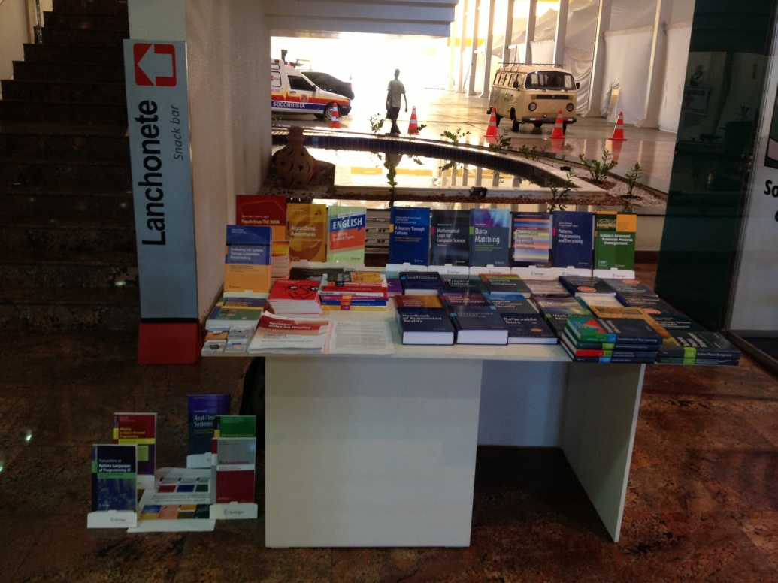
7. Dissemination
8 mln
papers
major academic institutions
companies

Slide 33
8. Indexing

Slide 34
How to start?
Send a proposal to
aliaksandr.birukou@springer.com

Slide 35
Author services

Slide 36
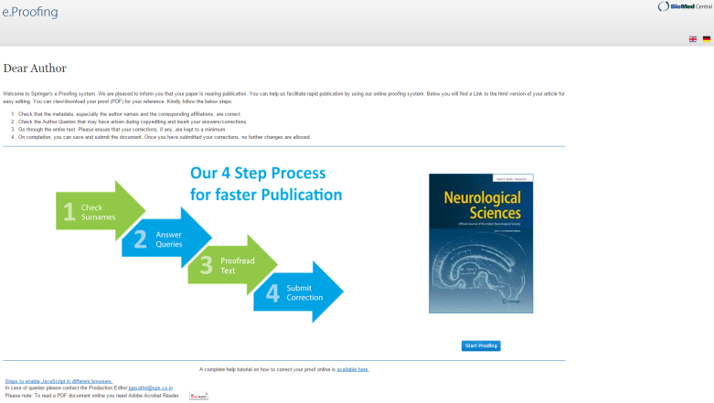
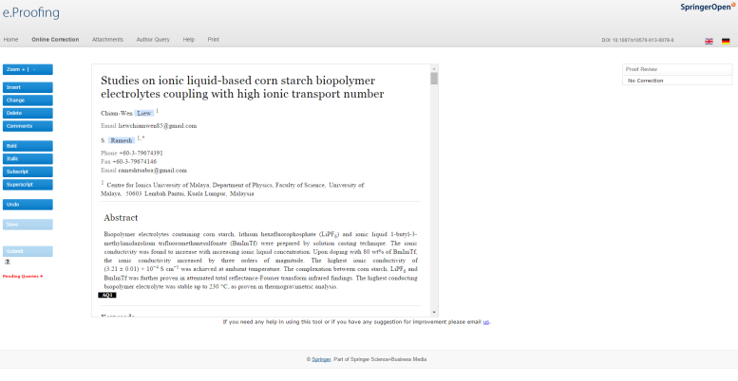
e.Proofing
Notes:
Narrative:
More than 1000 journals – including BMC (20 so far). Need fulltext XML to go through this process.
3-4 working days saved
90% acceptance rate
Users can still use old workflow if they want
Content can be directly edited – including math equation
Trend setter – SPS provide for other publishers

Slide 37
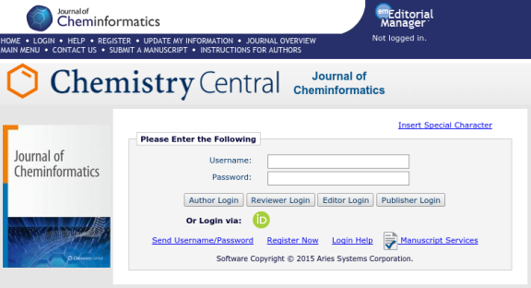
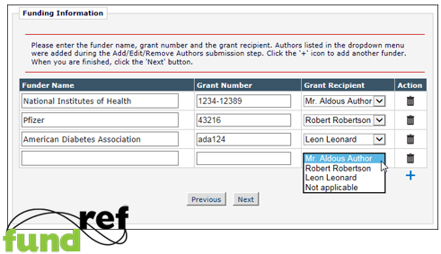
Orcid, Fundref, CrossMark
Notes:
**Click TO SHOW SCREENSHOT**
ORCID
What is it?
It stands for Open Researcher and Contributor ID
It is unique persistent digital identifier for researchers
Over 1.3M researchers have a registered ORCID
So what is the benefit?
It allows researchers to be univocally identified and ensures recognition and credit of their work from grant submission through to publication
Its is integrated into Editorial Manager as option fields in registration process and if the author already has an Orcid then EM automatically fills in their author profile
***EM screenshot is hyperlinked to a SpringerLink – you need to click on the PDF***
When the article is published the Orcid icon is visible next to the author’s name (currently only in the PDF). Clicking on the icon will take you to their profile on Orcid.org
It will also be available with the CrossMark dialog box
**Click TO SHOW SCREENSHOT**
Fundref
What is it?
FundRef is a standard taxonomy to describe the funding sources for published scholarly research
In 2014 this was added as an optional field within Editorial Manager
It will be visible on the published article within the CrossMark dialog box
***EM screenshot is hyperlinked to a SpringerLink – you need to click on the Record Tag within the CrossMark logo **
So what is the benefit?
It also gives the article additional visibility as it will be:
published as searchable meta-data
made publicly available through FundRef search interfaces
It allows funders to track the resulting publications of their research
Both Orcid and FundRef are in the early stages of adoption – but could lead to enhance author pages, memberships, FundRef – is more likely to be mandated

Slide 38
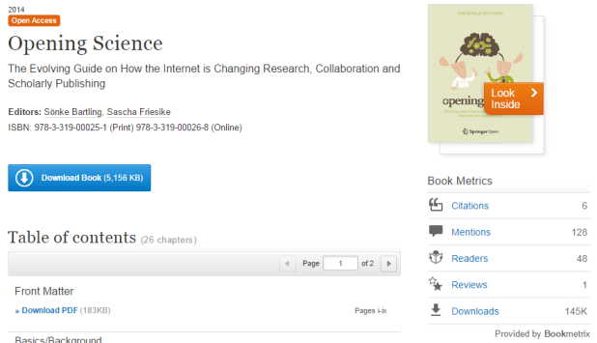
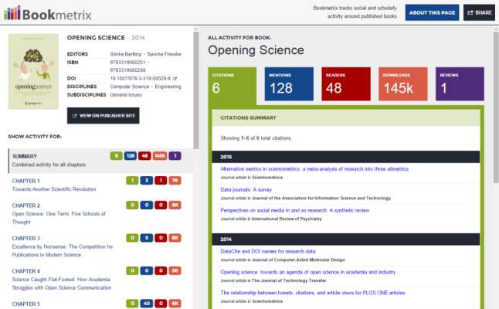
Notes:
To provide readers, authors, institutions and publishers, who are interested in the performance of a certain book, with information on citations, downloads, book reviews and altmetrics for comparison.
Publishers Interface
Search by various parameters to locate specific book or chapter quickly
DOI
ISBN
ISSN
Discipline / Subdiscipline
Year of Publication
Search results can be sorted by citations, downloads, online mentions, readers, book reviews, title and publication date
Metrics for multiple books are clearly displayed
Results can be exported for further analysis

Slide 39
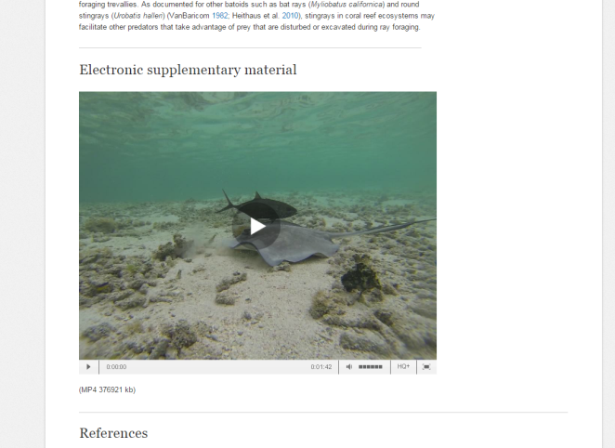
Embedded video
Notes:
***Screenshot is hyperlinked to SpringerLink***
Lots of medical videos

Slide 40
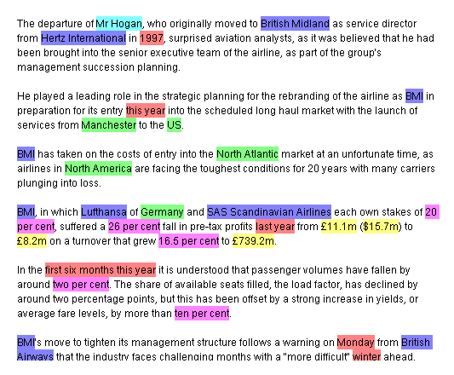
Semantics
.. contributed by Markus Kaindl (PDM)
Notes:
**Speaking points:**
Going beyond pure text,
Humans can read and understand the text – semantic mark-up allows a computer to „understand“ it

Slide 41
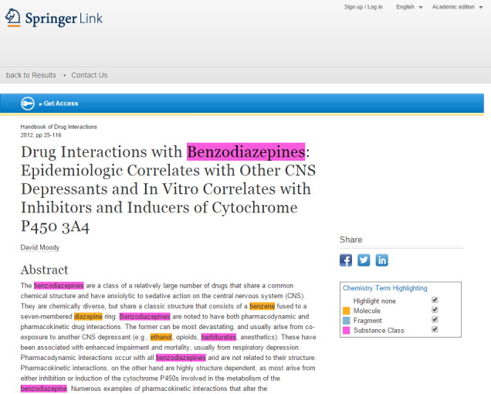
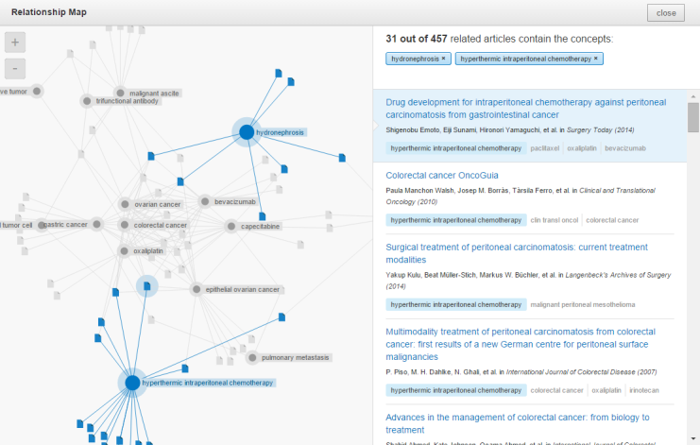
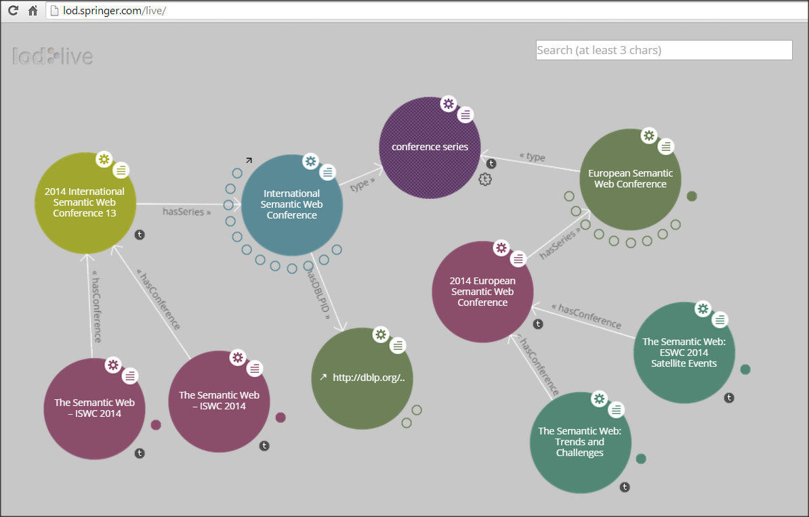
Semantics ... more concrete → InfoChem, Unsilo, LOD Conference Data
Notes:
**Speaking points:**

Slide 42
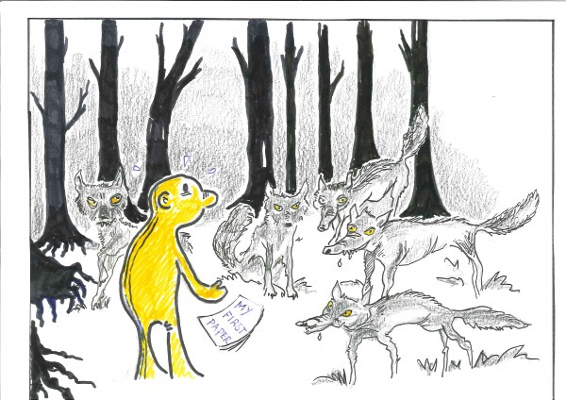
Predatory publishing
Source http://weblog.library.tudelft.nl/wp-content/uploads/2013/02/predatory-OA-publishers-600x424.jpg

Slide 43
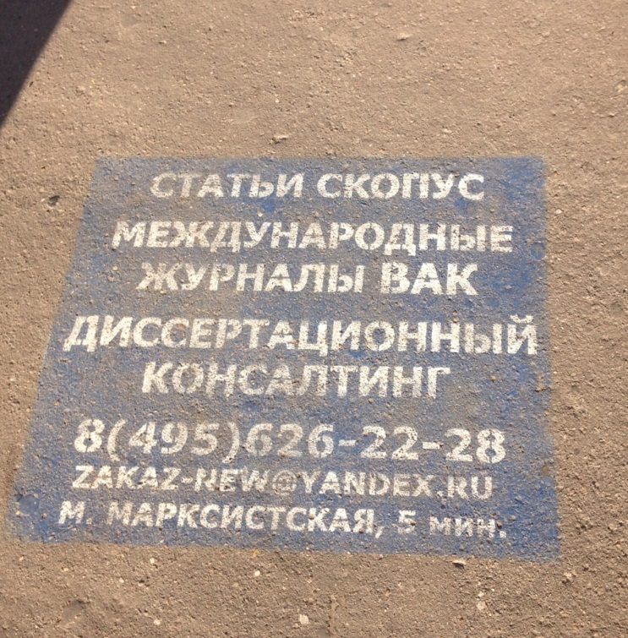
Примерная схема работы «пиратов»
Создать веб сайт журнала или конференции, насколько возможно красивый и внушающий доверие
может использоваться сходство с известным журналом / конференцией
Массовые рассылки ученым, с предложением подачи статей
Упор на индексирование, импакт фактор, быстрое рецензирование, а не на тему
Статьи «рецензируются», важный момент – оплата счета за публикацию или регистрации на конференции
Что происходит дальше?
В идеале, статья публикуется и индексируется
Конференция не обязательно проходит, или вы оказываетесь в комнате, где местный аспирант пытается организовать презентации и обсуждения статей
Статья и сайт могут пропасть через пару лет

Slide 44
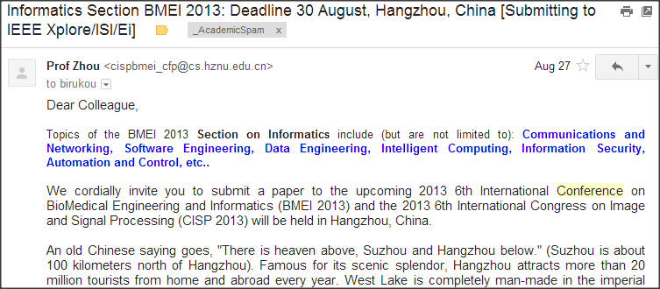
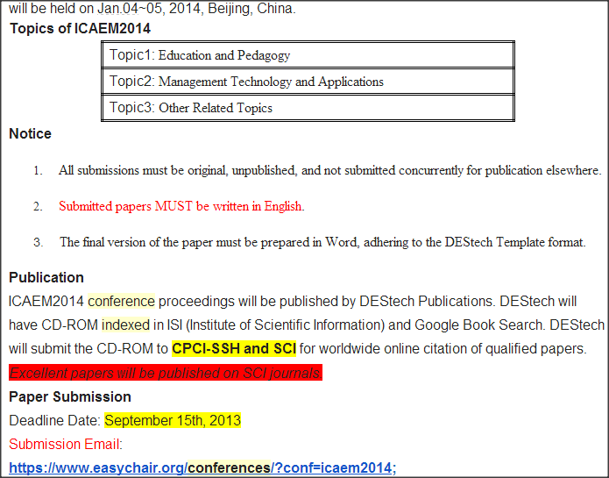
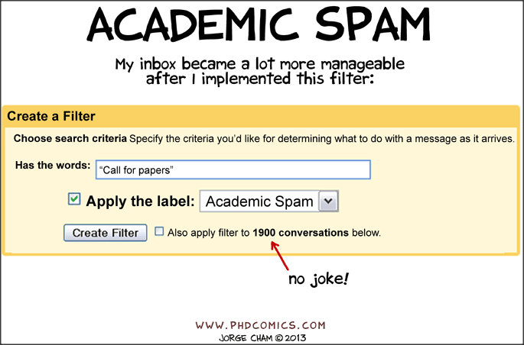
Top conferences and journals do not SPAM your mailbox...

Slide 45
Indexing vs Quality
Getting a paper in Web of Science or Scopus should not have higher priority than publishing in a reputable venue, which brings your research to scientists in your field
In Russia and Kazakhstan the number of publications in dubious journals is increasing
Избегайте следующих журналов, в частности:
World Applied Sciences Journal
Life Science Journal
Middle East Journal of Scientific Research
Actual Problems of Economic
Notes:
это псевдожурналы, готовые за плату $400–600 напечатать любую наукообразную ерунду
Most of reseach published in 2013-2014

Slide 46
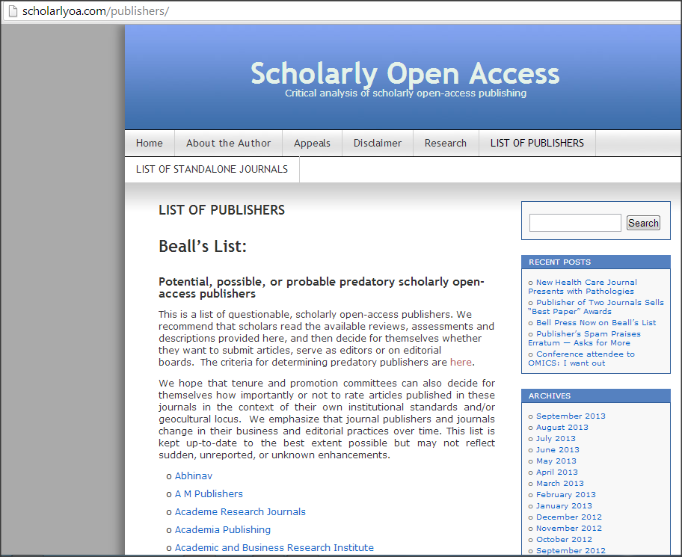
Beall’s List

Slide 47
Advice from Matt Holland
Five things librarians can do:
Add to the advice we already give potential authors a warning about predatory publishers.
Remind our users (again) that the Internet is a dangerous place. Using library provided database and resources adds a level of security to the quality of the information they find.
Be informed about current changes in publishing. Predatory publishing is a side effect of new(ish) Gold OA publishing business models.
Be vigilant about the activities of predatory publishers. It looks like they might be here to stay. Knowing they are out there is some protection for us and our users.
Share information with colleagues through professional networks if you identify suspect journals or publishers.
source_ http://www.cilip.org.uk/cilip/blog/are-we-doing-enough-warn-users-about-predatory-journals

Slide 48
Advice from Matt Holland
Five things your users should be told:
Never respond to unsolicited mail. Researchers may think they are great but it is unlikely that an email that begins Dear Sir/Madam has any insights to offer.
Check the people you are dealing with are the people you think they are. It only takes a minute to check the website or read the email address.
Use credible Open Access publishers with a track record, or established pay for view publishers with Open Access options.
Ask your Librarian to do some research on a title for you if you are unsure or if it is new.
Check the advice on how to spot a predatory journal.
- See more at: http://www.cilip.org.uk/cilip/blog/are-we-doing-enough-warn-users-about-predatory-journals#sthash.Pvyu0qLU.dpuf
source_ http://www.cilip.org.uk/cilip/blog/are-we-doing-enough-warn-users-about-predatory-journals

Slide 49
Read more at
scholarlyoa.com
http://slon.ru/economics/simulyatsiya_nauki_kak_otvet_na_upravlencheskiy_primitivizm-1148735.xhtml
http://www.time.kz/articles/nu/2014/09/11/nauchnij-podkop
http://www.editage.cn/file/science_2013_hvistendahl_publication_market.pdf
http://www.cilip.org.uk/cilip/blog/are-we-doing-enough-warn-users-about-predatory-journals

Slide 50
Final remarks

Slide 51
Resources and links
http://www.springer.com/gp/authors-editors/

Slide 52
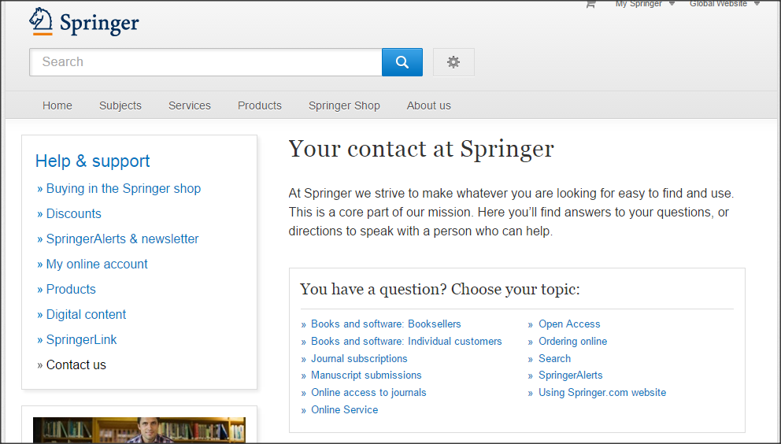
Contact us at
http://www.springer.com/gp/help/contact

Slide 53
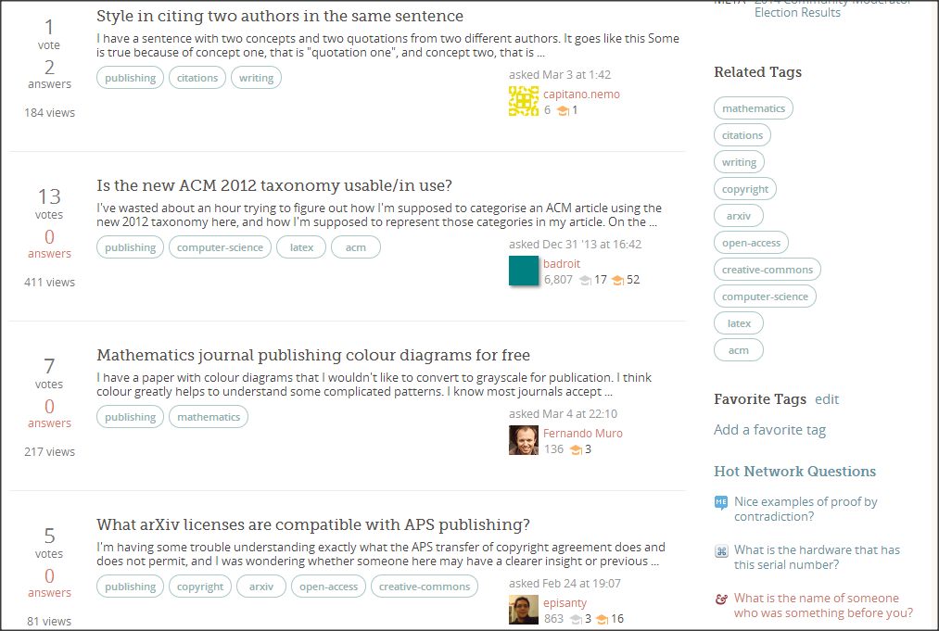
Ask your colleagues
http://academia.stackexchange.com/

Slide 54
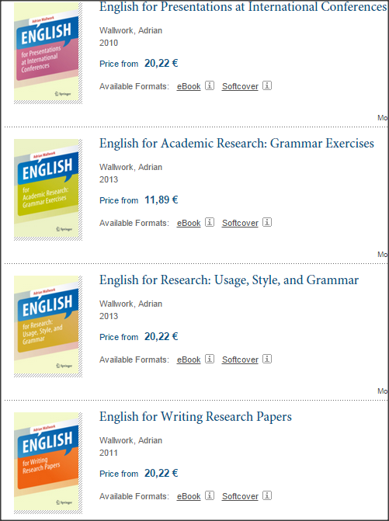
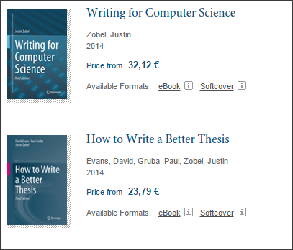
Полезные книги

Slide 55
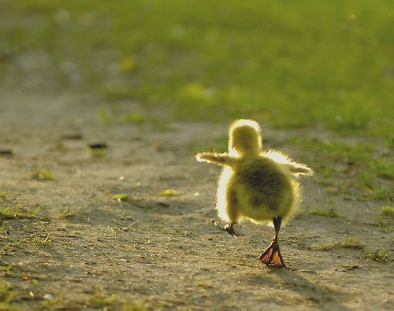
One step at a time
image from http://www.jeanscream.com

Slide 56
Any questions?
Thank you Good luck!
Download this presentation at
http://tinyurl.com/springer-kz
Notes:
Are there any questions about ANYTHING I have presented today?

Slide 57
Extra slides

Slide 58
Open Access at Springer
Book authors
Author Academy
Community
Open access
Journal authors
Society partners
Reviewers

Slide 59
Authors Have The Choice
Authors’ Rights
Hybrid Open Access
Fully Open Access
Self-archiving of an author’s accepted manuscript version at a repository
12-month embargo period applies
Open access option for the majority of Springer’s subscription-based journals
Open Choice fee of € 2,200/ US$ 3,000 per article
Open access fee depends on the individual journal/book
Creative Commons Attribution (CC BY) license for journals
Creative Commons Attribution Non-Commercial (CC BY-NC) license for books

Slide 60
Authors’ Rights at Springer
By signing the Copyright Transfer Statement (CTS) authors retain substantial rights, including self-archiving.
Springer allows self-archiving of the accepted version of an author’s manuscript at a repository, making it freely accessible for everyone.
Embargo periods apply:
Author’s own website: no embargo/immediately
Any repository: 12-month embargo
More information about authors’ rights at Springer, including our self-archiving policy for journal authors, can be found here.

Slide 61
SpringerOpen Books
Open access option for all types of books across all disciplines
High-quality publishing standards apply, including peer-review, copyediting...
Published under Creative Commons Attribution Non-Commercial (CC BY-NC) license
Authors/Editors retain the copyright to their work
Publishing charge is calculated individually, based on the number of pages per book
SpringerOpen books are covered by our Open Access Membership Program: Authors/Editors at member institutions are entitled to a 15% loyalty discount.
springeropen.com/books

Slide 62
Example of a WASJ paper

Slide 63
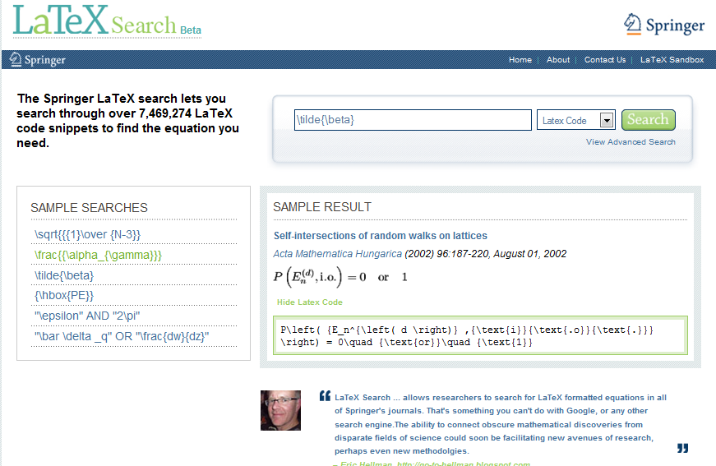
www.LaTeXSearch.com

Slide 64
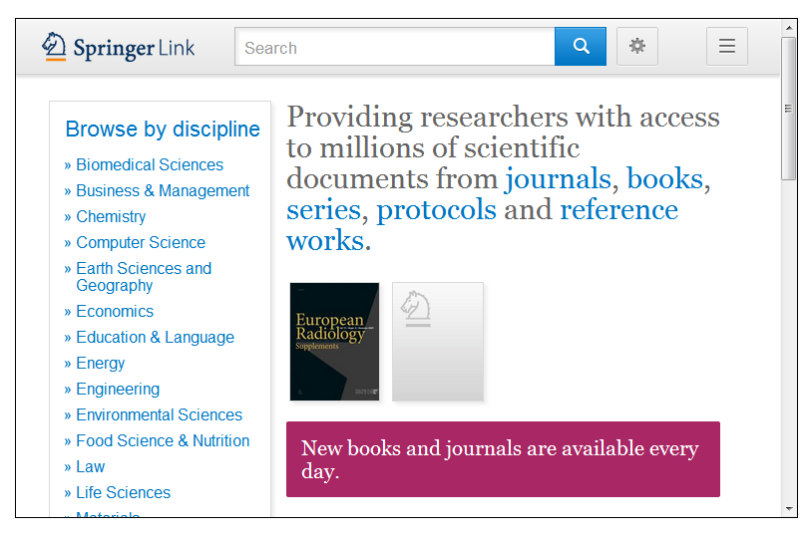
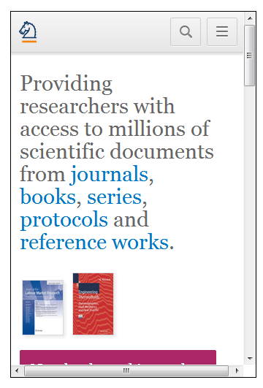
New SpringerLink - mobile optimized
Web responsive design allows for optimal viewing on all devices
Desktop
Tablet
Phone - verticle
Phone - horizontal

Slide 65
Compare...
IF: 0.25
IF: 0.3
IF: 3.62
IF: 2.88
IF: 1.6
IF: 1.4
IF: 1.6

Slide 66
More about Open Access funding
Armenia, Ukraine
your country can be eligible for free publication http://www.springeropen.com/authors/oawaiverfund
institution can be a member http://www.springeropen.com/inst/
http://www.springeropen.com/funding
International Hereditary Cancer Center Szczecin, Poland
International Institute of Molecular and Cell Biology Warsaw, Poland
Institute of Oncology, Vilnius University Vilnius, Lithuania
Vilnius University Faculty of Medicine Vilnius, Lithuania
Notes:
First two options do not cover Open Choice!
Ukraine, Armenia are there
2d option - Poland

Slide 67
Research evaluation

Slide 68
Impact Factor
There is much debate over Impact Factors in the scientific community, particularly with regard to the fairness of the system. However, there is no doubt that an Impact Factor is seen as a benchmark of quality of the journal in many academic communities.
Formula for the 2014 Impact Factor:
Number of citations in 2014 to articles published in 2012 + 2013
------------------------------------------------------------------------------------
Total citable articles published in 2012 + 2013
Example:
120 citations in 2014 (to articles published 2012 or 2013)
------------------------------------------------------------------------------ = 1.5
80 articles published in 2012 and 2013

Slide 69
Impact Factor - Points to consider
Discipline specific – does the subject lend itself to citations?
How big is the field? What is the number of scientists who research and write in a particular area?
Other factors influence the formula e.g. number of issues published per year
How “hot” the topic is

Slide 70
Cites per Doc index (same as IF, but from Scopus)
Source: http://www.scimagojr.com/journalsearch.php?q=13843&tip=sid&clean=0
Notes:
The SJR indicator measures the scientific influence of the average article in a journal, it expresses how central to the global scientific discussion an average article of the journal is. Cites per Doc. (2y) measures the scientific impact of an average article published in the journal, it is computed using the same formula that journal impact factor ™ (Thomson Reuters).

Slide 71
H-Index
основан на количестве публикаций и количестве цитирования этих публикаций
максимальное n, такое что есть n публикаций которые имеют n или более цитат

Slide 72
How to measure quality – beyond Impact Factor
Use Google Scholar, Microsoft Academic Search and tools based on them
E.g., Publish or Perish tool (GS), Rexplore (MAS)
http://www.harzing.com/pop.htm
For journals/conferences:
Acceptance rate
Quality and duration of peer review
Other factors to consider
Number of downloads
Speed of publication
Global distribution and long-term archiving

Slide 73
Lambert – personal experience (2009-now)

